Slide 1
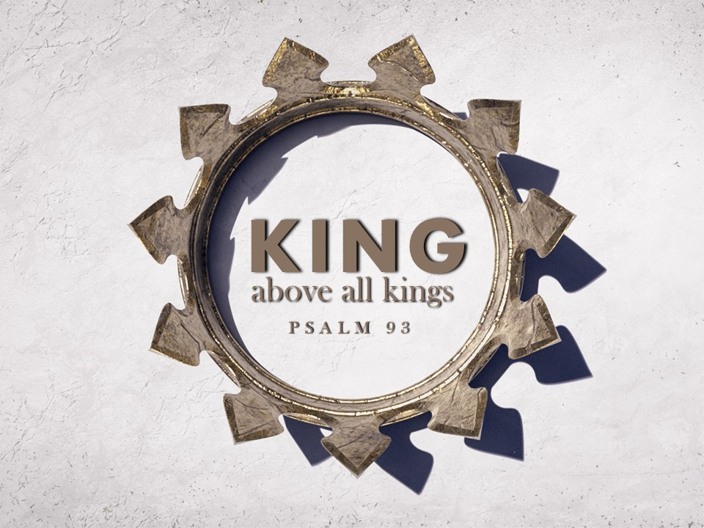

Slide 2
Outline
The Eternal King (1-2)
The Mighty King (3-4)
The Holy King (5)

Slide 3
The Eternal King (1-2)
God is adorned in strength and majesty.
Such as man cannot attain (Job 40:9-10)
God has firmly established the world.
Spoke it into existence and established its boundaries.
He’s The Eternal King!
- Ps. 90:2; 20:7-8

Slide 4
The Mighty King (3-4)
God is mightier than the mightiest of waters.
Ps. 89:8-9
“Mighty” foes are as nothing to God
Ex. 15:4-10
Rev. 20:7-10

Slide 5
The Holy King (5)
God’s words can be trusted (Is. 40:8)
Holiness is proper for God’s house
Was true in the physical temple (2 Kgs. 21:4-5 → Ezk. 8-11)
Is true in the spiritual temple! (1 Pet. 2:5; 2 Cor. 6:16)

Slide 6
Jesus is our eternal, mighty, and holy King!
Heb. 1:8-9; Rev. 19:11-16

