Slide 1
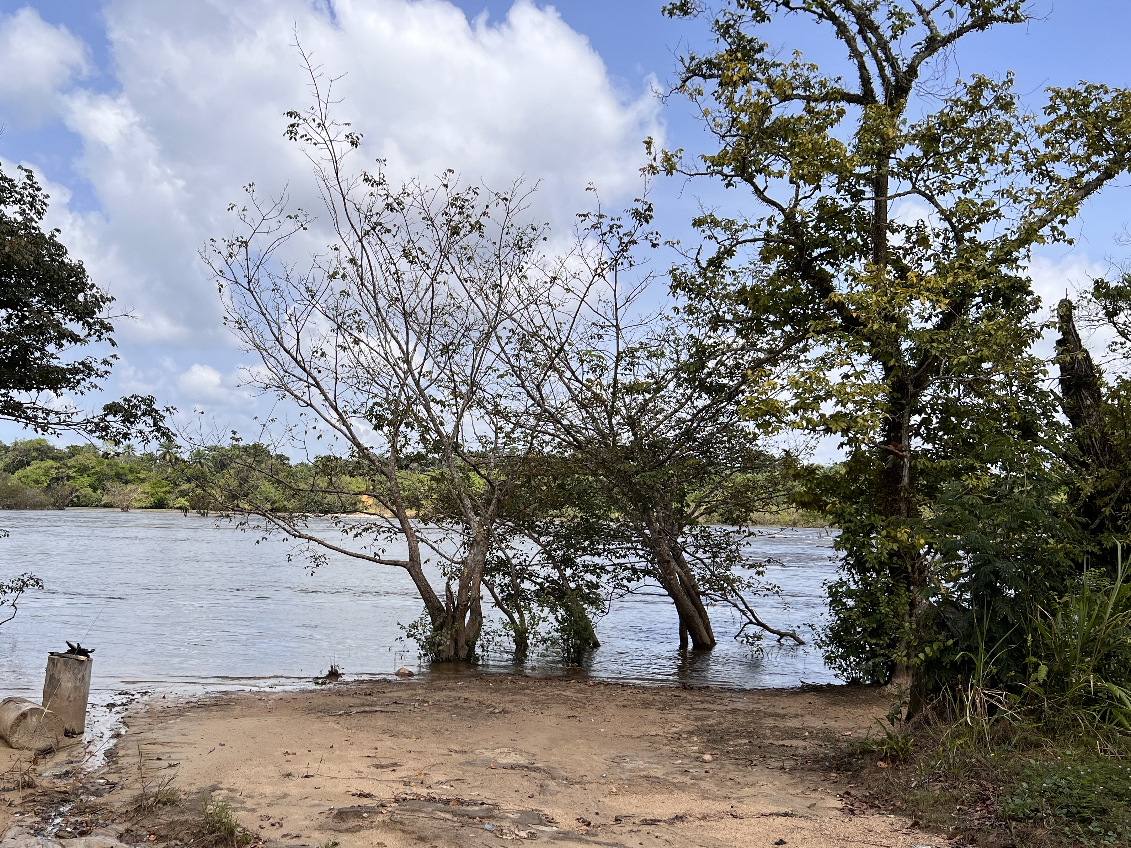
Down By The River
Reflections
On Our
Need For
Evangelism

Slide 2
“Go therefore and make disciples of all the nations, baptizing them in the name of the Father and the Son and the Holy Spirit, teaching them to observe all that I commanded you; and lo, I am with you always, even to the end of the age.” (Matthew 28:19-20)

Slide 3
“Seeing the people, He felt compassion for them, because they were distressed and dispirited like sheep without a shepherd. Then He said to His disciples, ‘The harvest is plentiful, but the workers are few. Therefore beseech the Lord of the harvest to send out workers into His harvest.’” (Matthew 9:36-38)

Slide 4
Evangelism Reminds Us Who We Are.
This is true when people reject the gospel.
Matthew 5:11-12
Romans 5:3-4
This is true when people accept the gospel.
Acts 17:30; 2:38; 3:19-21
Romans 6:3-4
1 Thessalonians 3:11-13; 4:3-5

Slide 5
Evangelism Helps us grow.
We grow when we persevere in the face of rejection. (Matthew 5:44-45)
We grow when we help new Christians grow.
We will need to help them bear burdens and face challenges. (1 Thessalonians 5:14)
We will need to help them find answers to their questions. (1 Thessalonians 4:13; 1 Corinthians 7:1; 8:1: 11:1: 15:12)
We will need to call some back when they stray. (Acts 8:22-23; Galatians 6:1)

Slide 6
Evangelism Keeps Us Focused on Heaven.
It should go without saying that preaching salvation in Jesus Christ will cause us to think about heaven. (cf. 2 Peter 3:13)
Paul spoke about heaven most in his letters to new converts.
1 Thessalonians 1:10
1 Thessalonians 2:19
1 Thessalonians 3:12-13
1 Thessalonians 4:13-18
1 Thessalonians 5:1-11

