Slide 1
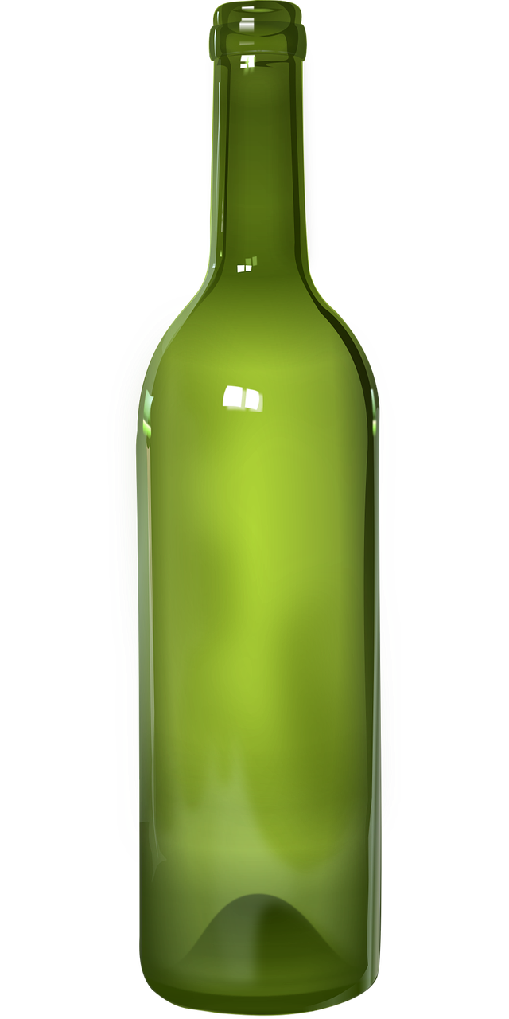
The Deeds of the Flesh
Drunkenness & Carousing Galatians 5:19-21

Slide 2
The Deeds of the Flesh:
“Now the deeds of the flesh are evident, which are: immorality, impurity, sensuality, idolatry, sorcery, enmities, strife, jealousy, outbursts of anger, disputes, dissensions, factions, envying, drunkenness, carousing, and things like these, of which I forewarn you, just as I have forewarned you, that those who practice such things will not inherit the kingdom of God.” (Galatians 5:19-21)

Slide 3
Drunkenness & Carousing:
“Let us behave properly as in the day, not in carousing and drunkenness, not in sexual promiscuity and sensuality, not in strife and jealousy.” (Romans 13:13)
“For the time already past is sufficient for you to have carried out the desire of the Gentiles, having pursued a course of sensuality, lusts, drunkenness, carousing, drinking parties and abominable idolatries.” (1 Peter 4:3)

Slide 4
A Note About Alcohol:
Crooks & Stein say in their text book Psychology, Science, Behavior, and Life “Alcohol …is an extremely potent drug that effects behavior in a highly variable manor… People under the influence of Alcohol may engage in behaviors they normally keep in check, probably because alcohol suppresses the inhibitory mechanisms of the cerebral cortex.”
“After one or two drinks there is a suppression of the neurons in the prefrontal cortex.” - Andrew Huberman – Associate Professor of Neurobiology at Stanford.

Slide 5
A Note About Alcohol:
“...alcohol intake is negatively associated with global brain volume measures, regional gray matter volumes, and white matter microstructure. Here, we show that the negative associations between alcohol intake and brain macrostructure and microstructure are already apparent in individuals consuming an average of only one to two daily alcohol units, and become stronger as alcohol intake increases.” (Associations between alcohol consumption and gray and white matter volumes in the UK Biobank:)

Slide 6
What About “Social Drinking?”
Wine in the Bible:
There must be sugar and yeast present.
The temperature should be between 50 and 75 degrees Fahrenheit.
Too much water or too much sugar will impede or prevent the process.
The quality of gluten (yeast) must be well regulated. Too much or too little will impede or prevent the process.
It should be noted that when things go awry in this process you get vinegar not wine.

Slide 7
What About “Social Drinking?”
Wine in the Bible:
There were at least four ways of preventing fermentation:
Boiling - Horace (born 65 BC) said “ there is no wine sweeter to drink than Lesbian; that it is like nectar and more resembled ambrosia than wine; that it was perfectly harmless and would not produce intoxication.”
Filtration - Plutarch (born 60 AD) “Wine is rendered old or feeble in strength when it is frequently filtered.
Subsidence
Fumigation

Slide 8
What About “Social Drinking?”
Wine in the Bible:
Even fermented wine was heavily watered.
Homer in the Odyssey refers to 20 to 1.
Pliny in Natural History makes reference to 8 to 1 mixture.
Aristophanes says that 3 to 2 was a strong mixture. (that would be about 5% alcohol)
The Talmud refers to a mixture of 3 to 1 (At 3 to 1 you would have 2% alcohol or less).
Plutarch states “we call the mixture wine, although the larger of the component parts is water.”

Slide 9
What Does The Bible Say?
“For the time already past is sufficient for you to have carried out the desire of the Gentiles, having pursued a course of sensuality, lusts, drunkenness, carousing, drinking parties and abominable idolatries.” (1 Peter 4:3)
“Who has woe? Who has sorrow? Who has contentions? Who has complaining? Who has wounds without cause? Who has redness of eyes? Those who linger long over wine, Those who go to taste mixed wine. Do not look on the wine when it is red, When it sparkles in the cup, When it goes down smoothly; At the last it bites like a serpent And stings like a viper. Your eyes will see strange things And your mind will utter perverse things. And you will be like one who lies down in the middle of the sea, Or like one who lies down on the top of a mast. "They struck me, but I did not become ill; They beat me, but I did not know it. When shall I awake? I will seek another drink.” (Proverbs 23:29-35)

Slide 10
Still Not Convinced?
Paul and “So-called liberty”
“But take care that this liberty of yours does not somehow become a stumbling block to the weak.” (1 Corinthians 8:9)
“For if someone sees you, who have knowledge, dining in an idol's temple, will not his conscience, if he is weak, be strengthened to eat things sacrificed to idols?” (1 Corinthians 8:10)
“Therefore, if food causes my brother to stumble, I will never eat meat again, so that I will not cause my brother to stumble.” (1 Corinthians 8:13)

Slide 11
Still Not Convinced?
A Couple of Questions:
If you drink, has alcohol ever made you a better person?
If you drink, what are your motivations?
“For the flesh sets its desire against the Spirit, and the Spirit against the flesh; for these are in opposition to one another, so that you may not do the things that you please.” (Galatians 5:17)
“And do not get drunk with wine, for that is dissipation, but be filled with the Spirit,” (Ephesians 5:18)

Slide 12
Alcohol is a spirit, but it is not spiritual!

