Slide 1
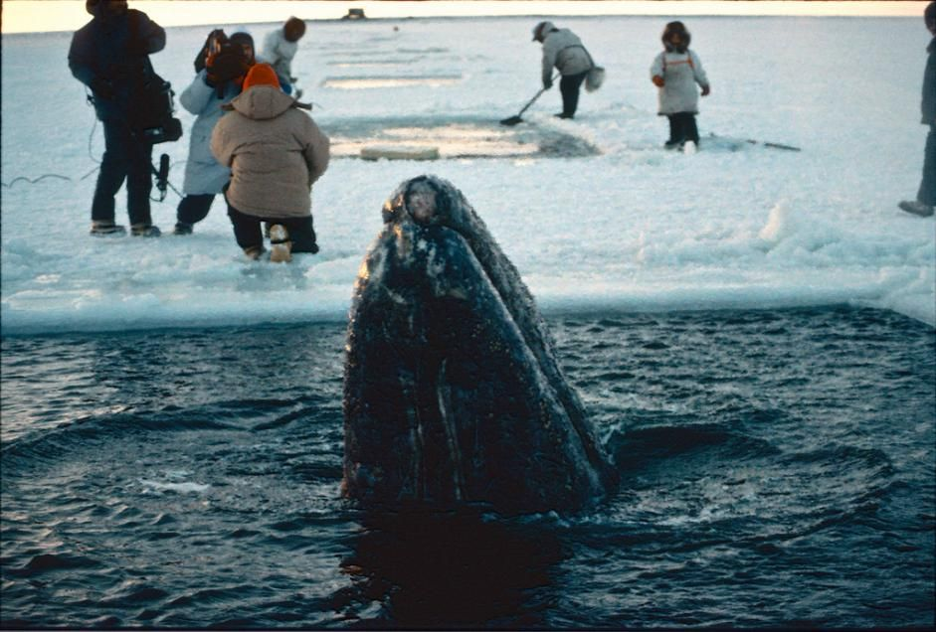
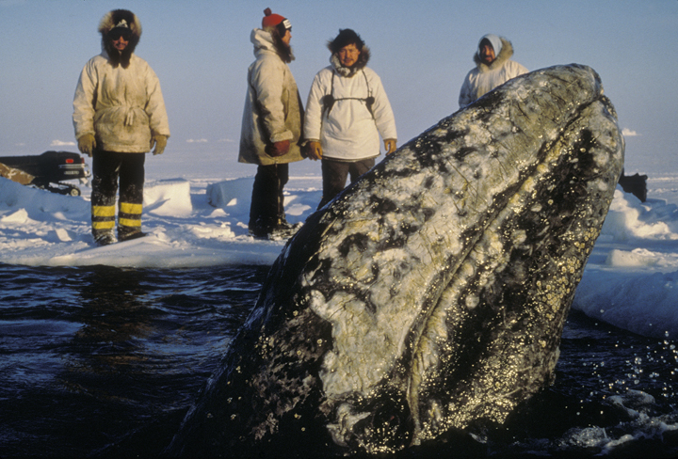

Slide 2
The Call to Encouragement
1 Thessalonians 5:11
Therefore encourage one another and build one another up, just as you are doing.
Hebrews 3:13
But exhort one another every day, as long as it is called “today,” that none of you may be hardened by the deceitfulness of sin.

Slide 3
Encouragement helps us stay focused on, and grow closer to God.

Slide 4
Hebrews 10:19-25
¹⁹ Therefore, brothers, since we have confidence to enter the holy places by the blood of Jesus, ²⁰ by the new and living way that he opened for us through the curtain, that is, through his flesh, ²¹ and since we have a great priest over the house of God, ²² let us draw near with a true heart in full assurance of faith, with our hearts sprinkled clean from an evil conscience and our bodies washed with pure water. ²³ Let us hold fast the confession of our hope without wavering, for he who promised is faithful. ²⁴ And let us consider how to stir up one another to love and good works, ²⁵ not neglecting to meet together, as is the habit of some, but encouraging one another, and all the more as you see the Day drawing near.

Slide 5
Each of Us Need to be…
Encouraged in Faith (v. 22)
2 Pet. 1:5-8; Acts 14:21-22; 15:36, 41; Rom. 1:11-12
Encouraged in Hope (v. 23)
The bridegroom is coming for His bride!
We can be confident in this!
He who promised is faithful (v. 23b; cf. Ps. 36:5)
Encouraged to Love and Good Works (v. 24)
Col. 3:14; 1 Cor. 13:13

Slide 6
Hebrews 10:24-25
²⁴ And let us consider how to stir up one another to love and good works, ²⁵ not neglecting to meet together, as is the habit of some, but encouraging one another, and all the more as you see the Day drawing near.
We can’t encourage each other if we’re not in the presence of one another.

Slide 7
Hebrews 10:24-25
²⁴ And let us consider how to stir up one another to love and good works, ²⁵ not neglecting to meet together, as is the habit of some, but encouraging one another, and all the more as you see the Day drawing near.
Consider –
a conscious, deliberate effort to encourage.

Slide 8
Encouraging Tips
Never forget the power of your presence.
Consider the unique challenges of each demographic.
Try to encourage one family/individual per day.
Don’t overthink it!

