Slide 1
Keys to Success
Nehemiah Rebuilding Walls of Jerusalem
(ruler)

Slide 2
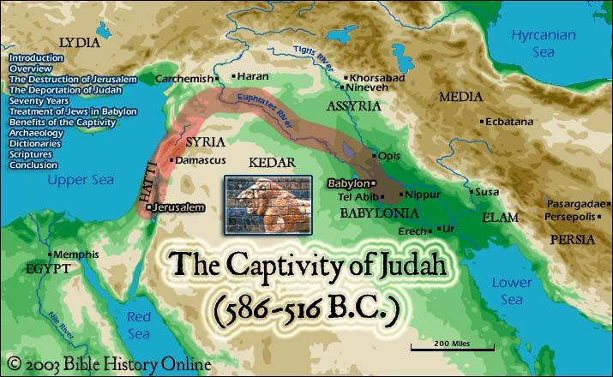
Nehemiah Rebuilding Walls of Jerusalem
Setting
In Shushan, capitol city of Babylon (captivity)
Artaxerxes (king)
Nehemiah – king’s cupbearer
Received word from those left behind in Jerusalem
Great affliction
Wall of Jerusalem broken down
Gates burned
Nehemiah wept and fasted
(ruler)

Slide 3
Nehemiah Rebuilding Walls of Jerusalem
Neh. 1:4-5, 11
4 As soon as I heard these words I sat down and wept and mourned for days, and I continued fasting and praying before the God of heaven.
5 And I said, “O LORD God of heaven, the great and awesome God who keeps covenant and steadfast love with those who love him and keep his commandments,
11 O Lord, let your ear be attentive to the prayer of your servant, and to the prayer of your servants who delight to fear your name, and give success to your servant today, and grant him mercy in the sight of this man.”
Now I was cupbearer to the king.
(ruler)

Slide 4
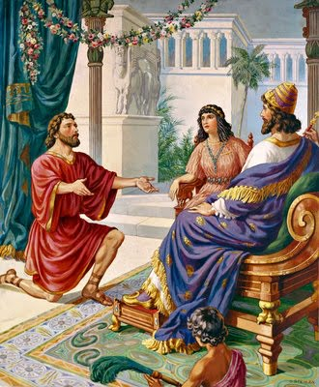
Nehemiah Rebuilding Walls of Jerusalem
Neh. 2:1-3
1 In the month of Nisan, in the twentieth year of King Artaxerxes, when wine was before him, I took up the wine and gave it to the king. Now I had not been sad in his presence.
2 And the king said to me, “Why is your face sad, seeing you are not sick? This is nothing but sadness of the heart.” Then I was very much afraid.
3 I said to the king, “Let the king live forever! Why should not my face be sad, when the city, the place of my fathers’ graves, lies in ruins, and its gates have been destroyed by fire?”
(ruler)

Slide 5
Nehemiah Rebuilding Walls of Jerusalem
Passion
We must have passion about peoples’ souls!
If not, we won’t sacrifice to win them.
(ruler)

Slide 6
Nehemiah Rebuilding Walls of Jerusalem
Get someone to sponsor you
Help you with materials, knowledge, strategy, etc.
Mentor for personal work, teaching a class, preaching, song leading…
(ruler)

Slide 7
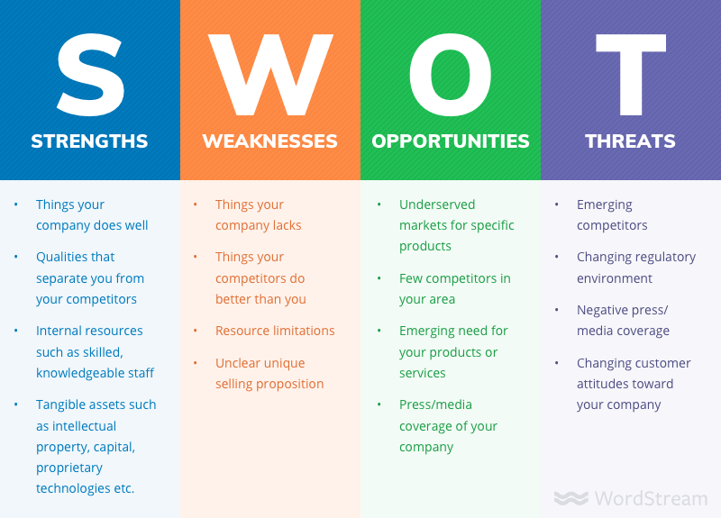
Nehemiah Rebuilding Walls of Jerusalem
Assess current situation
See what you’re up against
SWOT analysis
Strengths
Weaknesses
Opportunities
Threats
(ruler)

Slide 8
Nehemiah Rebuilding Walls of Jerusalem
Neh. 2:11-13
11 So I went to Jerusalem and was there three days.
12 Then I arose in the night, I and a few men with me. And I told no one what my God had put into my heart to do for Jerusalem. There was no animal with me but the one on which I rode.
13 I went out by night by the Valley Gate to the Dragon Spring and to the Dung Gate, and I inspected the walls of Jerusalem that were broken down and its gates that had been destroyed by fire.
(ruler)

Slide 9
Nehemiah Rebuilding Walls of Jerusalem
Neh. 2:14-16
14 Then I went on to the Fountain Gate and to the King’s Pool, but there was no room for the animal that was under me to pass.
15 Then I went up in the night by the valley and inspected the wall, and I turned back and entered by the Valley Gate, and so returned.
16 And the officials did not know where I had gone or what I was doing, and I had not yet told the Jews, the priests, the nobles, the officials, and the rest who were to do the work.
(ruler)

Slide 10
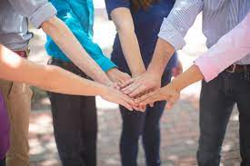
Nehemiah Rebuilding Walls of Jerusalem
Get others excited about it
Start with people that are supportive
(ruler)

Slide 11
Nehemiah Rebuilding Walls of Jerusalem
Neh. 2:17-18
17 Then I said to them, “You see the trouble we are in, how Jerusalem lies in ruins with its gates burned. Come, let us build the wall of Jerusalem, that we may no longer suffer derision.”
18 And I told them of the hand of my God that had been upon me for good, and also of the words that the king had spoken to me. And they said, “Let us rise up and build.” So they strengthened their hands for the good work.
(ruler)

Slide 12
Nehemiah Rebuilding Walls of Jerusalem
Neh. 2:17-20
19 But when Sanballat the Horonite and Tobiah the Ammonite servant and Geshem the Arab heard of it, they jeered at us and despised us and said, “What is this thing that you are doing? Are you rebelling against the king?”
20 Then I replied to them, “The God of heaven will make us prosper, and we his servants will arise and build, but you have no portion or right or claim in Jerusalem.”
(ruler)

Slide 13
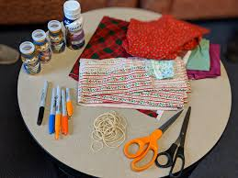
Nehemiah Rebuilding Walls of Jerusalem
Get the necessary materials
Invitation fliers for gospel meeting
Lesson plans
Reference books
Personal work material
(ruler)

Slide 14
Nehemiah Rebuilding Walls of Jerusalem
Neh. 2:8; 3:1
8 And a letter unto Asaph the keeper of the king's forest, that he may give me timber to make beams for the gates of the palace which appertained to the house, and for the wall of the city, and for the house that I shall enter into. And the king granted me, according to the good hand of my God upon me.
1 Then Eliashib the high priest rose up with his brethren the priests, and they builded the sheep gate; they sanctified it, and set up the doors of it; even unto the tower of Meah they sanctified it, unto the tower of Hananeel.
(ruler)

Slide 15
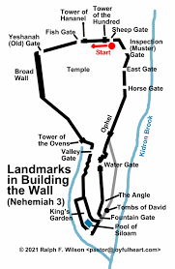
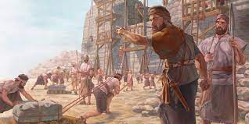
Nehemiah Rebuilding Walls of Jerusalem
Divide large tasks into small tasks
Make a list of what needs to be done
Tasks, sub-tasks
Determine what you can do and what you need help doing
(ruler)

Slide 16
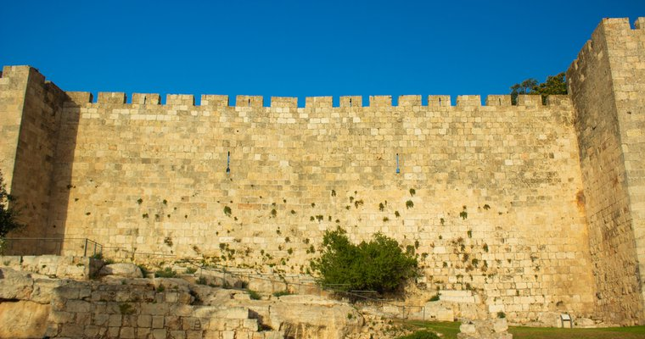
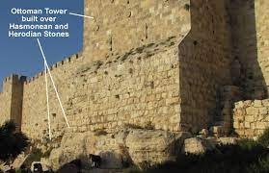
Nehemiah Rebuilding Walls of Jerusalem
Divide large tasks into small tasks
Size of the wall
2.5 miles long
39 ft avg height
8 ft avg thickness
(ruler)

Slide 17
Nehemiah Rebuilding Walls of Jerusalem
Neh. 3:1-3
1 Then Eliashib the high priest rose up with his brethren the priests, and they builded the sheep gate; they sanctified it, and set up the doors of it; even unto the tower of Meah they sanctified it, unto the tower of Hananeel.
2 And next unto him builded the men of Jericho. And next to them builded Zaccur the son of Imri.
3 But the fish gate did the sons of Hassenaah build, who also laid the beams thereof, and set up the doors thereof, the locks thereof, and the bars thereof.
(ruler)

Slide 18
Nehemiah Rebuilding Walls of Jerusalem
When things are at their worst and you don’t think you can go on, you need to be carried
Is. 46:4
4 And even to your old age I am he; and even to hoar hairs will I carry you: I have made, and I will bear; even I will carry, and will deliver you.
(ruler)

Slide 19
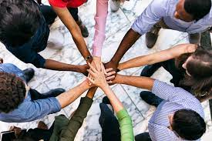
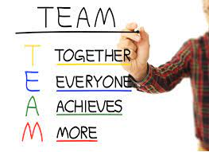
Nehemiah Rebuilding Walls of Jerusalem
Work together as teams
Experienced and non-experienced
Old and young
Husband and wife
(ruler)

Slide 20
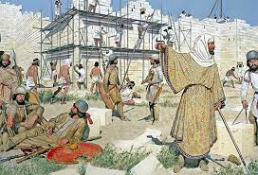
Nehemiah Rebuilding Walls of Jerusalem
Neh. 3:4
4 And next unto them repaired Meremoth the son of Urijah, the son of Koz. And next unto them repaired Meshullam the son of Berechiah, the son of Meshezabeel. And next unto them repaired Zadok the son of Baana.
(ruler)

Slide 21
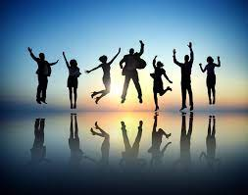
Nehemiah Rebuilding Walls of Jerusalem
Celebrate small victories
First stone laid
First section completed
First person invited to gospel meeting
(ruler)

Slide 22
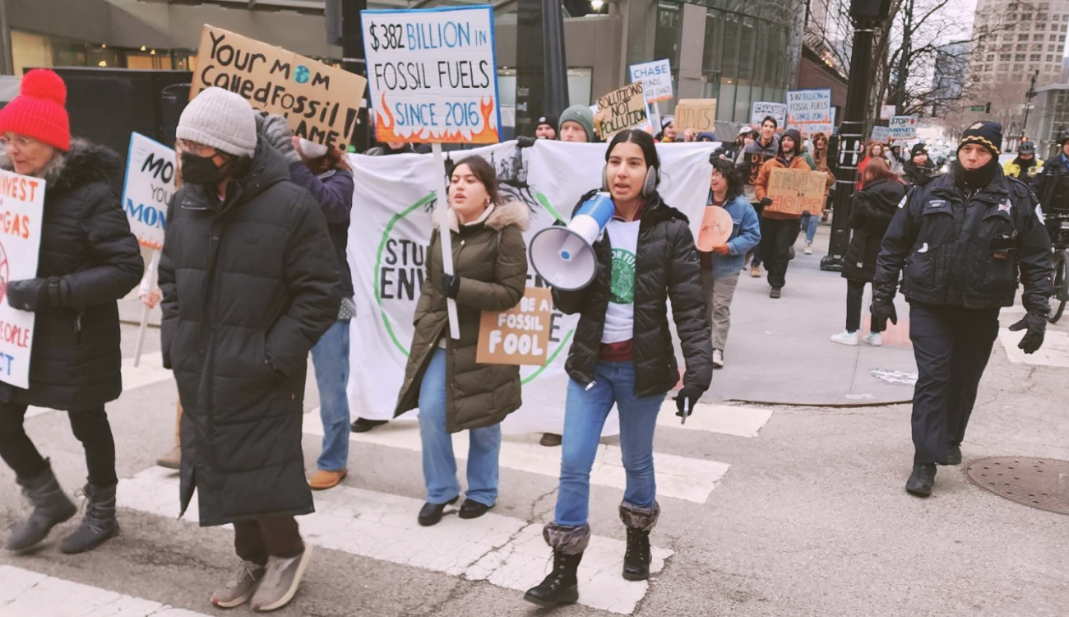
Nehemiah Rebuilding Walls of Jerusalem
Expect opposition and plan how to overcome it
Seek first to understand reason for opposition
Have a kind and loving heart in your response
(ruler)

Slide 23
Nehemiah Rebuilding Walls of Jerusalem
Neh. 2:10; 4:1-3
10 When Sanballat the Horonite, and Tobiah the servant, the Ammonite, heard of it, it grieved them exceedingly that there was come a man to seek the welfare of the children of Israel.
1 Now when Sanballat heard that we were building the wall, he was angry and greatly enraged, and he jeered at the Jews.
2 And he said in the presence of his brothers and of the army of Samaria, “What are these feeble Jews doing? Will they restore it for themselves? Will they sacrifice? Will they finish up in a day? Will they revive the stones out of the heaps of rubbish, and burned ones at that?”
3 Tobiah the Ammonite was beside him, and he said, “Yes, what they are building—if a fox goes up on it he will break down their stone wall!”
(ruler)

Slide 24
Nehemiah Rebuilding Walls of Jerusalem
Pray to God again
Neh. 4:4-5
4 Hear, O our God, for we are despised. Turn back their taunt on their own heads and give them up to be plundered in a land where they are captives.
5 Do not cover their guilt, and let not their sin be blotted out from your sight, for they have provoked you to anger in the presence of the builders.
(ruler)

Slide 25
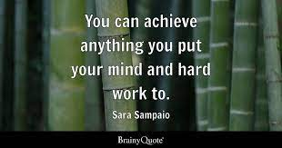
Nehemiah Rebuilding Walls of Jerusalem
Put your mind to it
Neh. 4:6
6 So we built the wall. And all the wall was joined together to half its height, for the people had a mind to work.
Phil. 4:13
13 I can do all things through him who strengthens me.
(ruler)

Slide 26
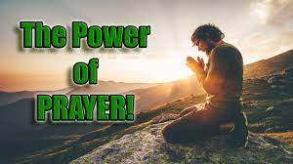
Nehemiah Rebuilding Walls of Jerusalem
Pray again
Neh. 4:9
9 And we prayed to our God and set a guard as a protection against them day and night.
(ruler)

Slide 27
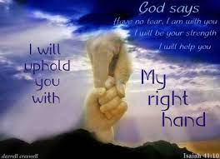
Nehemiah Rebuilding Walls of Jerusalem
Remember God is on your side
Neh. 2:20; 4:9
20 Then I replied to them, “The God of heaven will make us prosper, and we his servants will arise and build…
9 And we prayed to our God and set a guard as a protection against them day and night.
(ruler)

Slide 28
Nehemiah Rebuilding Walls of Jerusalem
Be vigilant day and night
Neh. 4:9, 14, 21
9 And we prayed to our God and set a guard as a protection against them day and night.
14 And I looked and arose and said to the nobles and to the officials and to the rest of the people, “Do not be afraid of them. Remember the Lord, who is great and awesome, and fight for your brothers, your sons, your daughters, your wives, and your homes.”
21 So we labored at the work, and half of them held the spears from the break of dawn until the stars came out.
(ruler)

Slide 29
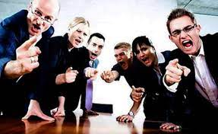
Nehemiah Rebuilding Walls of Jerusalem
Do not listen to your own people who try to discourage you and conspire against you
Neh. 3:5
5 And next to them the Tekoites repaired, but their nobles would not stoop to serve their Lord.
(ruler)

Slide 30
Nehemiah Rebuilding Walls of Jerusalem
Celebrate achievement of the goal
Neh. 6:15
15 So the wall was finished on the twenty-fifth day of the month Elul, in fifty-two days.
(ruler)

