Slide 1
9-3-23
Cultivate Hearts in regard to
* Reverence (Troy)
* Evangelism (Sid)
* Soundness (Brent)

Slide 2
Hebrews 12:28
Therefore let us be grateful for receiving a kingdom that cannot be shaken, and thus let us offer to God acceptable worship, with reverence and awe.

Slide 3
Can I be more Reverent than I am?
What would that look like?
What will I need to do to make that happen?

Slide 4
Can I be more Reverent than I am?
What would that look like?
What will I need to do to make that happen?

Slide 5
I am of the mindset that I could always improve, so yes, I could be more reverent.
Of course! I think that would always be a yes. We can always be more reverent.
Absolutely!
At times I feel all of us are distracted and not fully tuned in during worship! As hard as we try to prevent it, other thoughts enter our minds and cause us to wander, drift and lose focus! I believe this is something that affects us all, perhaps some more than others.

Slide 6
Can I be more Reverent than I am?
What would that look like?
What will I need to do to make that happen?

Slide 7
I can show up on time for worship and be in my pew ready to worship. Reading a few scriptures to get mentally focused.

Slide 8
One area that this is seen is in posture and body language. If I have deep respect for my God and know that I'm in his presence then how can I slouch, or not give it my all? I also think this can be seen in my desire to worship and my desire to be ready to worship. I think it pretty much boils down to my understanding of who God is. Only when I truly understand who He is can I then understand who I truly am. And that should lead to an automatic act to throw myself at his feet and worship with complete reverence. If it doesn't lead to that then I believe that I'm lacking in my understanding of who He is.

Slide 9
Also being ready to worship is a display of this. I understand the importance of the US President and if were attending a dinner with him you better believe I'd be early because I understand his importance. If my understanding of that kind of meeting would lead to a certain kind of behavior how much more should I be affected by my understanding of God.

Slide 10
When I think of reverence, focus is the first word that comes to mind. As a family we have a routine to set the tone before coming to Sunday worship- we set out clothes the night before, Bible lessons are done early, we don’t turn on the tv Sunday morning, we listen to hymns getting ready and/or on the way to church and we have a set time we want to leave for church so we have time to talk to visitors beforehand. We’ve taught the kids this is the most important part of our week and I think placing that emphasis helps give the respect (reverence) that God deserves.

Slide 11
I don’t want to give the impression that a family with busy toddlers coming in a little disheveled or someone that works the night shift on Saturday can’t have the same reverence as a routine oriented family. I can complete the checklist and my mind be all out of sorts overthinking something, intrusive thoughts and have a hard time being reverent during worship. In those moments, words from music that I know from memory helps clear my mind and push away the distractions.

Slide 12
When we come together to worship our God, it is very important to purge the worldly thoughts from our minds in order to focus more on God and be more intentional with our worship.

Slide 13
I think depending on what season in life people are in depends on their ability to be truly reverent. Young parents needing to step out to feed their baby. Parents with children middle age trying to teach their children how to be respectful in worship and discipline for that. Adults with young adult children or high school aged who can focus more now that their children are grown up.
Adults who have learned over the years how to be more reverent or what being reverent looks like for them. For some it’s truly honing in on the speaker and tuning everything out. Others can close their eyes. Some may need to take notes to help with their reverence.

Slide 14
Can I be more Reverent than I am?
What would that look like?
What will I need to do to make that happen?

Slide 15
Develop a better understanding of who God is and who I am. Through prayer and study.

Slide 16
Arriving on time. This means I may need to get up earlier, listen to praise songs before worship, have contribution ready. Have heart and mind focused.

Slide 17
A few minutes before worship starts, we try to get our minds in the right frame of mind to focus solely on our Lord. Making sure anything that can be a distraction is attended to i.e. cell phones silenced, etc. American culture is a culture of distraction. I think it is a major obstacle that we have to overcome in this country.

Slide 18
Emphasize it. Be purposeful and intentional. Prepare.

Slide 19
Exodus 3:5
Then he said, “Do not come near; take your sandals off your feet, for the place on which you are standing is holy ground.”

Slide 20
Last Sunday morning was the last time I will ever attempt to assemble with the saints. I say “attempt” because I did not succeed in assembling. It was a debacle. About midway through the debacle, I resolved that I wasn't going to put myself or my wife through such misery anymore. Then, it got worse. I’m simply not capable of going anywhere, even to worship.

Slide 21
This is bitter. If there is anything on earth that I love, it is the assembly. All of the things that we trivialize with the label “the five acts of worship” fill me with profound joy. I also love the opportunity to connect with my brethren before and after worship. Even when I am visiting an unfamiliar congregation, you might as well give me a key, because when the time comes to lock up, I'll still be around!

Slide 22
These times have become even more precious to me since my diagnosis. I knew that the time would come when I couldn't make it out anymore, so I strove to make my remaining opportunities to assemble as meaningful as I could. I worked to sink myself into each hymn and prayer. After services, I shunned small talk in an effort to speak to the hearts of my Christian family. Even when I wasn't talking to somebody, I would look around the auditorium and pray for each member I saw.

Slide 24
Cultivate Hearts in regard to
* Reverence (Troy)
* Evangelism (Sid)
* Soundness (Brent)

Slide 25
2023 Evangelistic Efforts

Slide 26
“And all those who had believed were together and had all things in common;” (Acts 2:44)
2022 Benevolence: $2650.00
2023 Year To Date Benevolence: $6790.94
Benevolence

Slide 27
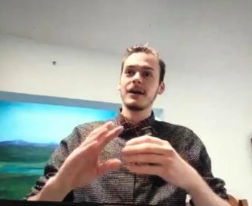
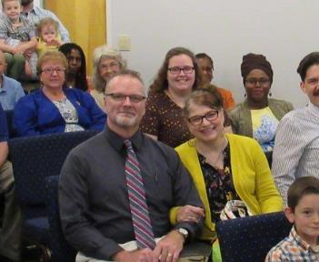
Fellowship in the Gospel
Logan Samons in
Mt. Sterling, KY
Simon Harris in
Albany, NY
Focus On Evangelism

Slide 28
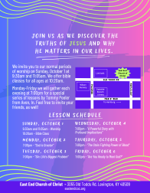
2023 Gospel Meeting:
This flyer is going to 8000 homes on the east end of Lexington.
Focus On Evangelism

Slide 29

2023 Gospel Meeting:
We are doing extensive Facebook advertising.
Focus On Evangelism

Slide 30

2023 Gospel Meeting:
We Need You!
Focus On Evangelism

Slide 31
2023 Gospel Meeting:
There are roughly 100 households here.
If each household invites 5 people, we will need to order more invitations.
The relationships you have with friends, family, neighbors and coworkers matter!
“Let your light shine before men in such a way that they may see your good works, and glorify your Father who is in heaven.” (Matthew 5:16)
Focus On Evangelism

Slide 32
2023 Gospel Meeting Format
This will be different.
Upon entering the building everyone will get a visitor’s card.
We will have an introduction and prayer and get straight to the message of the gospel.
We will take up the cards / questions.
There will be a brief recess after the lesson and then a short question and answer session.
Focus On Evangelism

Slide 33
Cultivate Hearts in regard to
* Reverence (Troy)
* Evangelism (Sid)
* Soundness (Brent)

Slide 34
* Your elders need help!
* Need qualified men:
then have them step up!

