Slide 3
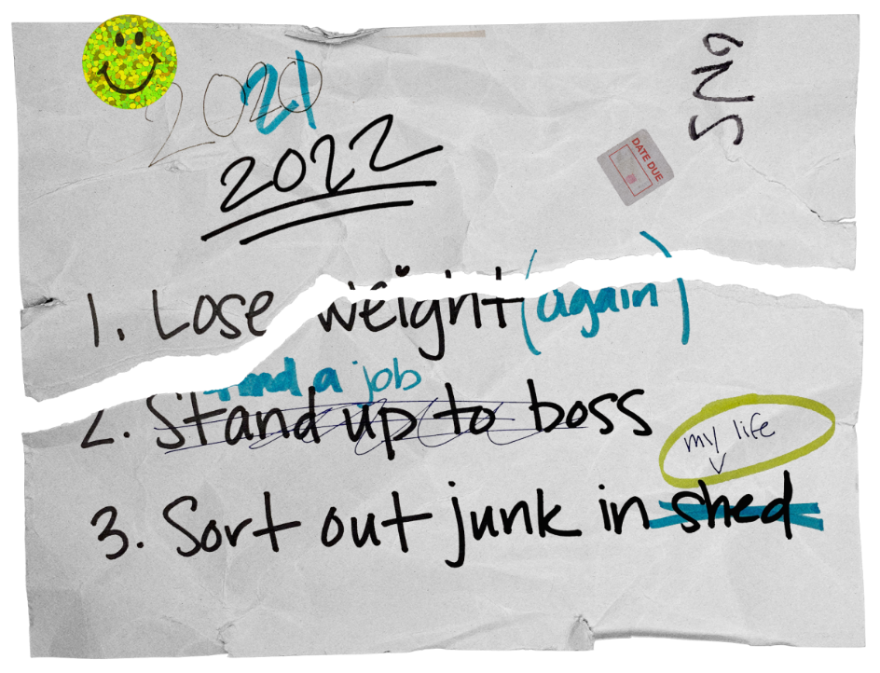

Slide 4
Finishing Our Commitment
Luke 14:25-27
Count The Cost
Know the price
Plan to Succeed

Slide 5
Parable 1: building a tower
Luke 14:28-30
Know what you need
Be prepared for the work
Build with Christ as your cornerstone

Slide 6
Parable 2: Going into battle
Luke 14:31-33
King vs. King
Prepare to count the cost of victory
With Christ on your side, YOU will win.

Slide 7
Parable 3: salt
Luke 14:34-35
Are you the salt you need to be?
Salt preserves, purifies, cleans
Be the salt that helps cleanse the world.

