Slide 1
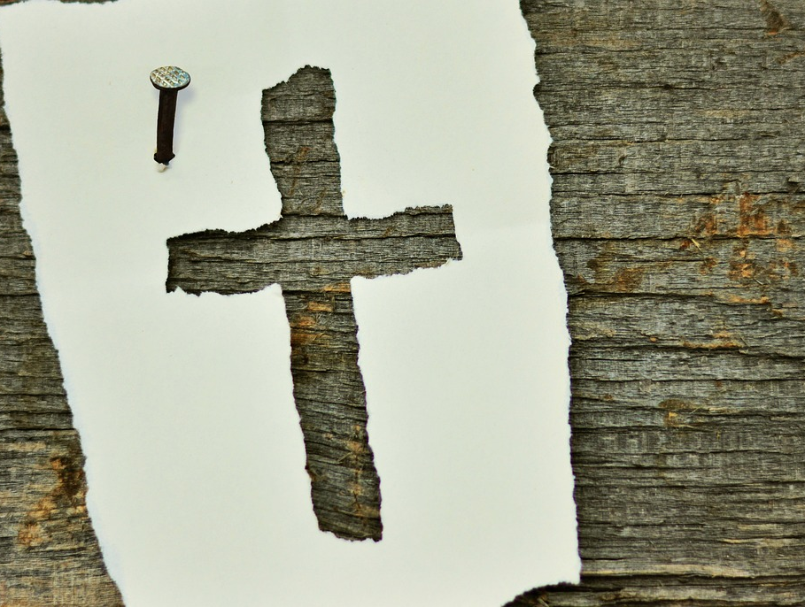
What does the cross mean?
Romans 3:21-26

Slide 2
The cross means redemption!
We are “...justified as a gift by His grace through the redemption which is in Christ Jesus...” (Romans 3:24)
God gave freely! However, the gift was not free for God.
1 Peter 1:18-19
Romans 5:6-8
Colossians 1:13-14 illustrates what God did for us in Christ Jesus.
God has a lot invested in you!

Slide 3
The cross means propitiation!
Jesus Christ was “displayed publicly as a propitiation in His blood through faith. (Romans 3:25)
An example: Genesis 32:19-20 (Brenton, LXX)
In the cross propitiation is turned upside down.
Hebrews 2:17
1 John 2:1-2
God wants to forgive you!

Slide 4
The cross means justification.
This was to demonstrate His righteousness, because in the forbearance of God He passed over the sins previously committed; for the demonstration, I say, of His righteousness at the present time, so that He would be just and the justifier of the one who has faith in Jesus. (Romans 3:25-26)
God wants to make us right
not catch us wrong!

