Slide 2
WHAT IS BIBLICAL AUTHORITY?
June 4,2023

Slide 3
WRONG QUESTIONS
Not how, but WHO…
GOD is the Source of authority.
Romans 13.1
Deuteronomy 10.12-17 (Psalm 97.1, 9)
WHAT IS BIBLICAL AUTHORITY?

Slide 4
GOD as Creator
Authority is linked to creation.
Psalm 24.1-2; 89.11-12; 95.5;
Exodus 19.5
WHAT IS BIBLICAL AUTHORITY?

Slide 5
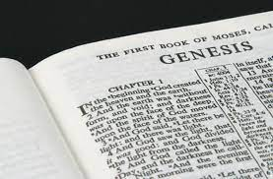
Genesis
Not merely the beginning…
Genesis = GOD’s authority.
Genesis 1.31
"In the unfolding of this grand program of God, Genesis introduces the reader to the nature of God as the sovereign Lord over the universe who will move heaven and earth to establish His will. He seeks to bless mankind, but does not tolerate disobedience and unbelief.” (Ross)
WHAT IS BIBLICAL AUTHORITY?

Slide 6
Genesis
Not merely the beginning…
Genesis = GOD’s authority.
Genesis 1.31
Langdon Gilkey in Marker of Heaven and Earth: “The idea that God is the Creator of all things is the indispensable foundation on which other beliefs of the Christian faith are based. It affirms what the Christian believes about the status of God in the whole realm of reality.”
WHAT IS BIBLICAL AUTHORITY?

Slide 7
GOD is CREATOR
we are creatures…
Dependence upon GOD
Psalm 100.3
Obedience to GOD
Romans 9.20-22
WHAT IS BIBLICAL AUTHORITY?

