Slide 2
JESUS & AUTHORITY
June 9,2023

Slide 3
JESUS’ ATTITUDE TOWARD AUTHORITY

Slide 4
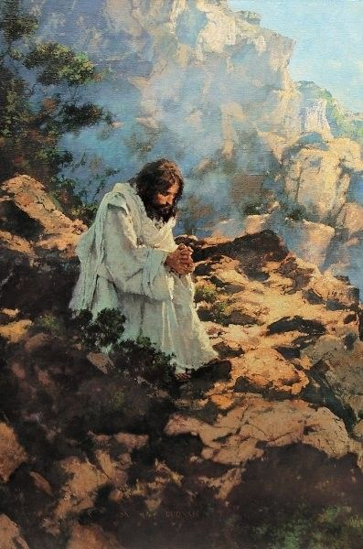
RESPONSE TO TEMPTATION
Matthew 4.1-11
(Deuteronomy 8.3)
JESUS’ ATTITUDE TOWARD AUTHORITY

Slide 5
RESPONSE TO TEMPTATION
Matthew 4.1-11
(Deuteronomy 8.3)
JESUS’ ATTITUDE: GOD’S WILL
Hebrews 4.15-16
John 4.34; 5.30; 8.29
JESUS’ ATTITUDE TOWARD AUTHORITY

Slide 6
^{LUKE 6.40} A pupil is not above his teacher; but everyone, after he has been fully trained, will be like his teacher.
“LIKE JESUS”

Slide 7
^{1 CORINTHIANS 11.1} Be imitators of me, just as I also am of Christ.
“LIKE JESUS”

Slide 8
^{1 PETER 2.21} For you have been called for this purpose, since Christ also suffered for you, leaving you an example for you to follow in His steps,
“LIKE JESUS”

Slide 9
To be like Jesus, to be like Jesus!
My desire - to be like Him!
All thro' life's journey from earth to glory; My desire - to be like Him.
To be like Jesus, to be like Jesus!
How I long to be like Him!
So meek and lowly, so pure and holy; How I long to be like Him.
“LIKE JESUS”

Slide 10
JESUS & AUTHORITY

Slide 11
…what the Father TOLD Him.
John 12.48-50
John 7.16; 8.26, 28.40; 14.24; 15.15
JESUS & AUTHORITY

Slide 12
…what the Father TOLD Him.
John 12.48-50
John 7.16; 8.26, 28.40; 14.24; 15.15
…what the Father SHOWED Him.
John 5.19-20
“The Father is not passive…”
JESUS & AUTHORITY

Slide 13
…what the Father TOLD Him.
John 12.48-50
John 7.16; 8.26, 28.40; 14.24; 15.15
…what the Father SHOWED Him.
John 5.19-20
“The Father is not passive…”
…with what must be NECESSARILY CONCLUDED.
Mark 12.18-27
JESUS & AUTHORITY

