Slide 1
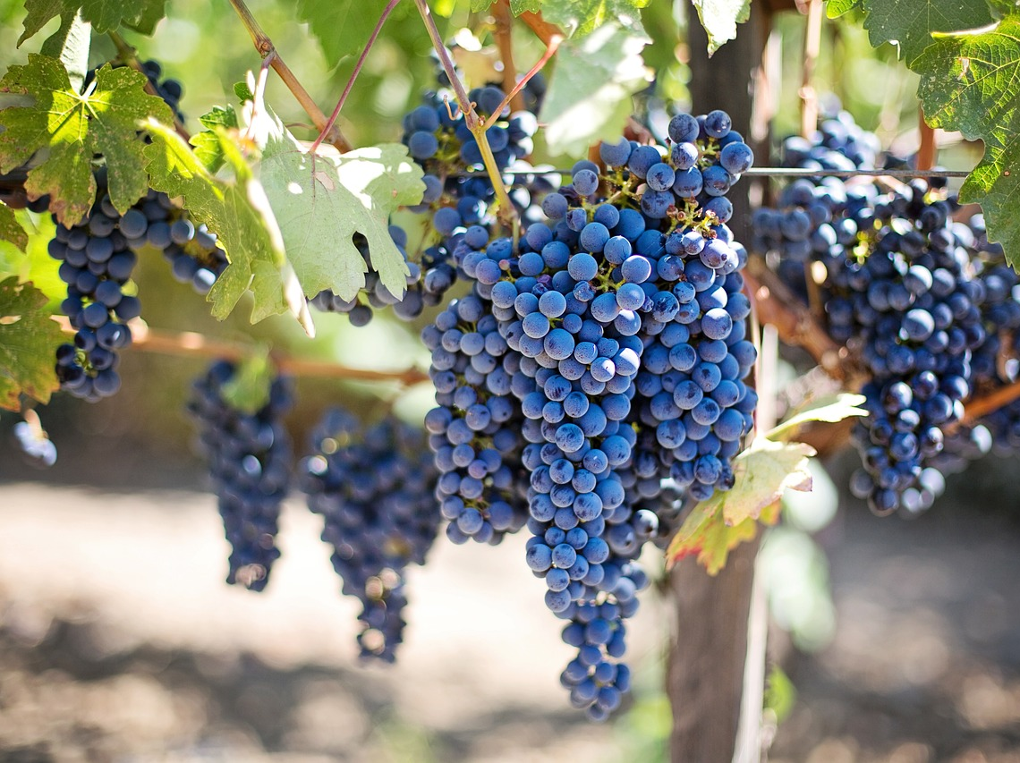
Grapes In The Wilderness Hosea 9:10-17

Slide 2
“I found Israel like grapes in the wilderness; I saw your forefathers as the earliest fruit on the fig tree in its first season. But they came to Baal-peor and devoted themselves to shame, And they became as detestable as that which they loved. As for Ephraim, their glory will fly away like a bird— No birth, no pregnancy, and no conception! Though they bring up their children, Yet I will bereave them of their children until not a person is left. Yes, woe to them indeed when I depart from them! Ephraim, as I have seen, Is planted in a pasture like Tyre; But Ephraim is going to bring out his children for slaughter. Give to them, LORD—what will You give? Give them a miscarrying womb and dried-up breasts.” (Hosea 9:10-14)

Slide 3
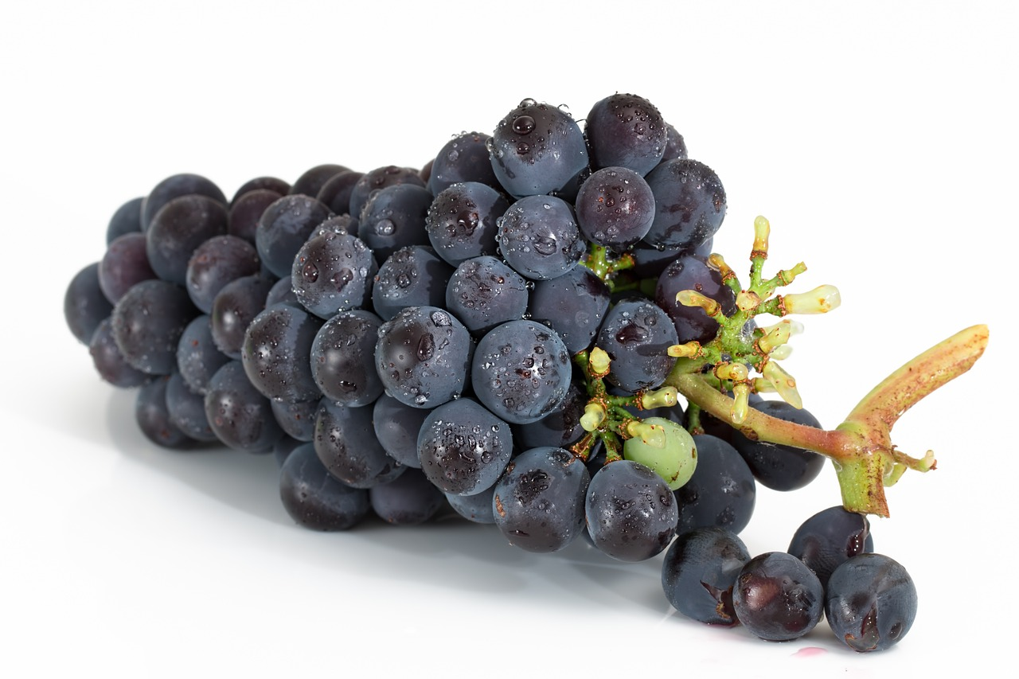
Grapes In The Wilderness
Grapes in the wilderness:
The illustration is seen in Micah 7:1-2
What could have been. (Deuteronomy 4:6; 1 Kings 4:34)
Baal-peor: What actually was.
Numbers 25:1-3
This was one of the most notorious failures in Israel’s history. (Deut. 4:3; Psalm 106:28; Hosea 9:10)
It could have been so different! (Deuteronomy 28:2-5)

Slide 4
“All their evil is at Gilgal; Indeed, I came to hate them there! Because of the wickedness of their deeds I will drive them out of My house! I will no longer love them; All their leaders are rebels. Ephraim is stricken, their root is dried up, They will produce no fruit. Even though they give birth to children, I will put to death the precious ones of their womb. My God will reject them Because they have not listened to Him; And they will be wanderers among the nations.” (Hosea 9:15-17)

Slide 5
An Historical Example
Gilgal: A place of covenant renewal. (Joshua 5:7-9)
Lost potential (Judges 2:3, 10)
Gilgal: A place of unfaithfulness.
Saul (1 Samuel 15:10-26)
Israel (Hosea 4:15; Amos 4:4)

Slide 6
Lessons Learned
Our choices effect those who come after us! (Exodus 34:6-7; Psalm 100:5)
Often what we fail to do has as much impact as what we do! (Judges 2:10)
There is an urgency to every opportunity to do good!

