Slide 2
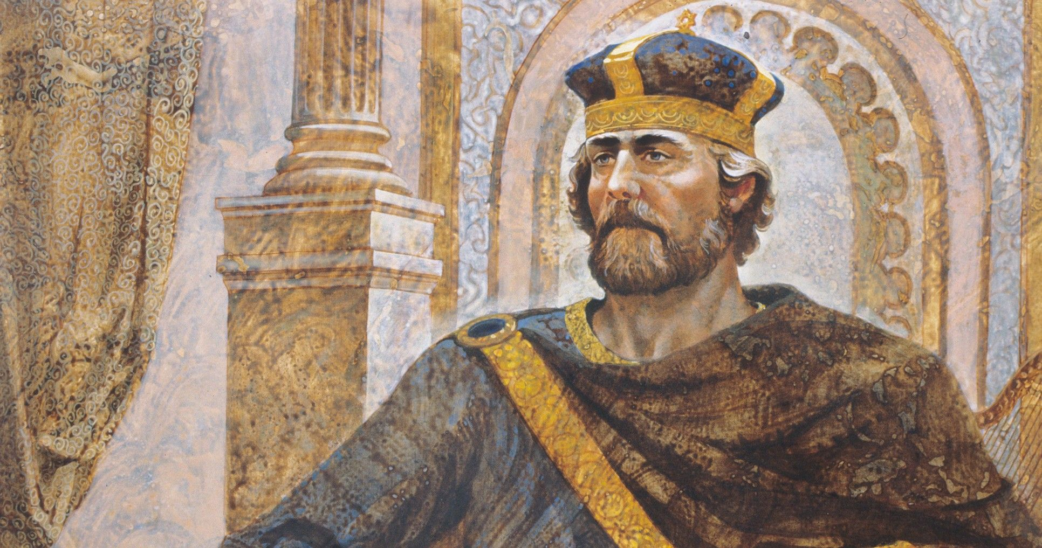
2 Samuel 7.1-7
Man DOESN’T Think Like God
Isaiah 55.8-9
Man CAN’T Read God’s Mind
1 Corinthians 2.11
When God Says Nothing, He Means “No!” Haggai 1.3-11; Ezra 1.2-4; 1 Kings 8.18-19

Slide 3
GOD’S SILENCE & AUTHORITY?
June 7,2023

Slide 4
Do All Things According To The Pattern: Exodus 25.9, 40; 26.30; 27.8; 31.11; 39.42-43; Acts 7.44; 2 Timothy 1.13; Hebrews 8.5.
Don’t Go Beyond: Numbers 22.18; 24.13; 1 Corinthians 4.6; 2 John 9-11
Don’t Add Or Subtract: Deuteronomy 4.1-2; 12.32; Proverbs 30.5-6; Galatians 3.15; Revelation 22.18-19.
Don’t Turn Aside: Deuteronomy 5.32-33; 17.11, 18-20; 28.13-14; Joshua 1.7; 23.6; Proverbs 4.26-27

Slide 5
Don’t Preach Another Gospel: Galatians 1.6-10
Don’t Teach A Different Doctrine: 1 Timothy 1.3-7; 6.3-5
Hold Firm The Apostolic Traditions: 1 Corinthians 11.2; 2 Thessalonians 2.15; 3.6
Speak As The Oracles Of God: 1 Peter 4.11

Slide 6
One Will Be Rebuked by God: Proverbs 30.5-6
One Is Accursed: Galatians 1.6-10
One Is Proud And Knows Nothing: 1 Timothy 6.3-5
One Does Not Have God: 2 John 9-11
One Will Receive Plagues: Revelation 22.18-19

Slide 7
^{DEUTERONOMY29.29} The secret things belong to the Lord our God, but the things revealed belong to us and to our sons forever, that we may observe all the words of this law.
“STAY IN YOUR LANE”
VS
“TAKE OWNERSHIP”

Slide 8
^{DEUTERONOMY29.29} The secret things belong to the Lord our God, but the things revealed belong to us and to our sons forever, that we may observe all the words of this law.
“STAY IN YOUR LANE”
VS
“TAKE OWNERSHIP”

Slide 9
^{DEUTERONOMY29.29} The secret things belong to the Lord our God, but the things revealed belong to us and to our sons forever, that we may observe all the words of this law.
“STAY IN YOUR LANE”
VS
“TAKE OWNERSHIP”

Slide 10
DEUTERONOMY29.29 [REVERSED ACCORDING TO OUR DESIRES] The secret things belong to us and to our sons forever, but the things revealed belong to the Lord our God….
“STAY IN YOUR LANE”
VS
“TAKE OWNERSHIP”

Slide 11
^{ACTS 15.24} Since we have heard that some of our number to whom we gave no instruction have disturbed you with their words, unsettling your souls,
“THE PRINCIPLE” IN LIFE

Slide 12
^{ACTS 15.24} Since we have heard that some of our number to whom we gave no instruction have disturbed you with their words, unsettling your souls,
DIASTELLO
NIV “authorization”
“THE PRINCIPLE” IN LIFE

Slide 13
God is extremely selective when He speaks.
His “creative power” is in His spoken word, not the “nothingness” of His silence.
Faith is based/built upon what is revealed not assumed: Romans 10.17.
The “logic-of-a-complete-revelation:” Jude 3.
Following the pattern of Jesus and the Spirit: John 14.10; 16.13.
“Man should learn to walk softly at the outer edge of God’s revelation.”
RANDOM THOUGHTS

