Slide 2
FALSE STANDARDS OF AUTHORITY
June 4,2023

Slide 3
Merriam-
Webster
“power to command thought, opinion, or behavior”

Slide 4
Merriam-
Webster
“power to command thought, opinion, or behavior”
Who has authority over religious action?

Slide 5
Merriam-
Webster
“power to command thought, opinion, or behavior”
Who has authority over religious action?
Stakes Are High: Matthew 7.21-23; John 14.23

Slide 6
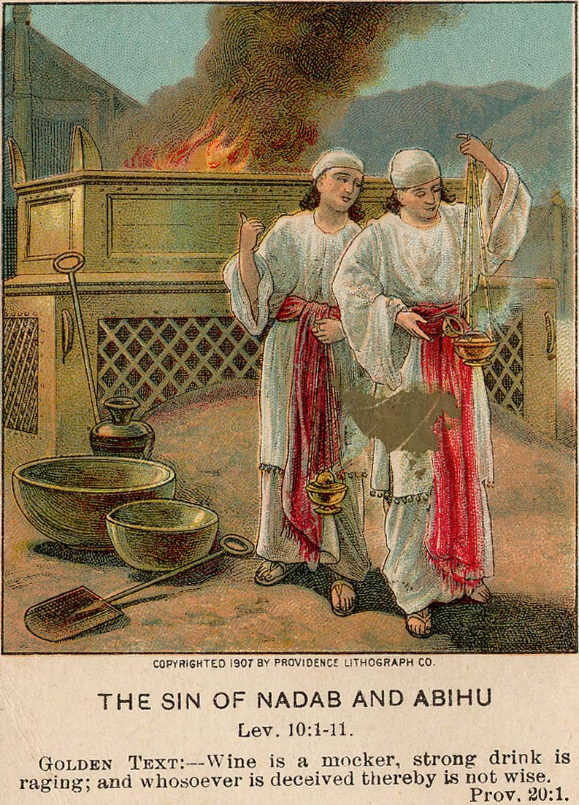
Leviticus 10.1-3
Nadab & Abihu
STANDARD OF AUTHORITY

Slide 7
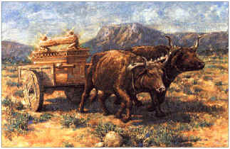
Leviticus 10.1-3
Nadab & Abihu
2 Samuel 6.1-11
David, Uzzah, & The Ark
STANDARD OF AUTHORITY

Slide 8
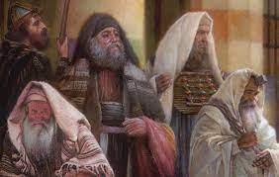
Leviticus 10.1-3
Nadab & Abihu
2 Samuel 6.1-11
David, Uzzah, & The Ark
Mark 7.1-13
Jesus, Pharisees, & Scribes
STANDARD OF AUTHORITY

Slide 9
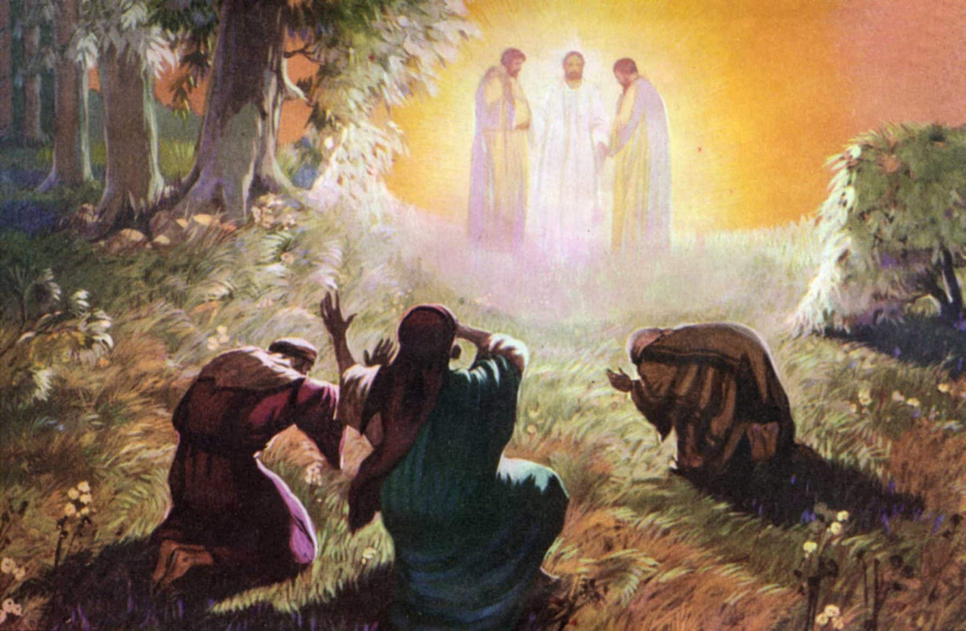
Leviticus 10.1-3
Nadab & Abihu
2 Samuel 6.1-11
David, Uzzah, & The Ark
Mark 7.1-13
Jesus, Pharisees, & Scribes
Mark 9.1-6
Mount of Transfiguration
STANDARD OF AUTHORITY

Slide 10
Leviticus 10.1-3
Nadab & Abihu
NOT
Human
Initiative
2 Samuel 6.1-11
David, Uzzah, & The Ark
Mark 7.1-13
Jesus, Pharisees, & Scribes
Mark 9.1-6
Mount of Transfiguration
STANDARD OF AUTHORITY

Slide 11
Leviticus 10.1-3
Nadab & Abihu
NOT
Human
Initiative
2 Samuel 6.1-11
David, Uzzah, & The Ark
NOT
Emotion or
Intention
Mark 7.1-13
Jesus, Pharisees, & Scribes
Mark 9.1-6
Mount of Transfiguration
STANDARD OF AUTHORITY

Slide 12
Leviticus 10.1-3
Nadab & Abihu
NOT
Human
Initiative
2 Samuel 6.1-11
David, Uzzah, & The Ark
NOT
Emotion or
Intention
Mark 7.1-13
Jesus, Pharisees, & Scribes
NOT
Tradition or
Custom
Mark 9.1-6
Mount of Transfiguration
STANDARD OF AUTHORITY

Slide 13
Leviticus 10.1-3
Nadab & Abihu
NOT
Human
Initiative
2 Samuel 6.1-11
David, Uzzah, & The Ark
NOT
Emotion or
Intention
Mark 7.1-13
Jesus, Pharisees, & Scribes
NOT
Tradition or
Custom
Mark 9.1-6
Mount of Transfiguration
NOT
Old
Covenant
STANDARD OF AUTHORITY

Slide 14
Leviticus 10.1-3
Nadab & Abihu
NOT
Human
Initiative
NOT
Emotion or
Intention
Standards of Authority
Illegitimate vs. Legitimate
Colossians 2.1-23
Hebrews 1.1-4
1 Thessalonians 2.13
2 Thessalonians 2.13-17
Ephesians 2.17-22
Philippians 2.9-11
2 Samuel 6.1-11
David, Uzzah, & The Ark
Mark 7.1-13
Jesus, Pharisees, & Scribes
NOT
Tradition or
Custom
Mark 9.1-6
Mount of Transfiguration
NOT
Old
Covenant
STANDARD OF AUTHORITY

