Slide 2
ACTS 15 & AUTHORITY
June 7,2023

Slide 3
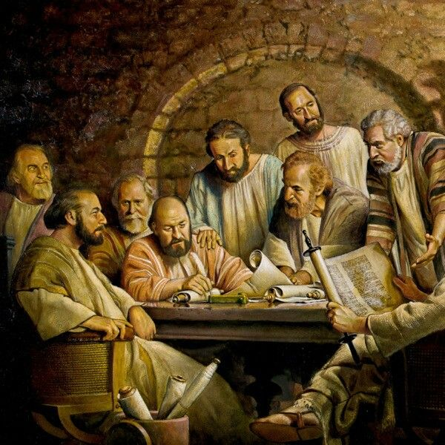
ACTS 15
Peter: Acts 15.7-11 (5)
Barnabas and Paul: Acts 15.12
James: Acts 15.13-21 (9)

Slide 4
ACTS 15
Peter: Acts 15.7-11 (5)
Barnabas and Paul: Acts 15.12
James: Acts 15.13-21 (9)
Appealed to God: Acts 15.7, 12, 16

Slide 5
ACTS 15
SAID
Peter: Acts 15.7
James : Acts 15.15-18

Slide 6
ACTS 15
SAID
Peter: Acts 15.7
James : Acts 15.15-18
SHOWED
Peter: Acts 15.8
Paul: Acts 15.12

Slide 7
ACTS 15
SAID
Peter: Acts 15.7
James : Acts 15.15-18
SHOWED
Peter: Acts 15.8
Paul: Acts 15.12
CONCLUDED
Peter: Acts 15.7-9
James : Acts 15.19

Slide 8
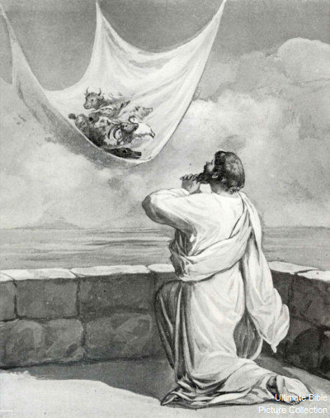
ACTS 10
SAID
Peter: Acts 10.20
SHOWED
Peter: Acts 10.9-16, 28
CONCLUDED
Peter: Acts 10.28-29, 34-35

Slide 9
Isn’t this kinda’ of arbitrary? Are we forcing this on Scripture? Is this man-made instead of God given?
Recognizing & Acknowledging
“The miracle of revelation was in the giving and confirming, not in the process of reception. God made man, for whom He made the word.”
Ephesians 3.1-7
CONCLUSION

Slide 10
Isn’t this kinda’ of complex? Is it fair that God rested salvation on something so convoluted?
Simplest things are hardest to explain…
“We are not asking the right questions…”
Valuing what God values…(Humility and Reverence)
CONCLUSION

