Slide 2
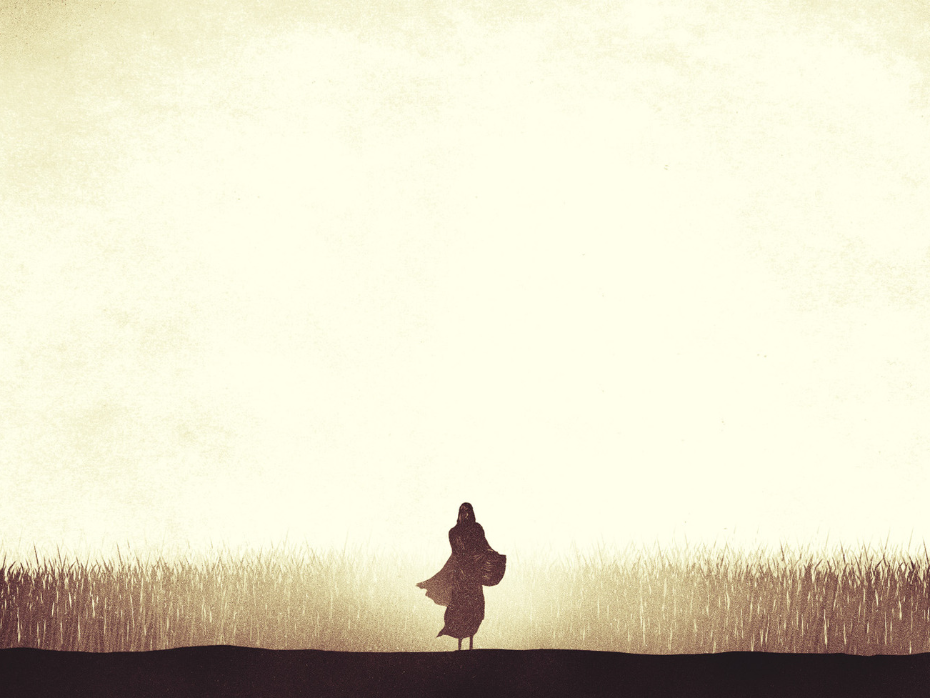
ACT I
Time Period
In the days of the judges (1:1a)
A period of moral and religious corruption (cf. Jud. 21:25)
Problem
A famine in the land (1:1b)
Result of Israel’s rebellion (Deut. 11:16-17; 28:2, 15-18)

Slide 3
ACT I
“Solution”
Elimelech, Naomi, and their two sons leave Bethlehem for Moab
Two sons marry two Moabite women
Tragedy
Elimelech and her two sons die
Happened within a period of 10 years

Slide 4
ACT I
Preparing to Return to Bethlehem
Naomi hears that the famine has eased (1:6)
One daughter-in-law stays in Moab, but Ruth stayed with Naomi (1:14-18)
Returning to Bethlehem
Naomi reveals her sorrow by requesting to be called “Mara” (1:20; Mara means bitter)

Slide 5
ACT II
Ruth Meets Boaz
Ruth gathers food from the field of Boaz (2:3)
Boaz - a relative of Naomi’s husband; a man of integrity (2:1)
Boaz treats Ruth with kindness (2:8-16)
Ruth returns and tells Naomi all that occurred; discovers that Boaz is their kinsman-redeemer (2:19-20)

Slide 6
A Role of a Redeemer
Purchase land back for a family member (Lev. 25:25)
Redeem a family member from indentured service (Lev. 25:47-49)
Marry a widow without a son to preserve the family line (Deut. 25:5-6)

Slide 7
The Redeemer Served as a Picture of God’s Care for His People
Ex. 6:6; 15:13; Ps. 74:2

Slide 8
ACT III
A Request for Redemption
Ruth approaches Boaz at the threshing floor.
Her actions symbolize her desire for Boaz to act as her redeemer (3:9)
Boaz but says there is another redeemer before him, but he would redeem Ruth if the other would not (3:12-13)

Slide 9
ACT III
A Request for Redemption
Ruth is sent home to Naomi with six measures of barley (3:15)
The “emptiness” of Act I is starting to be “filled”

Slide 10
ACT IV
Ruth’s Redemption
Boaz communicates with the nearest redeemer. He refuses to redeem Ruth (4:5-6)
Boaz becomes Ruth’s redeemer and together they have a son named Obed (4:13-17).
The women of the town complete the arch of the story with their statements in 4:14-17 (from bitter to sweet)

Slide 11
Boaz: A Forefather and Foreshadowing of Christ
Forefather of Christ
Obed was the grandfather of David
Genealogy in 4:18-22 is the same as in Matt. 1:3-6 (Matthew includes the names of Tamar, Rahab, and Ruth)

Slide 12
Boaz: A Forefather and Foreshadowing of Christ
Foreshadowing of Christ
Christ came to redeem us from sin by the power of His blood (Eph. 1:7; Titus 2:11-14; Heb. 9:12)

