Slide 1
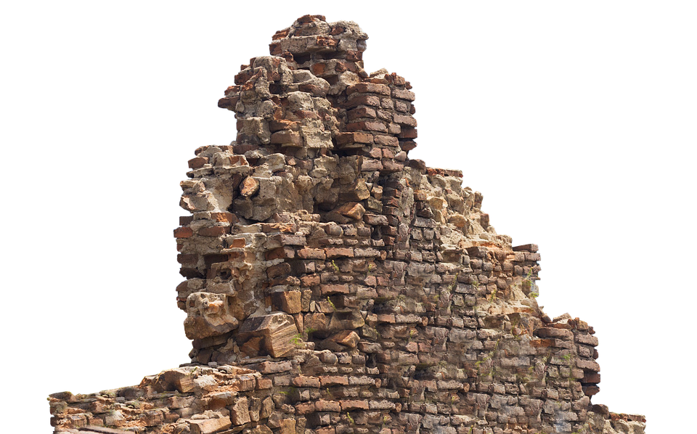
Restoration Is Driven By Scripture

Slide 2
Their Return Was Prophesied!
Moses, Isaiah and Jeremiah all spoke about captivity.
Leviticus 26:40-42
Isaiah 44:28
Jeremiah 29:10-11
These statements moved Daniel to pray.
Daniel 9:1-2
Daniel 9:11-12, 19
They had to get on board with God’s plan.
(Ezra 1-2)

Slide 3
TAKE AWAY: When we restore God’s way of doing things, God’s purposes are fulfilled!

Slide 4
Their Restoration was Regulated by Scripture
They set out to renew worship. This included the feast of booths. (Ezra 3:4)
It was to remember... (Leviticus 23:43)
It occurred at the harvest. (Leviticus 23:39)
It was one of the three mandatory feasts. (Deuteronomy 16:16
The sacrifices are prescribed in Numbers 29:12-40.

Slide 5
Their Restoration was Regulated by Scripture
They set out to renew worship. This included the feast of booths. (Ezra 3:4)
There is another effort to restore the feast of booths in Nehemiah 8.
They find it ”written in the law.” (Nehemiah 8:13-15)
They made booths. (Nehemiah 8:17-18)
They had not done this for over 800 years!

Slide 6
TAKE AWAY: We are never finished with restoration!

Slide 7
Their Renewed Commitment was Motivated by Scripture!
They READ the law.
Nehemiah 8:1
Nehemiah 8:3
Nehemiah 8:5, 8
They REPENTED of their sin. (Nehemiah 9:1-3)
They RENEWED their covenant with God.
Nehemiah 9:38
Nehemiah 10:28-29

Slide 8
TAKE AWAY: Restoration happens in the hearts and minds of God’s people. It goes beyond forms and structures.

