Slide 1
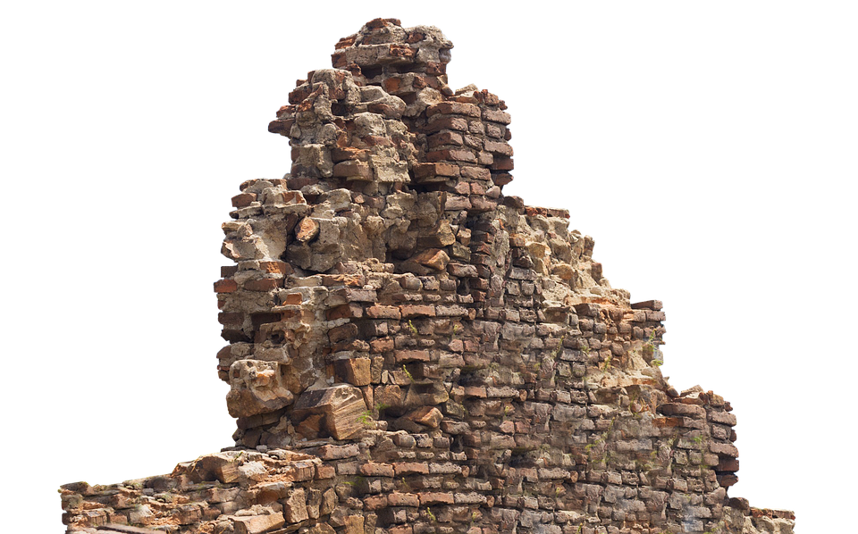
Restoration:
The Story of God’s People

Slide 2
Restoration is the Story of God’s People
Joshua – Joshua 5:4-5
Many of the kings:
David – 1 Chronicles 13:3
Asa – 2 Chronicles 15:8
Jehoshaphat – 2 Chronicles 19:4
Joash – 2 Chronicles 24:4
Hezekiah – 2 Chronicles 29:3
Josiah – 2 Chronicles 34:10

Slide 3
Restoration is the Story of God’s People
The Post Exilic Period:
Restoring the temple (Ezra 3-6)
Restoring purity (Ezra 9-10)
Restoring the walls (Nehemiah 1-6)
Restoring the covenant (Nehemiah 8-10)

Slide 4
The Church: A Restoration Movement
“Lord, is it at this time you are restoring the kingdom to Israel?” (Acts 1:6)
Luke 24:44-45
Acts 1:3
“I will rebuild the tabernacle of David...” (Acts 15:16-17)
The restoration of all things! (Acts 3:19-21)

Slide 5
Restoration: More Than Outward
Restoration has often been conceived of as outward and structural.
The church in Ephesus:
Acts 19:10
1 Timothy 1:3
Ephesus needed to be restored! (Revelation 2:2-4)
What is restoration? (Ephesians 4:11-13)

