Slide 2
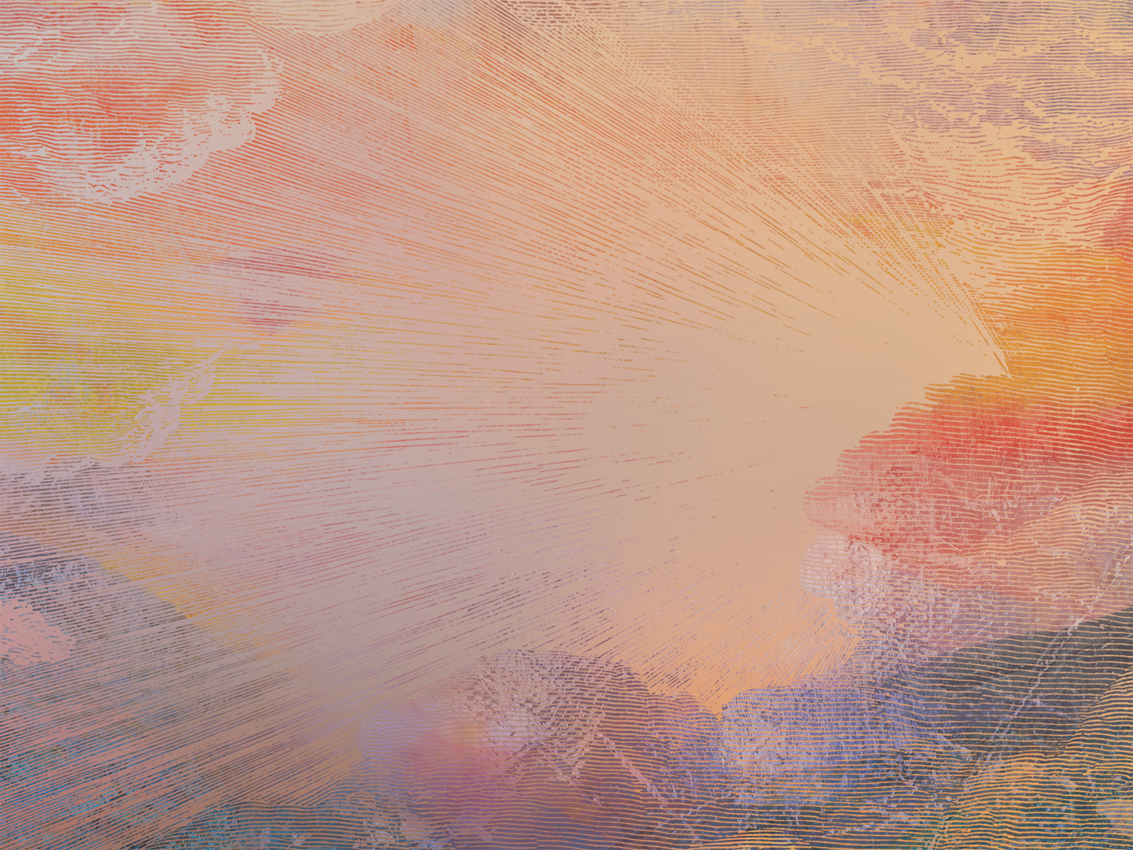
Plea for God’s Presence (1-3)
Isaiah asks God to enter the human realm.
To bring deliverance and for God’s name to be exalted.
Remembering God’s past presence brings confidence (cf. Ex. 19:16-20).
As Isaiah longed for God’s presence, we should long for the coming of Christ (Rom. 8:22-23; Rev. 22:20)

Slide 3
Promises for God’s People (4-5a)
God acts for those who wait for Him
God meets with those who do good and remember God’s ways
Even if the world is against us, God is for us. (2 Chr. 16:9)

Slide 4
Profession of Israel’s Sins (5b-7)
Isaiah includes himself in Israel’s shortcomings (“we sinned,” “our sins”)
Similar to Daniel (Dan. 9:3-7)
Even the most righteous among us have fallen short of God’s glory (Rom. 3:10, 23)

Slide 5
Proclamation of God’s Rule (8)
We follow after God as our Father (cf. Is. 63:16)
We are changed by God as our Potter (cf. Jer. 18; Is. 29; 45; Rom. 9)
Attitude of Jesus: “not as I will, but as you will”

Slide 6
Plea for God’s Mercy (9-12)
Asking God to show mercy as He’d done in the past (see Ex. 32:9-14)
God’s mercy is shown because of His goodness, not ours (Eph. 2:8-9)

Slide 7
The Answer to Isaiah’s Prayer:
Jesus Christ
Mark 1:9-11
⁹ In those days Jesus came from Nazareth of Galilee and was baptized by John in the Jordan. ¹⁰ And when he came up out of the water, immediately he saw the heavens being torn open and the Spirit descending on him like a dove. ¹¹ And a voice came from heaven, “You are my beloved Son; with you I am well pleased.”

Slide 8
The Answer to Isaiah’s Prayer:
Jesus Christ
Matthew 1:21-23
²¹ She will bear a son, and you shall call his name Jesus, for he will save his people from their sins.” ²² All this took place to fulfill what the Lord had spoken by the prophet: ²³ “Behold, the virgin shall conceive and bear a son, and they shall call his name Immanuel” (which means, God with us).

Slide 9
The Answer to Isaiah’s Prayer:
Jesus Christ
Mark 1:9-11
⁹ In those days Jesus came from Nazareth of Galilee and was baptized by John in the Jordan. ¹⁰ And when he came up out of the water, immediately he saw the heavens being torn open and the Spirit descending on him like a dove. ¹¹ And a voice came from heaven, “You are my beloved Son; with you I am well pleased.”

