Slide 2
Genesis
First book of the Pentateuch
Authorship attributed to Moses (around 1400BC)
Covers over 2000 years of history
Name comes from the first words in the book, “In the beginning.”
Reveals the origins of the universe, humanity, family, nations, languages, and sin…

Slide 3
Genesis 3:1-6
¹ Now the serpent was more crafty than any other beast of the field that the Lord God had made. He said to the woman, “Did God actually say, ‘You shall not eat of any tree in the garden’?” ² And the woman said to the serpent, “We may eat of the fruit of the trees in the garden, ³ but God said, ‘You shall not eat of the fruit of the tree that is in the midst of the garden, neither shall you touch it, lest you die.’”

Slide 4
Genesis 3:1-6
⁴ But the serpent said to the woman, “You will not surely die. ⁵ For God knows that when you eat of it your eyes will be opened, and you will be like God, knowing good and evil.” ⁶ So when the woman saw that the tree was good for food, and that it was a delight to the eyes, and that the tree was to be desired to make one wise, she took of its fruit and ate, and she also gave some to her husband who was with her, and he ate.

Slide 5
Genesis 3:23-24
²³ therefore the Lord God sent him out from the garden of Eden to work the ground from which he was taken. ²⁴ He drove out the man, and at the east of the garden of Eden he placed the cherubim and a flaming sword that turned every way to guard the way to the tree of life.

Slide 6
Genesis 6:5-9
⁵ The Lord saw that the wickedness of man was great in the earth, and that every intention of the thoughts of his heart was only evil continually. ⁶ And the Lord regretted that he had made man on the earth, and it grieved him to his heart. ⁷ So the Lord said, “I will blot out man whom I have created from the face of the land, man and animals and creeping things and birds of the heavens, for I am sorry that I have made them.” ⁸ But Noah found favor in the eyes of the Lord.

Slide 7
Genesis introduces us to the reality that restoration with God can’t be achieved on our own. We need a Savior!

Slide 8
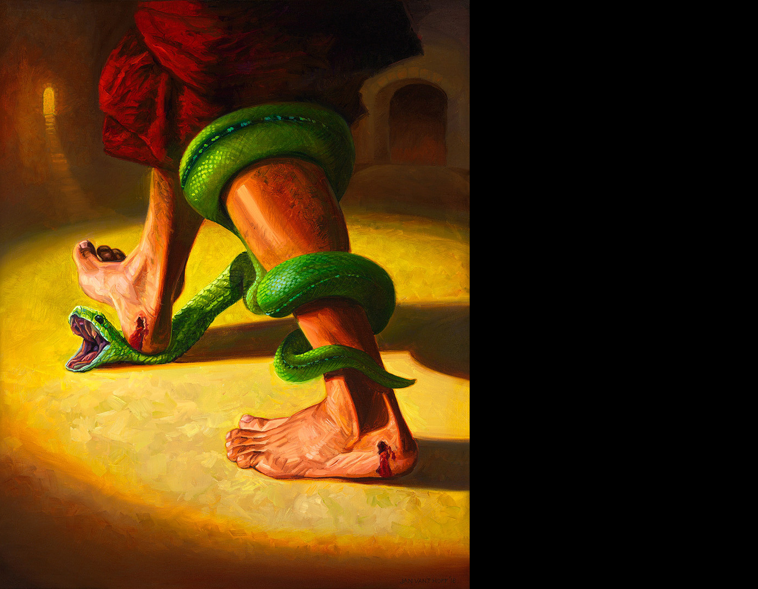
“I will put enmity between you and the woman, and between your offspring and her offspring; he shall bruise your head, and you shall bruise his heel.”
- Genesis 3:15

Slide 9
Jesus in Genesis
The one who would bruise the head of the serpent (Gen. 3:15)
The Ark of Safety (Gen. 6-9; Matt. 11:28; 1 Pet. 3:18-22)
The Promised Seed of Abraham (Gen. 12:1-3; 22:17-18; Gal. 3:7-9, 29)

Slide 10
Genesis 12:1-3
¹ Now the Lord said to Abram, “Go from your country and your kindred and your father's house to the land that I will show you. ² And I will make of you a great nation, and I will bless you and make your name great, so that you will be a blessing. ³ I will bless those who bless you, and him who dishonors you I will curse, and in you all the families of the earth shall be blessed.”

Slide 11
Jesus in Genesis
The one who would bruise the head of the serpent (Gen. 3:15)
The Ark of Safety (Gen. 6-9; Matt. 11:28; 1 Pet. 3:18-22)
The Promised Seed of Abraham (Gen. 12:1-3; 22:17-18; Gal. 3:7-9, 29)
The Perfect Sacrifice (Gen. 22; Matt. 20:28)
The “new” Joseph (Gen. 37-50)

Slide 12
Genesis sets the stage for the greatest story ever told – the story of redemption through Jesus Christ.

