Slide 1
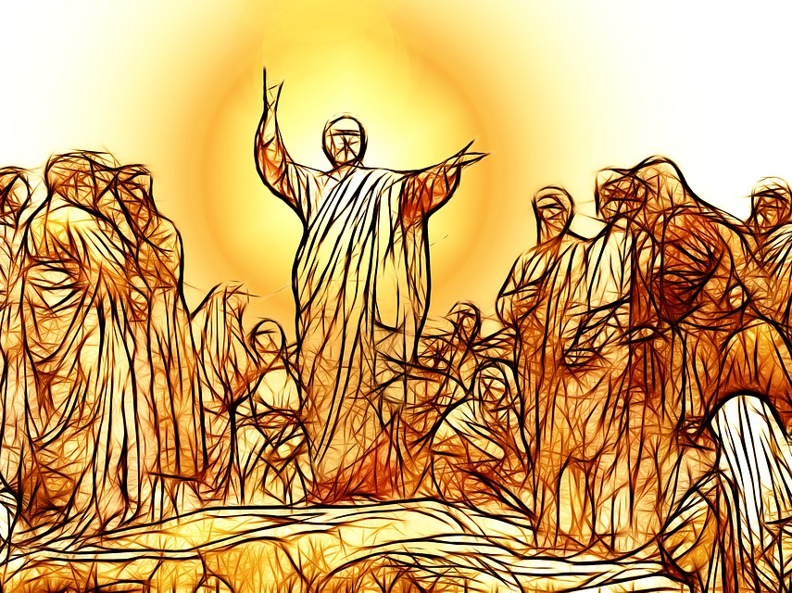
The Character of the Kingdom
Matthew 5:1-11

Slide 2
The Gospel of the Kingdom: A Righteous Message
The realization of the kingdom of heaven...
Matthew 4:23
Matthew 7:28-29
God’s rule is realized through righteousness!
Matthew 5:19-20
2 Samuel 8:15; 1Kings 10:9
Psalm 89:14
Matthew 7:21-23

Slide 3
The Gospel of the Kingdom: A Radical Message
Jesus’ sermon has not been well received!
“Most people are willing to take the Sermon on the Mount as a flag to sail under, but few will use it as a rudder by which to steer.” – Oliver Wendell Holmes Sr.
George Bernard Shaw referred to it as an “impractical outburst of anarchism and sentimentality.”
The sermon was first preached because the religious leaders had drained the life out of God’s word. (Matthew 5:20; 6:5; 7:15)
Just look at the values conveyed in the first few verses!

Slide 4
The Gospel of the Kingdom: A Redemptive Message
The progression of the sermon...
Jesus begins with eight beatitudes. (Matthew 5:3-12)
These are not unrelated are disconnected ideas.
This is a character sketch of the kingdom citizen!
He follows with two similitudes. (Matthew 5:13-16)
You are the salt of the earth... (Matthew 5:13)
You are the light of the world... (Matthew 5:14-16)
We can’t change the world until we are changed by the word! (Matthew 7:3-5)

