Slide 1
Gen 4:1-16

Slide 2
Gen 1:28 And God blessed them. And God said to them, "Be fruitful and multiply and fill the earth and subdue it, and have dominion over the fish of the sea and over the birds of the heavens and over every living thing that moves on the earth."
Gen 1:29 And God said, "Behold, I have given you every plant yielding seed that is on the face of all the earth, and every tree with seed in its fruit. You shall have them for food.

Slide 3
Gen 1:28 And God blessed them. And God said to them, "Be fruitful and multiply and fill the earth and subdue it, and have dominion over the fish of the sea and over the birds of the heavens and over every living thing that moves on the earth."
Gen 1:29 And God said, "Behold, I have given you every plant yielding seed that is on the face of all the earth, and every tree with seed in its fruit. You shall have them for food.

Slide 4
Gen 3:16 To the woman he said, "I will surely multiply your pain in childbearing; in pain you shall bring forth children. Your desire shall be for your husband, and he shall rule over you."
Gen 3:17 And to Adam he said, "Because you have listened to the voice of your wife and have eaten of the tree of which I commanded you, 'You shall not eat of it,' cursed is the ground because of you; in pain you shall eat of it all the days of your life;

Slide 5
Gen 3:16 To the woman he said, "I will surely multiply your pain in childbearing; in pain you shall bring forth children. Your desire shall be for your husband, and he shall rule over you."
Gen 3:17 And to Adam he said, "Because you have listened to the voice of your wife and have eaten of the tree of which I commanded you, 'You shall not eat of it,' cursed is the ground because of you; in pain you shall eat of it all the days of your life;

Slide 6
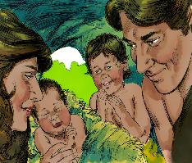
Gen 4:1 Now Adam knew Eve his wife, and she conceived and bore Cain, saying, "I have gotten a man with the help of the LORD."
Gen 4:2 And again, she bore his brother Abel.

Slide 7
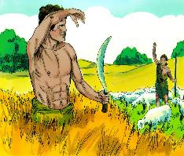
Gen 4:2 Now Abel was a keeper of sheep, and Cain a worker of the ground.

Slide 8
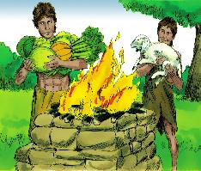
Gen 4:3 In the course of time Cain brought to the LORD an offering of the fruit of the ground,

Slide 9
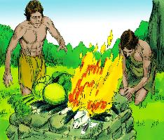
Gen 4:4 and Abel also brought of the firstborn of his flock and of their fat portions.

Slide 10
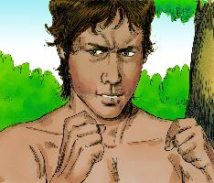
Gen 4:4 And the LORD had regard for Abel and his offering,
Gen 4:5 but for Cain and his offering he had no regard. So Cain was very angry, and his face fell.

Slide 11
Gen 4:4 And the LORD had regard for Abel and his offering,
Gen 4:5 but for Cain and his offering he had no regard. So Cain was very angry, and his face fell.

Slide 12
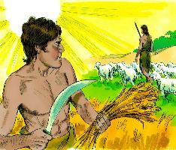
Gen 4:6 The LORD said to Cain, "Why are you angry, and why has your face fallen?
Gen 4:7 If you do well, will you not be accepted? And if you do not do well, sin is crouching at the door. Its desire is for you, but you must rule over it."

Slide 13
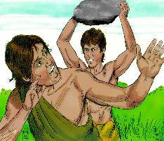
Gen 4:8 Cain spoke to Abel his brother. And when they were in the field, Cain rose up against his brother Abel and killed him.

Slide 14
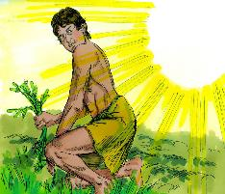
Gen 4:9 Then the LORD said to Cain, "Where is Abel your brother?" He said, "I do not know; am I my brother's keeper?"

Slide 15
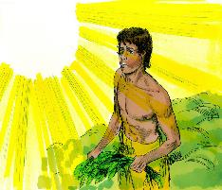
Gen 4:10 And the LORD said, "What have you done? The voice of your brother's blood is crying to me from the ground.

Slide 16
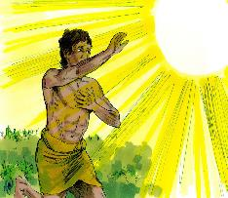
Gen 4:11 And now you are cursed from the ground, which has opened its mouth to receive your brother's blood from your hand.

Slide 17
Gen 3:15 I will put enmity between you and the woman, and between your offspring and her offspring; he shall bruise your head, and you shall bruise his heel."

Slide 18
Joh 8:44 You are of your father the devil, and your will is to do your father's desires. He was a murderer from the beginning, and does not stand in the truth, because there is no truth in him. When he lies, he speaks out of his own character, for he is a liar and the father of lies.

Slide 19
1Jn 3:12 We should not be like Cain, who was of the evil one and murdered his brother. And why did he murder him? Because his own deeds were evil and his brother's righteous.

Slide 20
Gen 4:12 When you work the ground, it shall no longer yield to you its strength. You shall be a fugitive and a wanderer on the earth."

Slide 21
Gen 4:13 Cain said to the LORD, "My punishment is greater than I can bear.

Slide 22
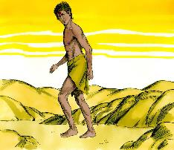
Gen 4:14 Behold, you have driven me today away from the ground, and from your face I shall be hidden. I shall be a fugitive and a wanderer on the earth, and whoever finds me will kill me."

Slide 23
Gen 4:15 Then the LORD said to him, "Not so! If anyone kills Cain, vengeance shall be taken on him sevenfold." And the LORD put a mark on Cain, lest any who found him should attack him.

Slide 25
Heb 12:24 and to Jesus, the mediator of a new covenant, and to the sprinkled blood that speaks a better word than the blood of Abel.

Slide 26
What does it mean that Jesus’ blood speaks a better word than Abel’s?

Slide 27
Gen 4:10 And the LORD said, “What have you done? The voice of your brother's blood is crying to me from the ground.

Slide 28
Gen 4:12 When you work the ground, it shall no longer yield to you its strength. You shall be a fugitive and a wanderer on the earth.”

Slide 29
I would like to make some parallels between Abel and Jesus.

Slide 30
Jesus and Abel
1. Righteous

Slide 31
Mat 23:35 so that on you may come all the righteous blood shed on earth, from the blood of righteous Abel to the blood of Zechariah the son of Barachiah, whom you murdered between the sanctuary and the altar.

Slide 32
Jesus and Abel
1. Righteous
2. Killed out of envy

Slide 33
Mat 27:18 For he knew that it was out of envy that they had delivered him up.

Slide 34
Jesus and Abel
1. Righteous
2. Killed out of envy
3. Their shed blood accomplished something

Slide 35
What did Abel’s blood crying out from the ground accomplish?

Slide 36
The banishment of Cain!

Slide 37
What did Jesus blood bring about?

Slide 38
Eph 2:13 But now in Christ Jesus you who once were far off have been brought near by the blood of Christ.

Slide 39
Heb 10:19 Therefore, brothers, since we have confidence to enter the holy places by the blood of Jesus,

