Slide 1
The spirit & The Flesh
walk by the Spirit, and you will not carry out the desire of the flesh. (Galatians 5:16)

Slide 2
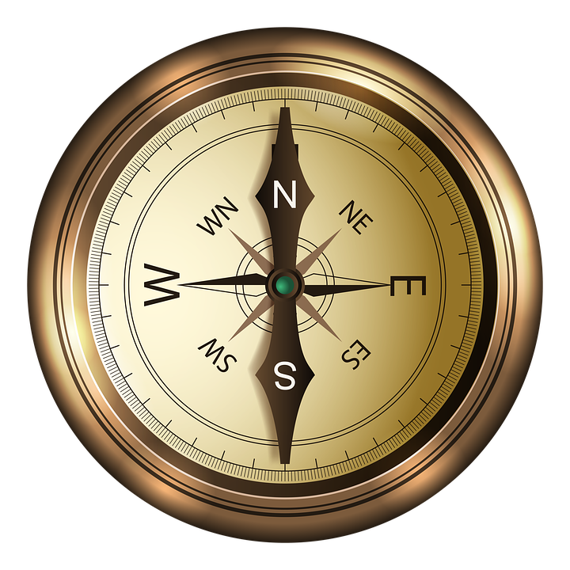
The Journey is the Destination
We are becoming what we will be.
1 John 3:2
John 4:24
1 Corinthians 15:51-53
Pursue the Spirit not the flesh!
Galatians 5:16-17
Romans 8:5-10

Slide 3
This Changes Everything!
It transforms our perception of reality.
Romans 5:3-5
Philippians 3:8
Hebrews 12:14
It transforms us.
1 Peter 1:14-16
Romans 8:29
Ephesians 4:14-15

Slide 4
The Nuts & Bolts of a spiritual life
The Individual Pursuit:
Galatians 5:18; Romans 8:14
Nehemiah 9:19-20; Exodus 19:4-6
Psalm 119:11, 33, 72
The Collective Pursuit:
Galatians 6:1
1 Thessalonians 5:11

