Slide 1
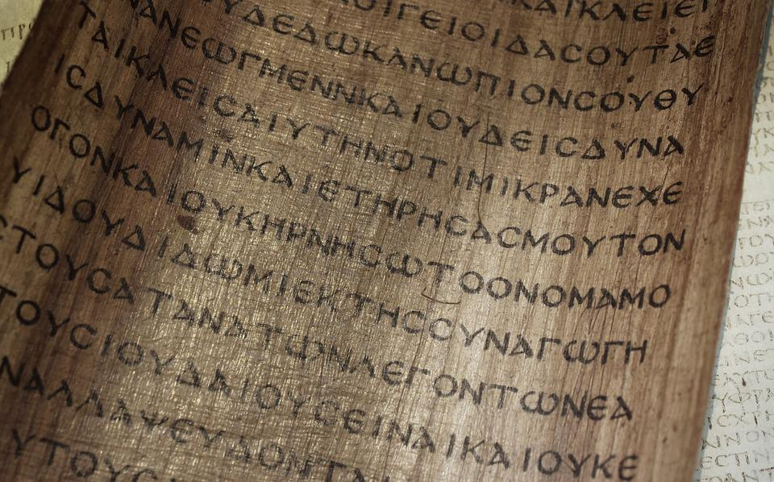
Has The New Testament Been Corrupted?

Slide 2
A New Testament Primer:
The New Testament is composed of 27 documents.
4 Gospels
13 Epistles by Paul
3 Epistles by John
2 Epistles by Peter
1 Epistle by James
1 Epistle by Jude
1 Anonymous Epistle (Hebrews)
Revelation - Apocalyptic

Slide 3
A New Testament Primer:
The New Testament is composed of 27 documents.
These documents were written in Greek between 49 and about 95 AD.
None of the original documents are in existence (extant).
Our New Testament is based on copies of the originals (Manuscripts).

Slide 4
Many claim the N. T. has been corrupted.
“…there are more differences in our manuscripts than there are words in the New Testament.” (Bart Ehrman, Misquoting Jesus, p. 10)
This argument has been picked up by Muslims.
It has been picked up and exaggerated by Dan Brown.
It has been repeated in the mainstream media.

Slide 5
Defining the Question:
We are not concerned with authorship.
We are not immediately concerned with the accuracy of content.
The question before us is: “Has the New Testament come down to us in substantially the same form as the original?”

Slide 6
The Evidence:
Autographs – None in existence.
Manuscript Copies – Handwritten Greek copies. These number in the thousands.
Lectionaries – Portions of scripture arranged for public reading.
Ancient Versions – Translations into Latin, Coptic, Syriac, Armenian, Arabic, Hebrew etc.
Citations – Quotations of the N. T. in early church writings.

Slide 7
Manuscript Evidence:
The official number is 5865. Daniel Wallace claims that the actual number is more like 5500.
This evidence is far better than any other ancient manuscript.
This is true because of the number of manuscripts.
This is true because of the close proximity of our manuscripts to the originals.

Slide 8
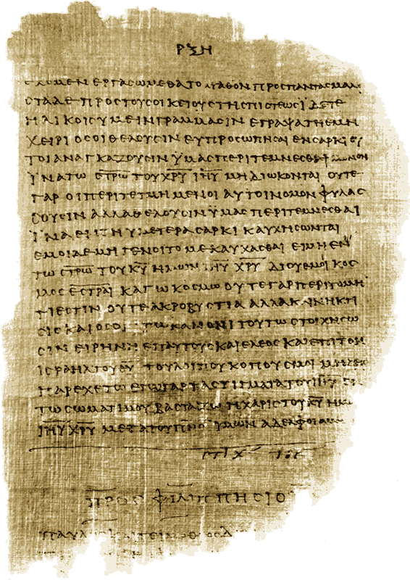
New Testament Manuscripts:
P52 – 125-150 AD (John 18:31-33, 37-38)
P46 – 175-225 Most of Paul’s Epistles

Slide 9
New Testament Manuscripts:
Codex Sinaiticus – All of the New Testament c. 325-360 AD

Slide 10
Manuscript Evidence:
There are 5 fragments from the 2nd century.
There are 12 manuscripts from the late 2nd and 3rd centuries.
There are 85 manuscripts from the 4th and 5th centuries.
As you move forward these numbers climb into the hundreds and thousands.

Slide 11
Other Ancient Documents:
Homer’s Illiad (800 BC) is based on 643 copies.
Herodotus (480-425 BC) is based on 8 copies. The earliest was made 1350 years after he wrote!
Plato is based on 7 copies. The earliest is 1300 years after the original.
Caesar’s Gallic Wars (100-44 BC) is based on 10 copies. The earliest copy was made 1000 years after the original.

Slide 12
NT Manuscript Evidence:
Fragments within 50 years.
Copies of books within 100 years.
All of the New Testament within 225 years.
This is unprecedented.
If the NT isn’t accurate there is no documentation of ancient history!

Slide 13
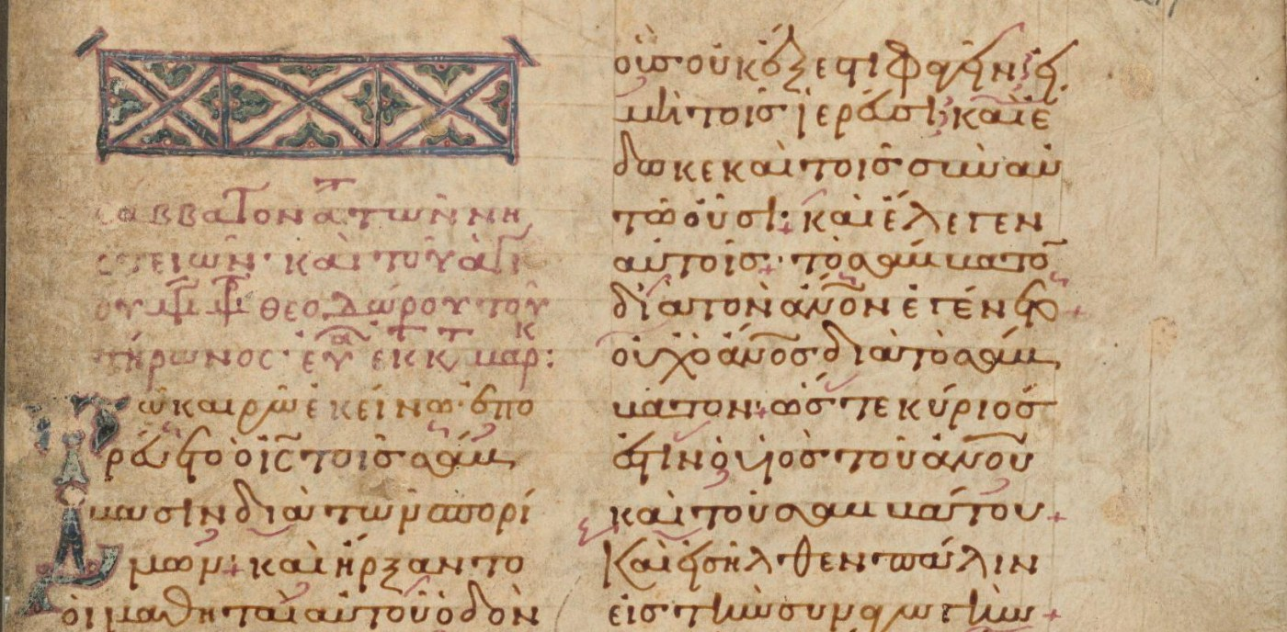
There is more!
There are 2453 lectionary manuscripts. Many are as early as the 8th and 9th century.
L1 is from the 10th century.

Slide 14
There is more!
There are a great many early translations.
There are 10,000 Latin manuscripts.
There are 350 Syriac manuscripts, some of which are dated to the 5th and 6th centuries.
There are almost 1000 Coptic manuscripts. Some of these are as early as the 3rd and 4th centuries.
In addition, we have an abundance of Patristic quotations.

Slide 15
The Quality of the NT Manuscript Evidence:
“…there are more differences in our manuscripts than there are words in the New Testament.” (Bart Ehrman, Misquoting Jesus, p. 10)
Is all of this evidence unreliable?

Slide 16
The Quality of the NT Manuscript Evidence:
There are 400,000 textual variants in the NT Greek manuscripts.
Blunders – easy to spot.
Spelling variations.
Minor textual variants.
Variations in word order.
Articular vs. anathrous readings.
This constitutes over 99% of all variants.

Slide 17
Some Examples of Substantive Variants:
Romans 5:1
“Therefore, having been justified by faith, we have peace with God through our Lord Jesus Christ.”
“Being therefore justified by faith, let us have peace with God through our Lord Jesus Christ.”
Romans 10:17
“…the word of Christ.”
“…the word of God.”

Slide 18
What Conclusion Should We Draw?
There is another statement by Bart Ehman buried in an appendix to the paperback edition of Misquoting Jesus: “Essential Christian beliefs are not affected by textual variants in the manuscript tradition of the New Testament.” (Misquoting Jesus, paperback, p. 252)

Slide 19
A Thought Experiment:
The KJV is based on the Textus Receptus – a Greek New Testament based on 6 or 7 late manuscripts.
Modern Translations (NASB, ESV, NIV) are based on an eclectic Greek text derived from thousands of manuscripts many of which are very early.
What is the substantive difference?
The New Testament we have is substantively the same as the original!

