Slide 1
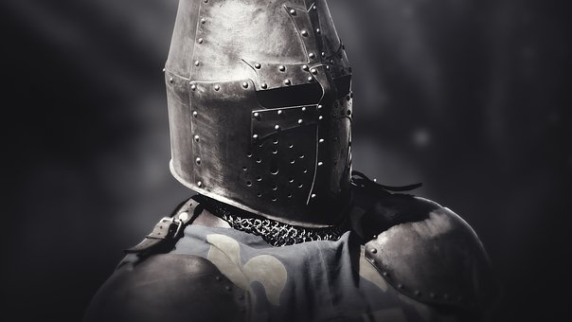
Honor

Slide 2
A Primer on Honor and Shame
Honor and shame matter to God.
Psalm 86:8-9
Romans 3:23
Honor and shame are always shared.
Joshua 7:1
Joshua 7:8-9
Honor is built over time; it is lost in a moment.
Ecclesiastes 7:1
Ecclesiastes 10:1

Slide 3
Honor & Shame: David
Our Actions Reflect on God!
1 Samuel 17:10
1 Samuel 17:26
We derive honor from God.
2 Samuel 7:1
2 Samuel 7:8-9
Our Actions Reflect on God!
2 Samuel 12:10
2 Samuel 12:14

Slide 4
Honor & Shame: Christians
What we do reflects on Christ!
1 Corinthians 6:14-17
1 Corinthians 6:19 - “You are not your own!”
We must be willing to suffer shame in order to honor God.
Hebrews 11:24-26
Hebrews 13:12-13

