Slide 1
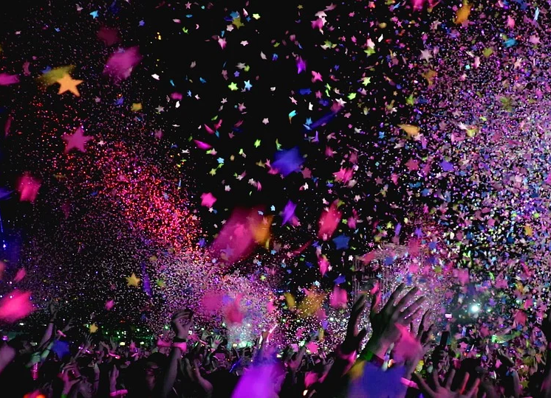
Should I go to the dance?

Slide 2
Dancing in the Bible
Old Testament
Worship (Exodus 15:20; 2 Samuel 6:14-16; Psalm 149:3; 150:4)
Idolatry (Exodus 32:19)
Celebratory (Judges 11:34; 1 Samuel 18:6; 30:16; Psalm 30:11)
New Testament
Celebratory (Matthew 11:17; Luke 15:25)
Entertainment (Matthew 14:6)

Slide 3
Biblical Principles
Immodesty (1 Timothy 2:9-10)
Sensuality
Romans 13:13-14
2 Corinthians 12:21
1 Peter 4:3

Slide 4
We Are Called To...
Be separate from the world. (John 17:14; Romans 12:2)
Be holy. (Ephesians 1:3-4; Colossians 1:21-22)
Glorify God. (1 Corinthians 6:19-20)

