Slide 1
Preserve The Unity of The Spirit
(Ephesians 4:1-3)

Slide 2
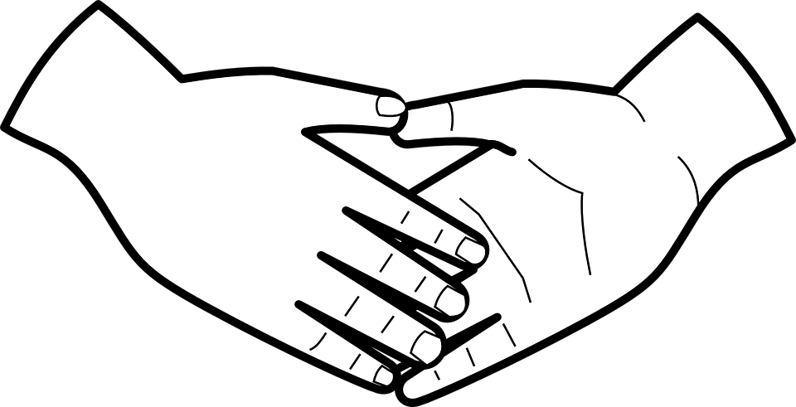
The Pillars of Unity...
Humility
Isaiah 66:2
Philippians 2:3
Galatians 6:1
Ephesians 4:1-3

Slide 3
The Pillars of Unity...
Humility
Gentleness
Titus 3:2
Isaiah 42:2-3
Galatians 6:1
Ephesians 4:1-3

Slide 4
The Pillars of Unity...
Humility
Gentleness
Patience
Romans 2:4
Galatians 5:22
2 Timothy 4:2
Ecclesiastes 7:8
Ephesians 4:1-3

Slide 5
The Pillars of Unity...
Humility
Gentleness
Patience
Tolerance in love
Proverbs 19:11
Proverbs 10:12
1 Peter 4:8
Ephesians 4:1-3

