Slide 1
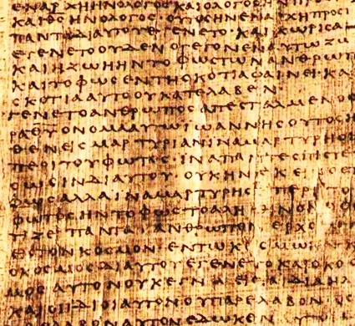
The New Testament Canon

Slide 2
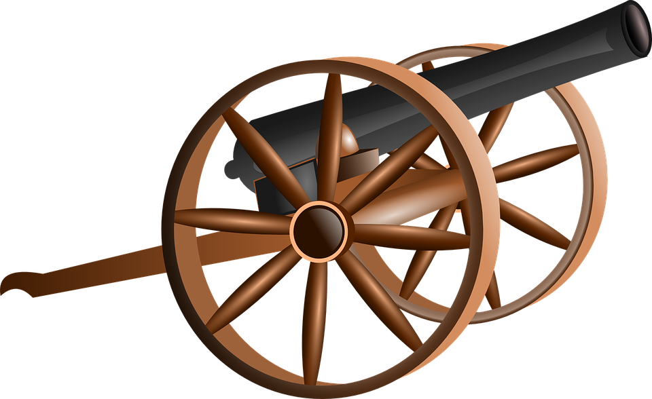
What is a Canon?

Slide 3
What is a Canon?
a general law, rule, principle, or criterion by which something is judged. (cf. Galatians 6:16)
a collection or list of sacred books accepted as genuine.

Slide 4
Mistaken Ideas About The Canon
A Book is not in the canon because it was written in Hebrew or Greek.
A Book is not in the canon due to age. (Daniel 9:2)
Agreement with other accepted canonical books. It is true that they will agree however this is not the criteria.
All of these ideas are based on the idea that man determines which books go into the canon...

Slide 5
The Basis of the N. T. Canon
The Promise: "These things I have spoken to you while abiding with you. "But the Helper, the Holy Spirit, whom the Father will send in My name, He will teach you all things, and bring to your remembrance all that I said to you. (John 14:25-26)
The Fulfillment: “...His divine power has granted to us everything pertaining to life and godliness, through the true knowledge of Him who called us by His own glory and excellence.” (2 Peter 1:3)

Slide 6
The Basis of the N. T. Canon
The writings of the Apostles and Prophets became the foundational documents of the church.
“So then you are no longer strangers and aliens, but you are fellow citizens with the saints, and are of God's household, having been built on the foundation of the apostles and prophets, Christ Jesus Himself being the corner stone...” (Ephesians 2:19-20)

Slide 7
The Basis of the N. T. Canon
Apostolic and prophetic writings became the standard for the early Christians.
1 Thessalonians 2:13
2 Thessalonians 2:15
As we have said before, so I say again now, if any man is preaching to you a gospel contrary to what you received, he is to be accursed! (Galatians 1:9)

Slide 8
When Did the Canon Begin?
It is popular today to say that the canon did not come into existence until the fourth century.
“...it is not until 367 that a list is circulated by Athanasius, bishop of Alexandria, which finally establishes the content of the New Testament.” (http://www.historyworld.net)
This is simply not true!

Slide 9
When Did the Canon Begin?
Evidence of early recognition:
The letters to the Thessalonians are among the earliest New Testament documents. (51-52 AD)
2 Thessalonians 2:1-2
2 Thessalonians 3:17
2 Thessalonians 3:14
Canonicity had to be recognized from the very beginning!

Slide 10
When Did the Canon Begin?
Evidence of early collection:
Therefore, beloved, since you look for these things, be diligent to be found by Him in peace, spotless and blameless, and regard the patience of our Lord as salvation; just as also our beloved brother Paul, according to the wisdom given him, wrote to you, as also in all his letters, speaking in them of these things, in which are some things hard to understand, which the untaught and unstable distort, as they do also the rest of the Scriptures, to their own destruction. (2 Peter 3:14-16)

Slide 11
When Did the Canon Begin?
The Early Christians:
Polycarp (150 AD)
Justin Martyr (140 AD)
Iraeneus (170 AD)
The Muratorian Canon (170 AD) includes, The four gospels, Paul’s 13 epistles, Jude, 1 John and 2 or 3 John and Revelation.
Obviously, Christians have always been concerned with which books are authoritative.

Slide 12
The Recognition of the Gospels
Papias (c. AD 60-130) writes, “Matthew put together the oracles [of the Lord] in the Hebrew language, and each one interpreted them as best he could.”
Irenaeus (c. 120-200) “Now the Gospels, in which Christ is enthroned, are like these. ..... Matthew proclaims his human birth, saying, 'The book of the generation of Jesus Christ, son of David, son of Abraham...”

Slide 13
The Recognition of the Gospels
Polycarp (c. 70-155) quotes Mark 9:35 in his Letter to the Philippians (5:2)
Irenaeus (c. 120-200) Now the Gospels, in which Christ is enthroned, are like these. ..... But Mark takes his beginning from the prophetic Spirit who comes on men from on high saying, 'The beginning of the gospel of Jesus Christ, as it is written in Isaiah the prophet,' showing a winged image of the gospel. Therefore he made his message compendious and summary, for such is the prophetic character. (3.11.8)”

Slide 14
The Recognition of the Gospels
Justin Martyr (100-165) “...in the Memoirs [Gospels] which, as I have said, were drawn up by the apostles and their followers, [it is recorded] that sweat fell like drops of blood while he [Jesus] was praying, and saying, 'If it be possible, let this cup pass'.” (cf. Luke 22:41-45)
Irenaeus (c. 120-200) “Now the Gospels, in which Christ is enthroned, are like these. ..... That according to Luke, as having a priestly character, began with the priest Zacharias offering incense to God. For the fatted calf was already being prepared which was to be sacrificed for the finding of the younger son.” (3.11.8) [c.f. Luke 1:8-10]

Slide 15
The Recognition of the Gospels
Irenaeus (c. 120-200) ”Now the Gospels, in which Christ is enthroned, are like these. For that according to John expounds his princely and mighty and glorious birth from the Father, saying, 'In the beginning was the Word, and the Word was with God, and the Word was God,' and, 'All things were made by him, and without him nothing was nothing made' . Therefore this Gospel is deserving of all confidence, for such indeed is his person.” (3.11.8)
Justin Martyr (100-165) Christ also said 'Unless you are born again you will not enter into the kingdom of heaven'.(3:3)

Slide 16
The Acceptance of the Gospels
The following authorities accepted all four gospels:
Justin Martyr (c. 100-165)
Irenaeus of Lyons (c. 140-200)
Clement of Alexandria (Wrote c. 180-200)
Tertullian of Carthage (c. 155/160 - 220)
Origen (c. 185-253/4)
Eusebius (c. 260-340)

Slide 17
Why So Much Concern with Canon?
The books were prophetic. (2 Peter 3:15-17)
A growing church needed to recognize what was inspired. (Colossians 4:16)
Heretical movements necessitated judgment.
The spread of Christianity necessitated translation.
Persecution: “It was the nineteenth year of the reign of Diocletian, and the month Dystrus, or March, as the Romans would call it, in which as the festival of the Saviour’s Passion was coming on, an imperial letter was everywhere promulgated, ordering the razing of the churches to the ground and the destruction by fire of the scriptures, and proclaiming that those who held high positions would lose all civil rights, while those in households, if they persisted in their profession of Christianity, would be deprived of their liberty. Such was the first document against us.” - Eusebius 318 AD

Slide 18
The Basis of the N. T. Canon
Flawed View
Church determines canon.
Church regulates canon.
Church is mother of canon.
Church is judge of canon.
Proper View
Church discovers canon.
Church recognizes canon.
Church is child of canon.
Church is witness of canon.
Canon Criteria:
Is the book from an Apostle or prophet? (Ephesians 2:19-20) As we will see, authorship becomes very important!
Is the book consistent with accepted revelation? (Galatians 1:6-9)
How did the early church receive the work?

