Slide 2
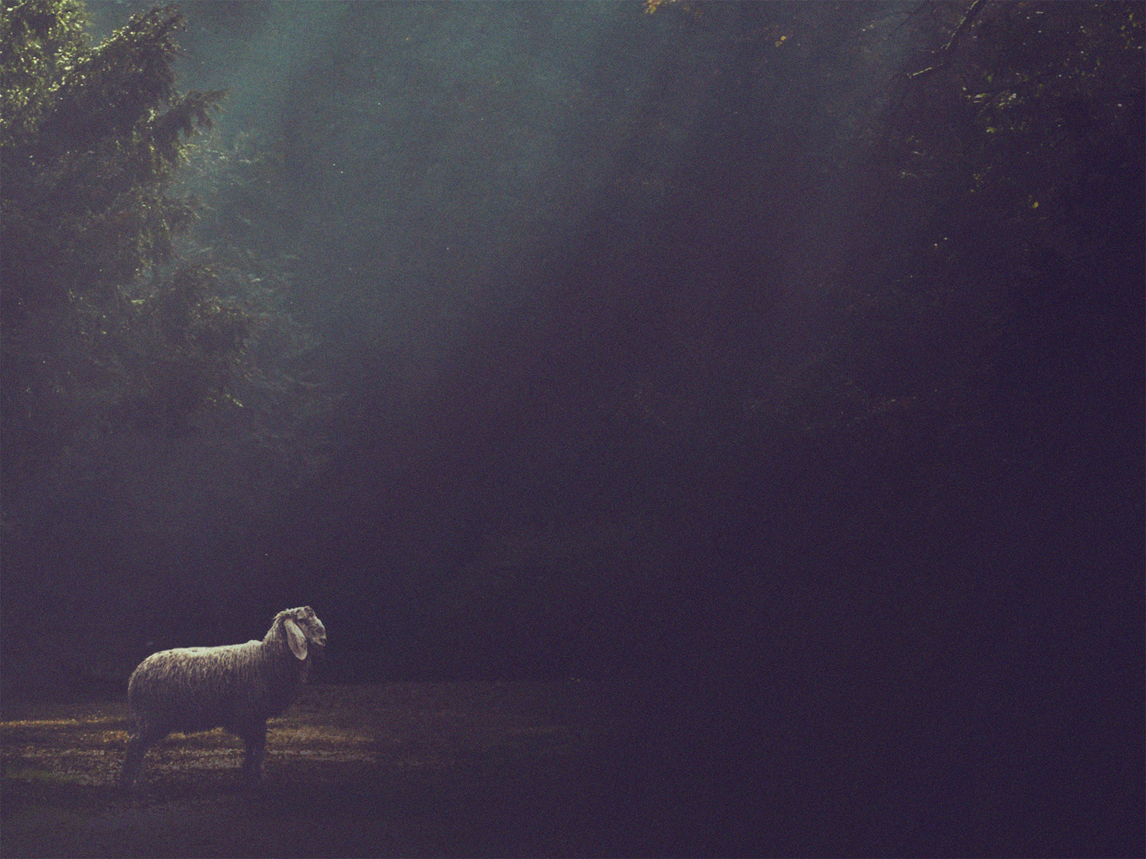
We Are Sheep
1 Ps. 100:3; Jn. 10:27; 1 Pet. 5:2

Slide 3
Shepherds In Ezekiel 34
Refers to priests, judges, and kings
Ex. 2 Samuel 5:2
Charged with leading the people spiritually
Most failed
Resulted in idolatry, corruption, and eventually exile
Their description help us see the type of leaders New Testament shepherds are to be.

Slide 4
Ezekiel 34:1-6
¹ The word of the Lord came to me: ² “Son of man, prophesy against the shepherds of Israel; prophesy, and say to them, even to the shepherds, Thus says the Lord God: Ah, shepherds of Israel who have been feeding yourselves! Should not shepherds feed the sheep? ³ You eat the fat, you clothe yourselves with the wool, you slaughter the fat ones, but you do not feed the sheep.

Slide 5
Ezekiel 34:1-6
⁴ The weak you have not strengthened, the sick you have not healed, the injured you have not bound up, the strayed you have not brought back, the lost you have not sought, and with force and harshness you have ruled them. ⁵ So they were scattered, because there was no shepherd, and they became food for all the wild beasts. My sheep were scattered; ⁶ they wandered over all the mountains and on every high hill. My sheep were scattered over all the face of the earth, with none to search or seek for them.

Slide 6
Godly Shepherds…
Feed the sheep (v. 2)
Shepherds aren’t to be self-focused, but others-focused (v. 2, 3, 8)
Shepherds feed the untainted Word of God (Titus 1:9; Acts 20:29-31a)
Nurture the ailing (v. 4)
The church is a hospital for the spiritually sick
All have the responsibility to help one another (1 Thess. 5:14), but the lead surgeons are the elders (Js. 5:14)

Slide 7
Godly Shepherds…
Seek the lost and straying (v. 4)
Satan is actively seeking to lead sheep away from the flock
A shepherd does what he can to bring the wandering back (Matt. 18:12)
Lead with gentleness and compassion (v. 4)
Shepherds don’t lead from the back with a heavy hand, but gently from the front (1 Pet. 5:3; Mark 6:34)
We should be able to say, “This is what the Christian life should look like.”

Slide 8
Godly Shepherds…
Protect the sheep from beasts (v. 5)
False doctrine can come from without or within (2 Pet. 2:1-3; Acts 20:29-31)

Slide 9
Shepherds are responsible for
guiding God’s Sheep
“My sheep” (or similar) is used 16x in Ezek. 34.

Slide 10
Ezekiel 34:22-24
²² I will rescue my flock; they shall no longer be a prey. And I will judge between sheep and sheep. ²³ And I will set up over them one shepherd, my servant David, and he shall feed them: he shall feed them and be their shepherd. ²⁴ And I, the Lord, will be their God, and my servant David shall be prince among them. I am the Lord; I have spoken.

Slide 11
Jesus, the ultimate shepherd has come (Ezk. 34:22-24; Jn. 10:11; 1 Pet. 5:4)
Will you follow Him?

