Slide 1
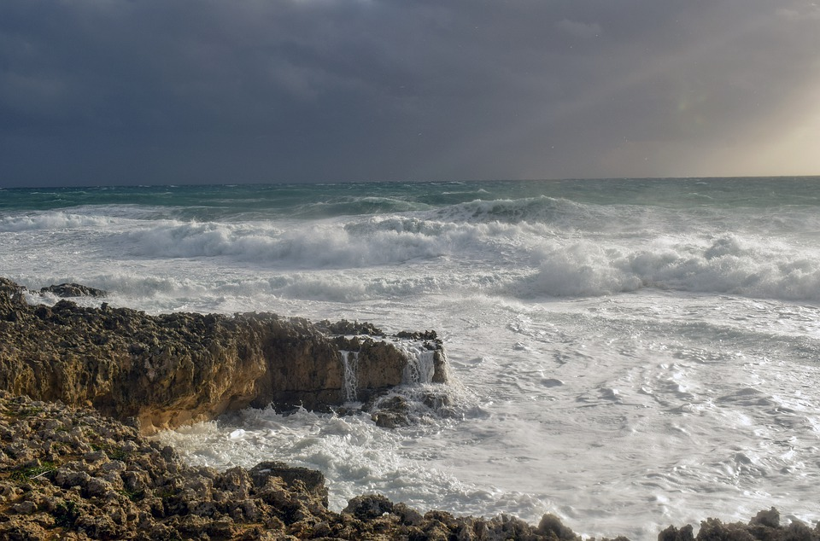
The Church Built Upon the Rock

Slide 2
United, Intent on One Purpose
The church was of one mind.
Acts 1:14; 2:46-47
Acts 15:7, 25
Ephesians 4:1-2
Their purpose is wonderfully illustrated in Acts 11:19-26.

Slide 3
A Community That Cares
The church took care of their own!
Acts 2:44-45
Acts 4:32, 34-35
It is not just physical!
Acts 8:14-15
Acts 11:20-22
Matthew 7:12; Galatians 6:1

Slide 4
A People That Prayerfully Persevere
They always met challenges the same way.
Acts 4:23-24, 31
Acts 5:40-42
Acts 6:6; 12:5; 13:1-3
We need to follow this example! (Acts 12)

