Slide 1
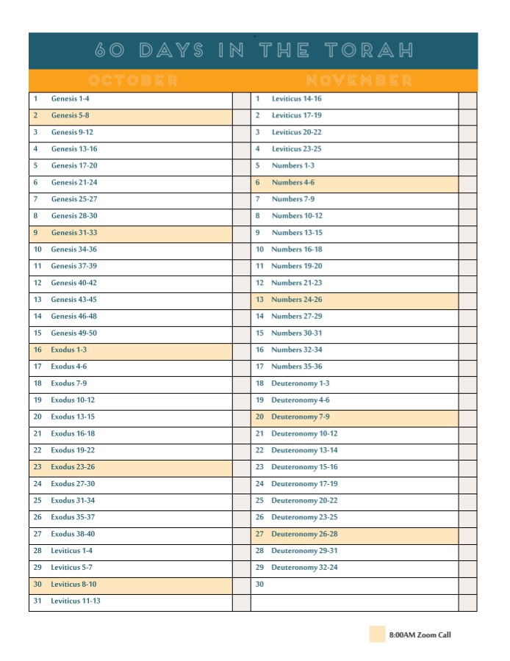

Slide 5
Before We Speak, Remember…
God cares deeply about everyone
All are made in His image (Gen. 1:27)
Christ was sent for all (1 Pet. 3:18; 1 Jn. 2:2; Jn. 3:16)
God desires all to be saved (1 Tim. 2:4; 2 Pet. 3:9)
We are to love those who identify as transgender
Jesus associated with those in sin because He loved them and wanted them to leave their sin (Matt. 9:10-11).
Loving someone does NOT mean agreeing with them!

Slide 6
Before We Speak, Remember…
“My sin is just as vile…”
Our sin might be different, but it’s equally condemnable (Rom. 3:23; 6:23; Gal. 5:19-21)
Everyone is in equal need of the cross!
The goal isn’t behavioral change, but heart change.
If we convince a person to leave a life of sin but not give their life to Jesus, the end result is the same.
Jesus is the only way to salvation (Jn. 14:6).

Slide 7
When we speak, tell them truth…
There is one source of objective truth
Transgenderism is about feelings and emotions. Neither are the standard of truth (Pr. 14:12; 28:26; Jer. 17:9).
Scripture is objective truth (2 Pet. 1:21; Ps. 119:89; 1 Pet. 1:25)

Slide 8
When we speak, tell them truth…
True Identity is Found in Christ
We were designed as male and female image bearers of God (Gen. 1:27)
Despite corrupting that image, Christ brings restoration (Rom. 3:23-24)
In Him, we know our true identity (Acts 2:38; Rom. 6:3, 11; 8:1; 12:5)

Slide 9
When we speak, tell them truth…
True Community is Found in Christ
In Christ we share a common redemptive story, a common objective. We are a spiritual family
Acts 2:44-47: a snapshot of Christian community
All are invited (Gal. 3:27-28; Matt. 11:28)

Slide 10
When we speak, tell them truth…
True Freedom is Found in Christ
Following desires is not passion, it’s slavery (Js. 1:14-15; Jn. 8:34; Rom. 6:1-23).
Freedom is found in submitting oneself to Christ (Jn. 8:36; Matt. 11:28)
We live out who we were designed to be
Become more conformed to the image of Christ
Increase our ability to resist the influence of sin

Slide 11
By the fifth edition of the DSM (2013), “Gender Identity Disorder” was replaced with “Gender Dysphoria” to remove the stigma associated with the word “disorder.” -
A Christian response to
transgenderism

