Slide 1
Showing Our Love by Obedience

Slide 2
John 14:15
“If you love me, keep my commands.

Slide 3
1 John 5:3
In fact, this is love for God: to keep his commands. And his commands are not burdensome,

Slide 4
^{Matthew 28:18-20}
¹⁸ And Jesus came and said to them, “All authority in heaven and on earth has been given to me. ¹⁹ Go therefore and make disciples of all nations, baptizing them in the name of the Father and of the Son and of the Holy Spirit, ²⁰ teaching them to observe all that I have commanded you. And behold, I am with you always, to the end of the age.”

Slide 5
^{Matthew 28:18-20}
¹⁸ And Jesus came and said to them, “All authority in heaven and on earth has been given to me. ¹⁹ Go therefore and make disciples of all nations, baptizing them in the name of the Father and of the Son and of the Holy Spirit, ²⁰ teaching them to observe all that I have commanded you. And behold, I am with you always, to the end of the age.”

Slide 6
^{Matthew 28:18-20}
¹⁸ And Jesus came and said to them, “All authority in heaven and on earth has been given to me. ¹⁹ Go therefore and make disciples of all nations, baptizing them in the name of the Father and of the Son and of the Holy Spirit, ²⁰ teaching them to observe all that I have commanded you. And behold, I am with you always, to the end of the age.”

Slide 7
^{Matthew 28:18-20}
¹⁸ And Jesus came and said to them, “All authority in heaven and on earth has been given to me. ¹⁹ Go therefore and make disciples of all nations, baptizing them in the name of the Father and of the Son and of the Holy Spirit, ²⁰ teaching them to observe all that I have commanded you. And behold, I am with you always, to the end of the age.”

Slide 8
go
Did Jesus give the particular way(s) to accomplish the command to go?

Slide 9
make disciples
^{Acts 8:35}
Then Philip opened his mouth, and beginning with this Scripture he told him the good news about Jesus.

Slide 10
baptizing them
1 Peter 3:21
Baptism, which corresponds to this, now saves you,

Slide 11
Greek: ἀγάπη, ης, ἡ
Transliteration: agapé Phonetic Spelling: (ag-ah'-pay)
Definition: love
LOVE

Slide 12
Greek: βαπτίζω
Transliteration: baptizó Phonetic Spelling: (bap-tid'-zo)
Definition: to sink, immerse, dip
Baptizing

Slide 13
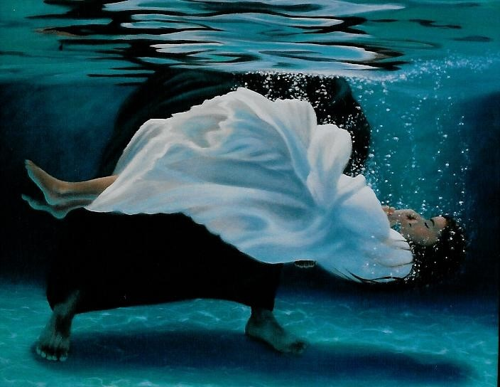
Transliteration: baptizó Phonetic Spelling: (bap-tid'-zo) Definition: to sink, immerse
βαπτίζω

Slide 14
Rom 6:4 We were buried therefore with him by baptism into death, in order that, just as Christ was raised from the dead by the glory of the Father, we too might walk in newness of life.

Slide 15
“You have a fine way of setting aside the commands of God in order to observe your own traditions!
Mark 7:9

Slide 16
--We show our love to Jesus by keeping His commandments.
--Expediencies have to be lawful and cannot change the command
--We must not allow emotional circumstances to change what God has commanded.
--We should always be willing to examine our actions.
Key Points

Slide 17
With this lesson in mind the elders want all of us to consider what the scripture teaches us for the proper mode for the Lord’s Day assembly .
Elder’s Request

Slide 18
