Slide 1
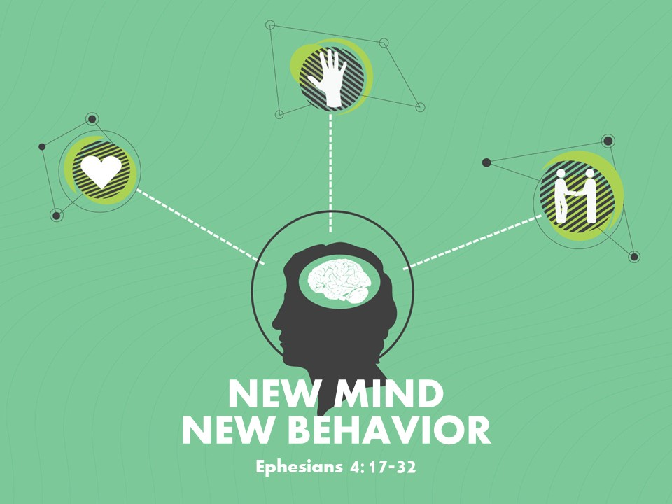

Slide 2
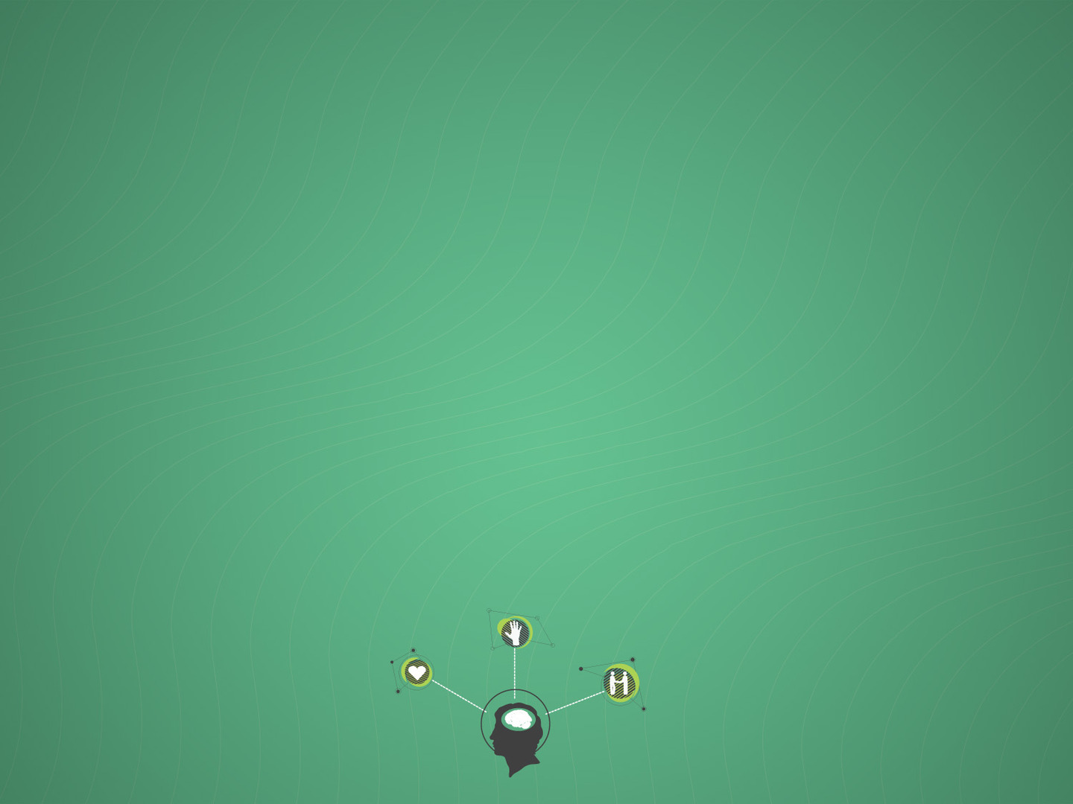
Ephesians 4:22-23
²² to put off your old self, which belongs to your former manner of life and is corrupt through deceitful desires, ²³ and to be renewed in the spirit of your minds,

Slide 3
Ephesians 4:19
They have become callous and have given themselves up to sensuality, greedy to practice every kind of impurity.

Slide 4
Luke 6:45
The good person out of the good treasure of his heart produces good, and the evil person out of his evil treasure produces evil, for out of the abundance of the heart his mouth speaks.

Slide 5
New Life Behavior
Honesty (v. 25)
Lying is a big deal (Pr. 6:16-19; 12:22; 19:9; Rev. 21:8)
Lying is an act of selfishness
Christians should be honest because we’re not focused on self, but are members of one another

Slide 6
New Life Behavior
Patience (v. 26)
Anger is an abandonment of self-control (Titus 2:12)
Anger damages relationships and our impact in the Kingdom
Christian anger should be without sin
Dealt with quickly; processed with wisdom
Cf. Matt. 11:15-17

Slide 7
New Life Behavior
Hard Work and Generosity (v. 28)
Theft can be stealing possessions… or time
Christians are to work as for the Lord (Col. 3:32)
Hard work should produce a spirit of generosity (cf. Acts 2:44-45)

Slide 8
New Life Behavior
Wholesome Speech (v. 29)
Corrupting speech = damages and destroys; Wholesome speech = uplifts, strengthens and unifies

Slide 9
Before We Speak, THINK!
T – Is it TRUE?
H – Is it HELPFUL?
I – Is it INSPIRING?
N – Is it NECESSARY?
K – Is it KIND

Slide 10
New Life Behavior
Seeks to honor God (v. 30)
We are sealed (identified) with God by His Spirit
Our sins grieve the Spirit of our Father, like the sins of a child grieve a parent

Slide 11
Ephesians 4:31-32
³¹ Let all bitterness and wrath and anger and clamor and slander be put away from you, along with all malice. ³² Be kind to one another, tenderhearted, forgiving one another, as God in Christ forgave you.
New life behavior seeks the betterment of others

Slide 13
NEW MIND
NEW BEHAVIOR
Ephesians 4:17-32

