Slide 2
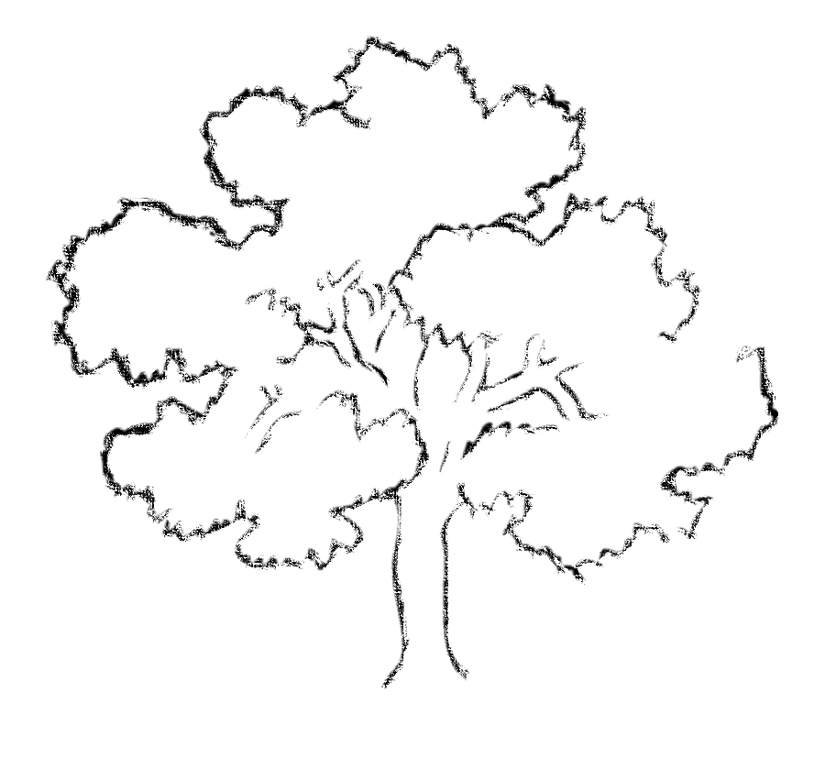
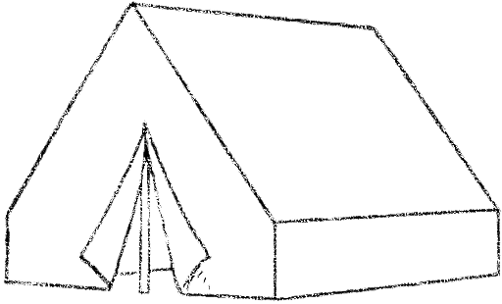
God is not distant and uninvolved. He desires to be with His people.

Slide 3
Genesis 1:1
In the beginning, God created the heavens and the earth.

Slide 4
God’s Presence in the Garden…
God talked with His creation
Communicated His instructions and provisions (Gen. 1:28-30; 2:16-17
God walked with His creation
Appeared to be a common occurrence (Gen. 3:8)
God’s presence removed because of sin
Eden blocked and guarded by cherubim with flaming swords (Gen 3:22-24)

Slide 5
God’s Presence in the Tabernacle
Details point back to Eden
Vegetation/garden imagery (Ex. 25:32-33; 1 Kgs. 6:18, 29)
Precious materials (Gen. 2:10-12; 1 Chr. 29:1-2)
Priesthood (Gen. 2:15; Num. 3:7)
Adam was to `abad and shamar the garden
Priests were to `abad and shamar the temple

Slide 6
God’s Presence in the Tabernacle
Details point back to Eden
The dwelling place of God (Ex. 25:8; 40:34-35; 2 Chr. 7:1-2)
Guarded by cherubim (Gen. 3:24; Ex. 31:32)
Garden = NO access; Tabernacle = LIMITED access
God is working toward full reconciliation with His people

Slide 7
God’s Presence in the Jesus
Jesus is God incarnate (Jn. 1:1; 8:58; Col. 2:9; Is. 9:6)
Jesus came to dwell with his disciples
“dwell” in Jn. 1:14 means “tabernacle”
Jesus is the embodiment of the tabernacle (Jn. 1:14; 2:18-21)
Jesus’ death once again brought access to God (Matt. 27:51; Heb. 10:19-25)

Slide 8
Because of Christ’s sacrifice, we are now in His presence as His temple
1 Cor. 3:16; 6:19-20; 2 Cor. 6:16-17; Eph. 2:19-22

Slide 9
God’s Presence in the Heavenly Garden
Heaven is the spiritual and eternal Eden
Full presence of God (Rev. 21:2-4; 22:3-5)
River of waters of life (Rev. 22:1; cf. Gen. 2:10-14)
Tree of Life (Rev. 22:2; cf. Gen. 2:9)
Absence of corruption (Rev. 22:3; cf. Gen. 1:31)
Heaven is the spiritual and eternal temple
The true Holy of Holies (Rev. 21:16; cf. Ezk. 41:4)
A place of precious materials (Rev. 21:18, 21; cf. 1 Kgs. 6:19-21)

Slide 11
God’s Presence With His People
Discovering god’s plan of Reconciliation

