Slide 1
Photo credit: minted.com
Designed by: Robert and Stella

Slide 2
Photo credit: minted.com
Designed by: Kelsey Mucci

Slide 3
Photo credit: minted.com
Designed by: Erica Krystek

Slide 4
Photo credit: minted.com
Designed by: Danie Romwell

Slide 6
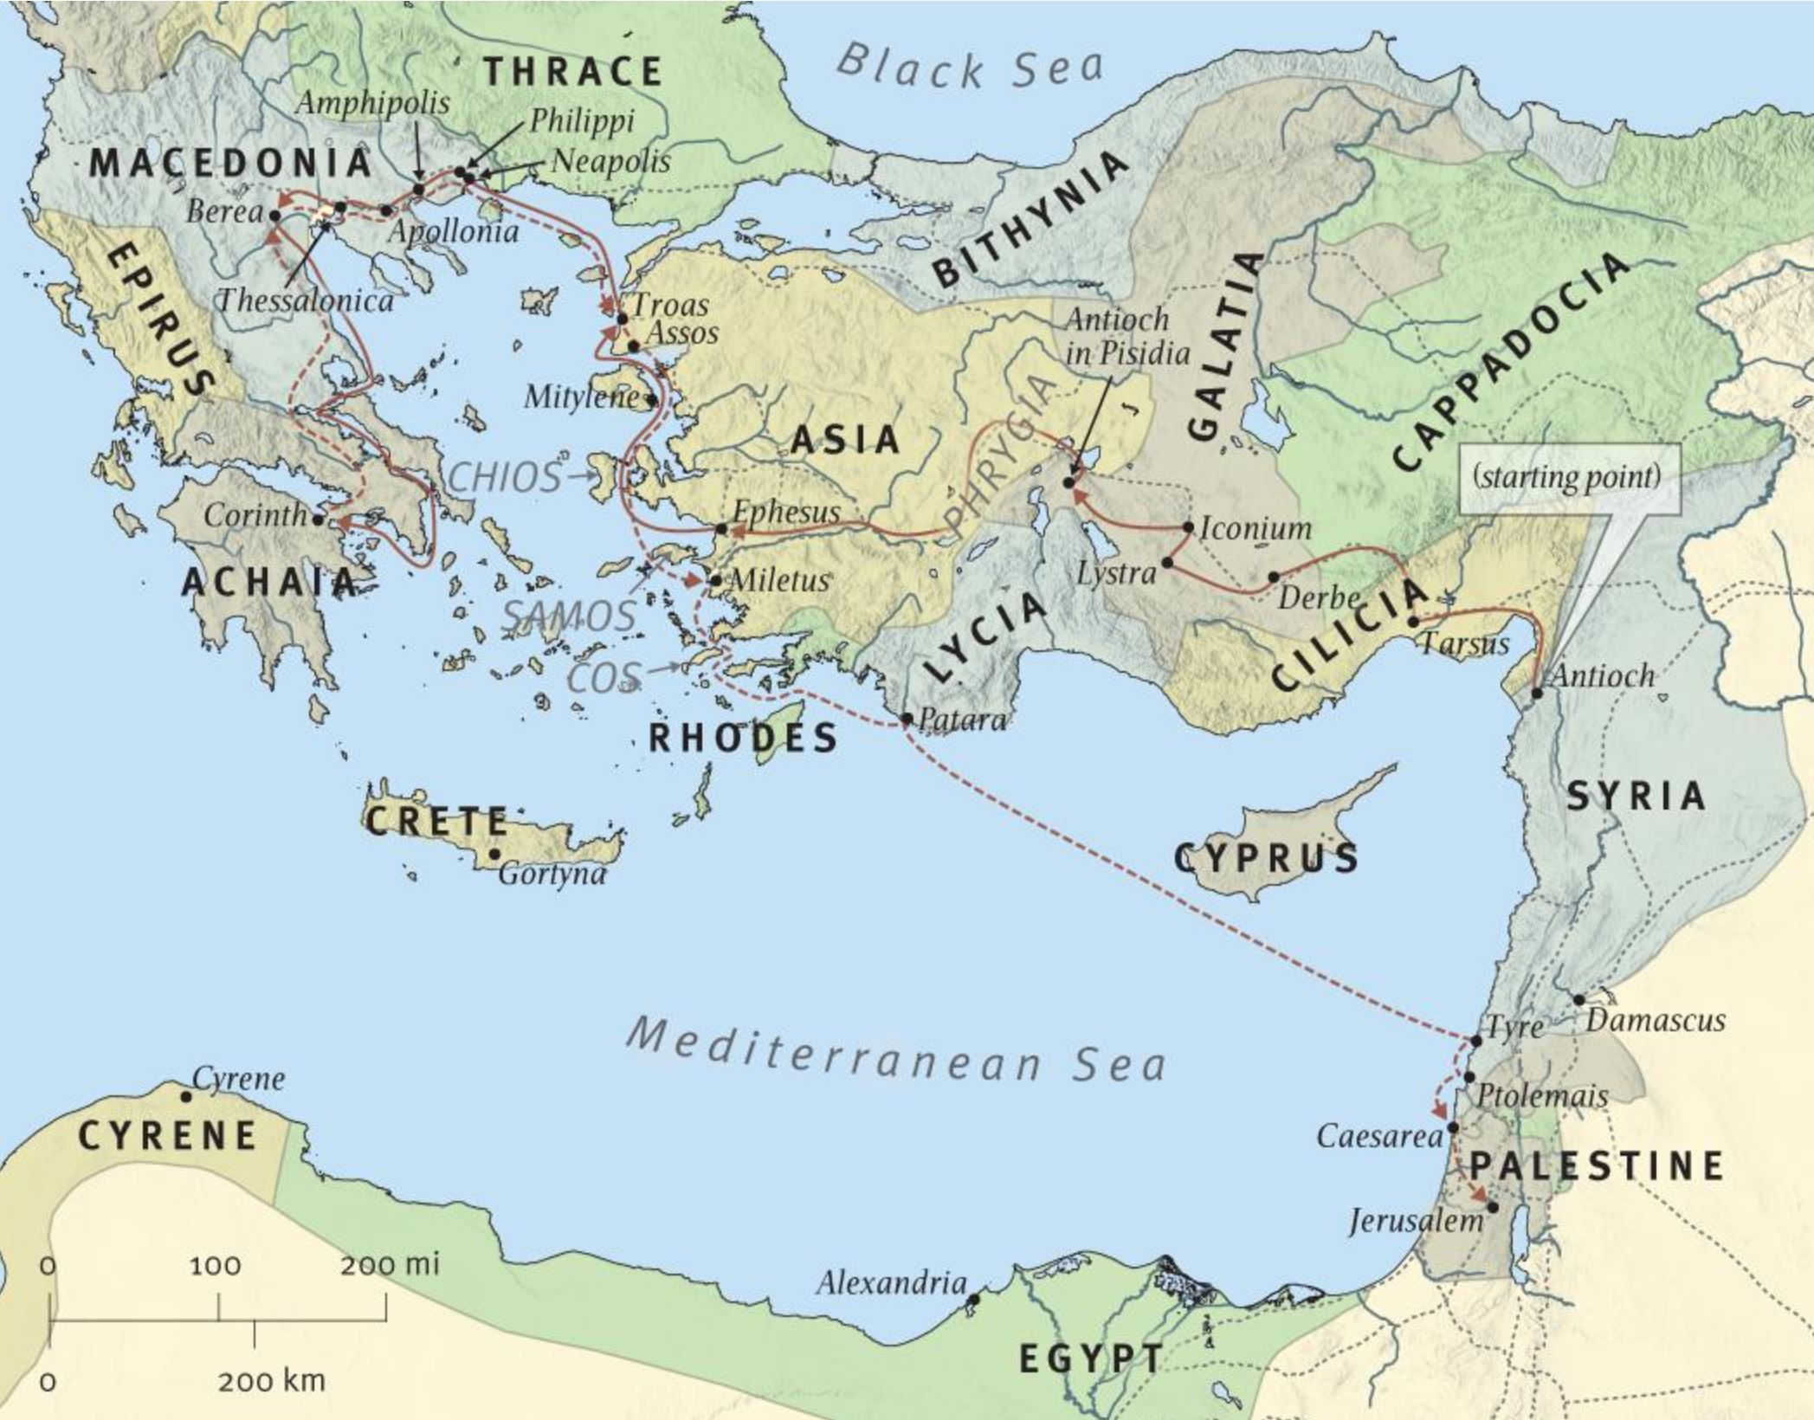
ESV Study Bible

Slide 7
Ephesians: Two Distinct Halves
Chapters 1-3 – Spiritual blessings in Christ
Chapters 4-6 – Living as a result of blessing

Slide 8
Spiritual Blessings in 2020
Redemption (Eph. 1:7)
Bought back from spiritual slavery (Rom. 6:22)
Purchased with Christ’s blood (Heb. 9:13-14)
Not because of meritorious works, but God’s grace (Eph. 2:8-9)
Spiritual Adoption (1:6)
been given a sense of purpose and belonging
We await a future inheritance (1:13b-14)

Slide 9
Spiritual Blessings in 2020
III. Life in Christ (2:1-6)
We were spiritually dead (facing eternal spiritual destruction, unable to help ourselves)
Future implication (eternal life in the presence of God)
Present implication (created for good works)
Spiritual Family (2:13-19)
Christ unites people from all backgrounds and brings them into one family.
We are “one.”
Peace, not hostility, is to be present in our family

Slide 10
Spiritual Blessings in 2020
Access to the Father (2:28, 22; 3:12)
We are in His presence as His temple (2:22; cf. 1 Cor. 3:16)
We can approach with boldness and confidence.
Do we take advantage of this privilege? (Heb. 4:16)
Utilize this privilege by praying for spiritual strength. For ourselves, and others (Eph. 3:14-21)

