Slide 1
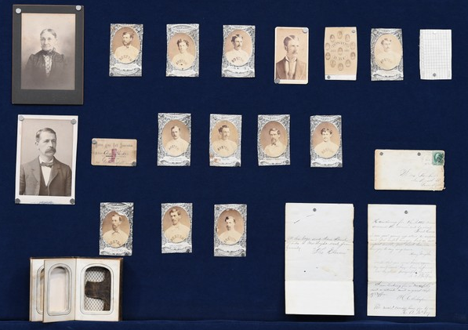
pbs.org/wgbh/roadshow

Slide 2
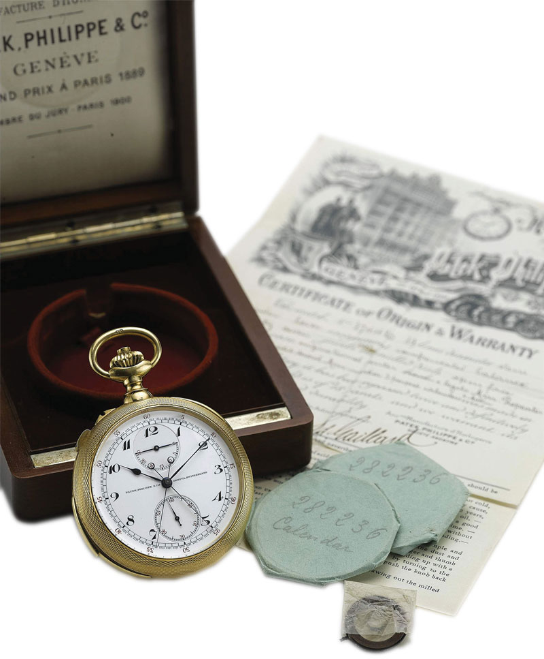
artfulliving.com

Slide 3
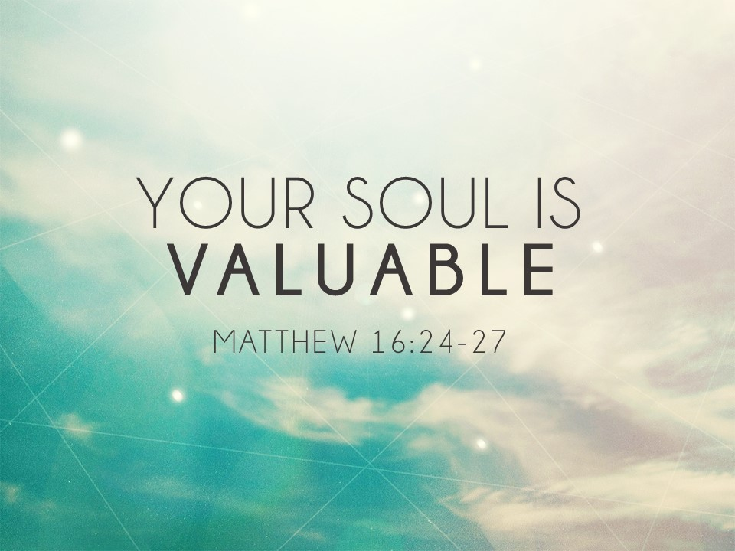

Slide 4
Soul
The aspect of our personhood that is not dependent on, and exists apart from, our physical bodies.
Matt. 10:28; Gen. 35:18

Slide 5
Why So Valuable?
Fashioned by the Divine Creator
Col. 1:16
It’s immortal
Created in His image (Gen. 1:27)
We have a beginning, but not an end.
We’ve only got one
Cannot be replaced
Consider Ezk. 18:20; Heb. 9:27-28

Slide 6
We can lose our soul!
By cutting a deal with Satan
Nothing he has to offer is worth it (1 Jn. 2:15-17; Jn. 8:44)
Eternally devastating results
Separation from God
A life void of spiritual blessings through Christ (Eph. 1:3-5)
An eternity of anguish (2 Thess. 1:9)
Not a Christian? This is your soul’s condition
Rom. 3:23; 6:23; 1 Thess. 1:9

Slide 7
God is The Redeemer of Souls
Our souls can only be bought back with the blood of Christ (1 Pet. 1:18-19)
Entrust Your Soul to Christ
God promises to secure your soul (Jn. 10:27-29).
Deny yourself and live for Him (Matt. 16:24-26)

Slide 8
Now is the time to respond to Christ’s love.
Repent of your sins (2 Pet. 3:9)
Confess Christ as Lord (Rom. 10:9)
Be baptized for the forgiveness of sin (Acts 2:38)

Slide 10
YOUR SOUL IS
VALUABLE
MATTHEW 16:24-27

