Slide 1
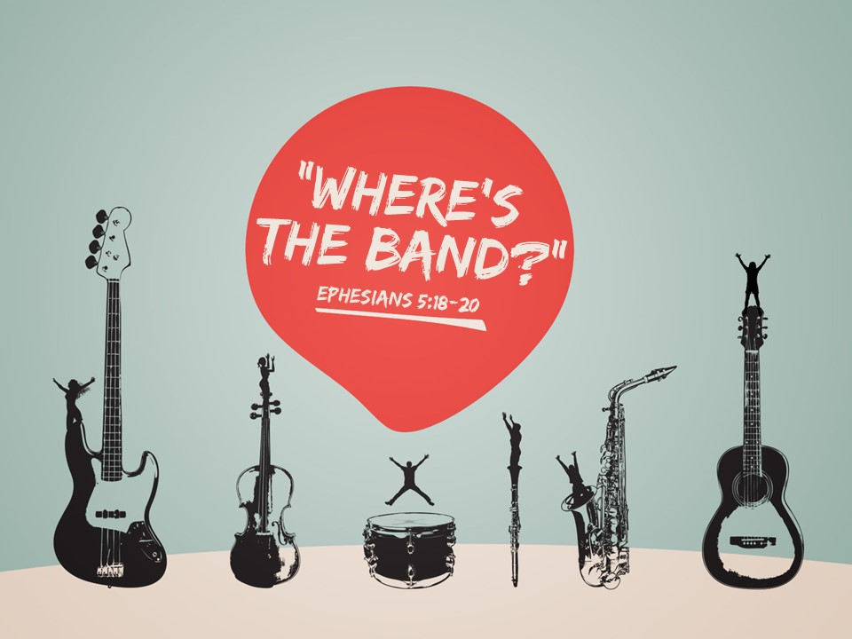

Slide 2
“We render our hymn with a living psalterion and a living cithara with spiritual songs. The unison voices of Christians would be more acceptable to God than any musical instrument.”
- Eusebius, commentary on Psalm 91:2-3

Slide 3
“I have no objection to instruments of music in our worship, provided they are neither seen nor heard."
- John Wesley, (quoted in Adam Clarke’s
Commentary, Vol. IV, p. 685)

Slide 4
"…could this be adduced with any semblance of reason, that [instruments] ought to be used in Christian worship? No; the whole spirit, soul, and genius of the Christian religion are against this; and those who know the Church of God best, and what constitutes its genuine spiritual state, know that these things have been introduced as a substitute for the life and power of religion; and that where they prevail most, there is least of the power of Christianity. Away with such portentous baubles from the worship of that infinite Spirit who requires His followers to worship Him in spirit and
truth, for to no such worship are these instruments friendly."
- Adam Clarke, Clarke's Commentary,
Vol. II, pp. 690-691

Slide 5
“What a degradation to supplant the intelligent song of the whole congregation by the theatrical prettinesses of a quartette, the refined niceties of a choir, or the blowing off of wind from inanimate bellows and pipes! We might as well pray by machinery as praise by it”
- Charles Haddon Spurgeon,
Commentary on Psalm 42:4

Slide 6
“Although Josephus tells of the wonderful effects produced in the Temple by the use of instruments of music, the first Christians were of too spiritual a fiber to substitute lifeless instruments for or to use them to accompany the human voice”
- The Catholic Encyclopedia, p. 651

Slide 7
Instruments in the Old Testament
- Psalm 33:2; 98:6; 150:3
- 1 Chronicles 15:15-16
- 2 Chronicles 29:25-28
Instruments in the New Testament…

Slide 8
John 4:19-21
¹⁹ The woman said to him, “Sir, I perceive that you are a prophet. ²⁰ Our fathers worshiped on this mountain, but you say that in Jerusalem is the place where people ought to worship.” ²¹ Jesus said to her, “Woman, believe me, the hour is coming when neither on this mountain nor in Jerusalem will you worship the Father...

Slide 9
John 4:23-24
²³ But the hour is coming, and is now here, when the true worshipers will worship the Father in spirit and truth, for the Father is seeking such people to worship him. ²⁴ God is spirit, and those who worship him must worship in spirit and truth.”

Slide 10
Christians offer worship that is spiritual and true to God’s will, character, and nature.

Slide 11
Physical Temple of the OT
- 1 Kings 8:20-21
- 1 Chr. 22:1-6
Spiritual Temple of the NT
- 1 Cor. 6:19-20; 3:16-17
- Eph. 2:19-21

Slide 12
Physical Sacrifices of the OT
- Nehemiah 28
- 1 Kings 8:62-64
Spiritual Sacrifices of the NT
- 1 Pet. 2:4-5
- Rom. 12:1
- Heb. 13:15

Slide 13
Spiritual Instrument of the New Testament:
The Heart
Ephesians 5:18-20
¹⁸ And do not get drunk with wine, for that is debauchery, but be filled with the Spirit, ¹⁹ addressing one another in psalms and hymns
and spiritual songs, singing and making melody
to the Lord with your heart, ²⁰ giving thanks
always and for everything to God the Father
in the name of our Lord Jesus Christ,

Slide 14
Spiritual Instrument of the New Testament:
The Heart
Col. 3:16-17
¹⁶ Let the word of Christ dwell in you richly, teaching and admonishing one another in all wisdom, singing psalms and hymns and spiritual songs, with thankfulness in your hearts to God.
¹⁷ And whatever you do, in word or deed, do everything in the name of the Lord Jesus,
giving thanks to God the Father
through him.

Slide 15
"Musical instruments in celebrating the praises of God would be no more suitable than the burning of incense, the lighting of lamps, and the restoration of the other shadows of the law.”
- John Calvin, Commentary on Psalms 33

Slide 16
What about the instruments in heaven?
(Rev. 5:8; 14:1-2; 15:2…)
- Heaven is a spiritual realm
Items described in heaven are not physical
in nature (see 2 Pet. 3:10; Rev. 5b; 14:2)
- Caution must be taken before saying
something in the spiritual realm gives
approval for something in the
physical realm.

Slide 17
Only the spiritual worship of the heart can…
- Praise God
Eph. 5:19b-20
- Teach and Admonish
Col. 3:16-17

