Slide 2
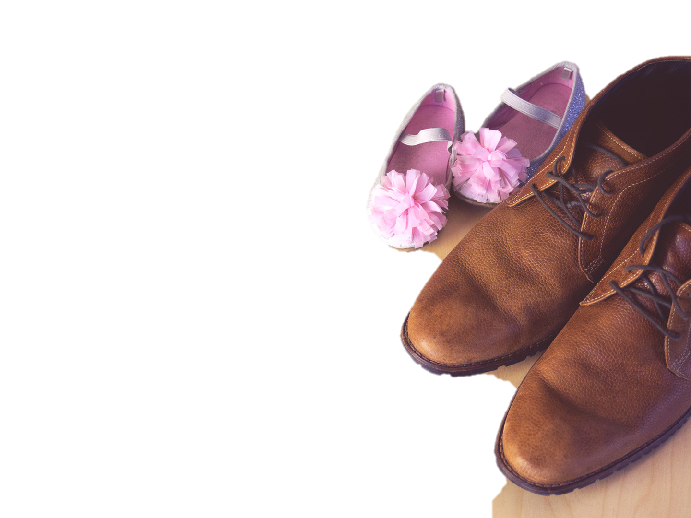
Mark 5:21
²¹ And when Jesus had crossed again in the boat to the other side, a great crowd gathered about him, and he was beside the sea.

Slide 3
Mark 5:21-23
²¹ And when Jesus had crossed again in the boat to the other side, a great crowd gathered about him, and he was beside the sea.
²² Then came one of the rulers of the synagogue, Jairus by name, and seeing him, he fell at his feet ²³ and implored him earnestly, saying, “My little daughter is at the point of death. Come
and lay your hands on her, so that she
may be made well and live.”

Slide 4
Mark 5:24
²⁴ And he went with him.

Slide 5
Mark 5:24-28
²⁴ And he went with him.
And a great crowd followed him and thronged about him. ²⁵ And there was a woman who had had a discharge of blood for twelve years, ²⁶ and who had suffered much under many physicians, and had spent all that she had, and was no better but rather grew worse. ²⁷ She had
heard the reports about Jesus and came
up behind him in the crowd and touched
his garment. ²⁸ For she said, “If I touch
even his garments, I will be made well.”

Slide 6
Mark 5:29-31
²⁹ And immediately the flow of blood dried up, and she felt in her body that she was healed of her disease. ³⁰ And Jesus, perceiving in himself that power had gone out from him, immediately turned about in the crowd and said, “Who touched my garments?” ³¹ And his disciples said to him, “You see the crowd
pressing around you, and yet you say,
‘Who touched me?’”

Slide 7
Mark 5:32-34
³² And he looked around to see who had done it. ³³ But the woman, knowing what had happened to her, came in fear and trembling and fell down before him and told him the whole truth. ³⁴ And he said to her, “Daughter, your faith has made you well; go in peace, and be healed of your disease.”

Slide 8
Mark 5:35-36
³⁵ While he was still speaking, there came from the ruler's house some who said, “Your daughter is dead. Why trouble the Teacher any further?” ³⁶ But overhearing what they said, Jesus said to the ruler of the synagogue, “Do not fear, only believe.”

Slide 9
Mark 5:37-40a
³⁷ And he allowed no one to follow him except Peter and James and John the brother of James. ³⁸ They came to the house of the ruler of the synagogue, and Jesus saw a commotion, people weeping and wailing loudly. ³⁹ And when he had entered, he said to them, “Why are you making a commotion and
weeping? The child is not dead but
sleeping.” ⁴⁰ And they laughed at him.

Slide 10
Mark 5:40b-43
^{40b} But he put them all outside and took the child's father and mother and those who were with him and went in where the child was. ⁴¹ Taking her by the hand he said to her, “Talitha cumi,” which means, “Little girl, I say to you, arise.” ⁴² And immediately the girl got up and began walking (for she was twelve
years of age), and they were immediately
overcome with amazement. ⁴³ And he
strictly charged them that no one should
know this, and told them to give her
something to eat.

Slide 11
We Need Fathers Who…
- See their need for Jesus
John 6:63; 15:4-5; Pr. 3:5-6
- Know their children need Jesus
Pray – 1 Chr. 29:19
Teach – Eph. 6:4; Deut. 6:7-8
Be an Example – Ti. 2:6-8; Jms. 1:22
- Trust in the power of Jesus in
Difficult Times
Rom. 5:3-5; Jms. 1:2-3

