Slide 1
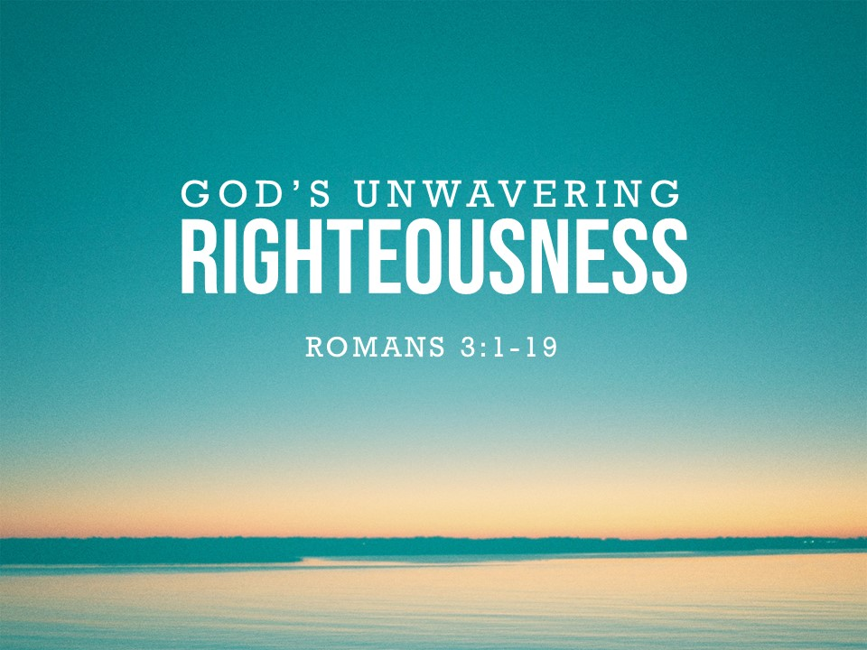

Slide 2
Question #1
¹ Then what advantage has the Jew? Or what is the value of circumcision?
² Much in every way. To begin with, the Jews were entrusted with the oracles of God.
Deut. 4:5-8; Ps. 147:19-20

Slide 3
Question #2
³ What if some were unfaithful? Does their faithlessness nullify the faithfulness of God?
⁴ By no means! Let God be true though every one were a liar, as it is written,
“That you may be justified in your words,
and prevail when you are judged.”
2 Tim. 2:13; Ps. 51:4

Slide 4
Question #3
⁵ But if our unrighteousness serves to show the righteousness of God, what shall we say? That God is unrighteous to inflict wrath on us? (I speak in a human way.)
⁶ By no means! For then how could God judge the world?
See 1 Pet. 4:5; 2 Tim. 4:1; Rom. 2:3

Slide 5
Question #4
⁷ But if through my lie God's truth abounds to his glory, why am I still being condemned as a sinner? ⁸ And why not do evil that good may come?
^{8b} Their condemnation is just

Slide 6
Question #5
⁹ What then? Are we Jews any better off?
No, not at all. For we have already charged that all, both Jews and Greeks, are under sin,
vv. 10-18 see Ps. 14:2, 3; 5:10; 140:3;
10:7; 36:7; Isa. 59:7, 8

Slide 7
Takeaways
When it comes to getting right with God, what excuses are you making?
All are guilty and in need of God’s salvation
Even if we are unfaithful to Him, God will always keep His promises

