Slide 2
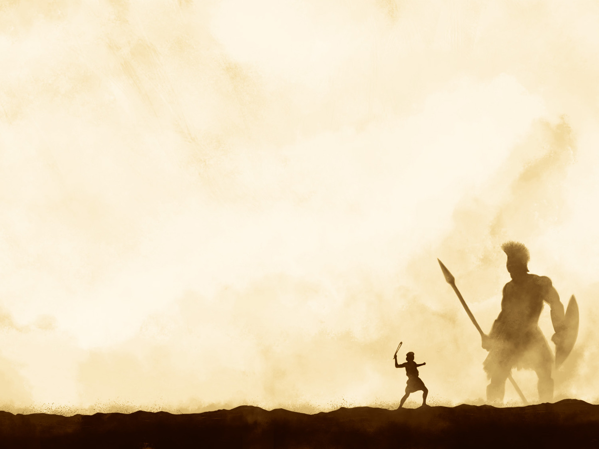
Godly leaders are servant leaders
1 Sam. 17:17-20; Matt. 20:26-28; Jn. 13:12-16
Godly warriors keep their eyes on God
1 Sam. 17:26; Heb. 12:1-2; Col. 3:1-2

Slide 3
God gives us confidence to do great things despite the doubts and fears of others
1 Sam. 17:32-37; Phil. 4:13
Let past moments of God’s deliverance embolden you in the present
1 Sam. 17:34-37; Ps. 34:17; Gal. 5:1
God has equipped us to face the giants
in our lives
1 Sam. 17:44-47; 2 Cor. 10:3-4; Eph. 6:12-18

Slide 4
Spiritual victory is found through
faith in Jesus Christ
1 Jn. 1:1-5; Jn. 14:6; 1 Cor. 15:20-24

