Slide 1
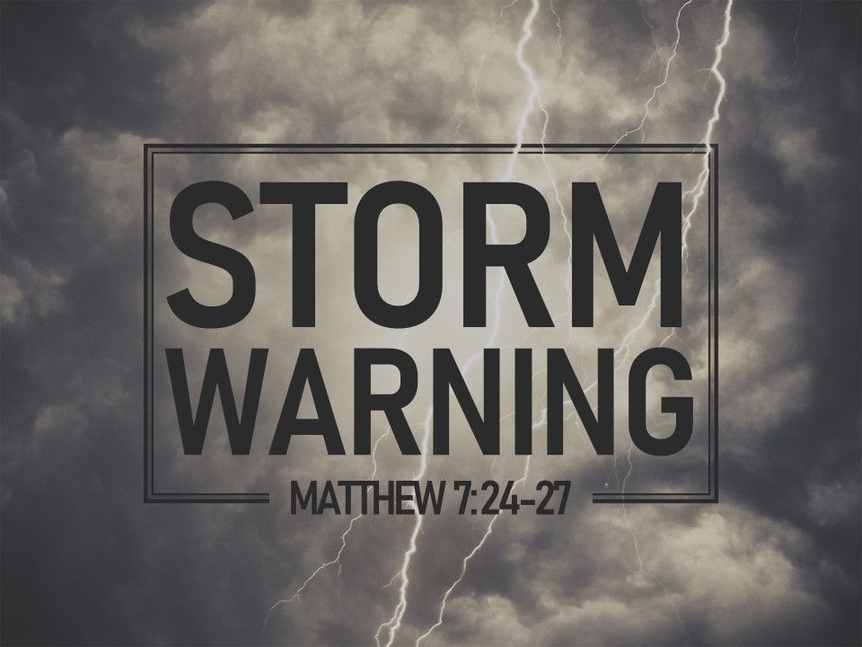

Slide 2
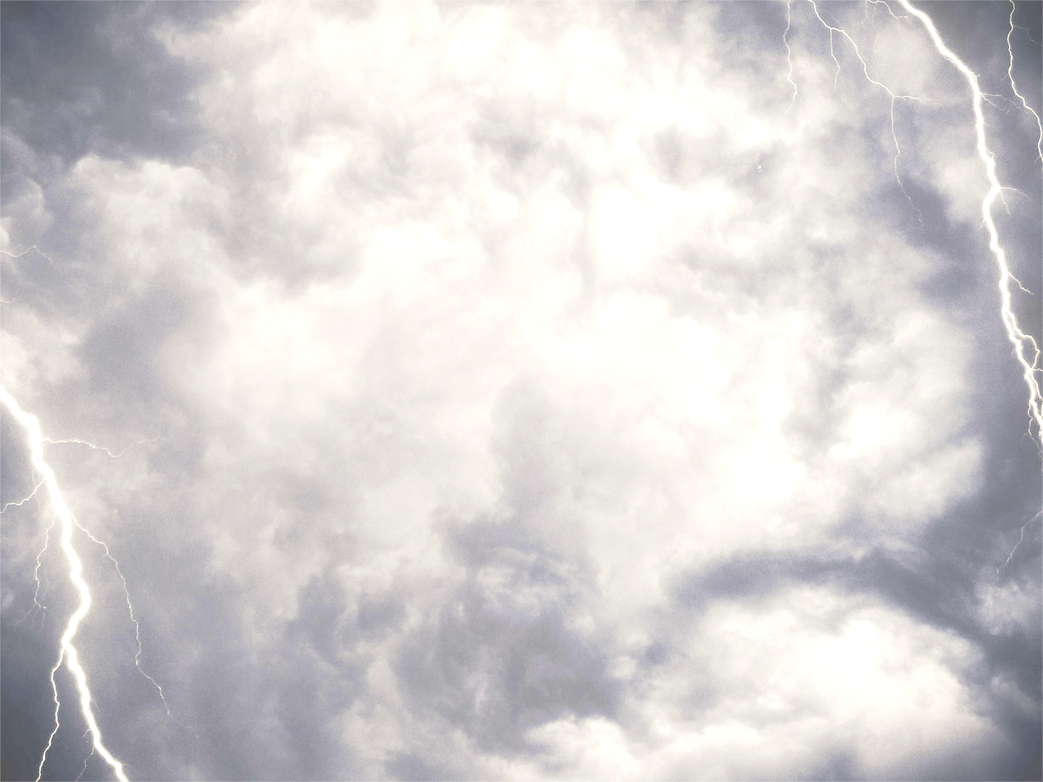
Matthew 7:28-29
²⁸ And when Jesus finished these sayings, the crowds were astonished at his teaching, ²⁹ for he was teaching them as one who had authority, and not as their scribes.

Slide 3
Matthew 7:24-27
²⁴ “Everyone then who hears these words of mine and does them will be like a wise man who built his house on the rock. ²⁵ And the rain fell, and the floods came, and the winds blew and beat on that house, but it did not fall, because it had been founded on the rock. ²⁶ And everyone who hears these words of mine and does not do them will be like a foolish man who built his house on the sand. ²⁷ And the rain fell, and the floods came, and the winds blew and beat against that house, and it fell, and great was the fall of it.”

Slide 4
James 1:22-25
²² But be doers of the word, and not hearers only, deceiving yourselves. ²³ For if anyone is a hearer of the word and not a doer, he is like a man who looks intently at his natural face in a mirror. ²⁴ For he looks at himself and goes away and at once forgets what he was like. ²⁵ But the one who looks into the perfect law, the law of liberty, and perseveres, being no hearer who forgets but a doer who acts, he will be blessed in his doing.

Slide 5
Matthew 7:24-27
²⁴ “Everyone then who hears these words of mine and does them will be like a wise man who built his house on the rock. ²⁵ And the rain fell, and the floods came, and the winds blew and beat on that house, but it did not fall, because it had been founded on the rock. ²⁶ And everyone who hears these words of mine and does not do them will be like a foolish man who built his house on the sand. ²⁷ And the rain fell, and the floods came, and the winds blew and beat against that house, and it fell, and great was the fall of it.”

