Slide 3
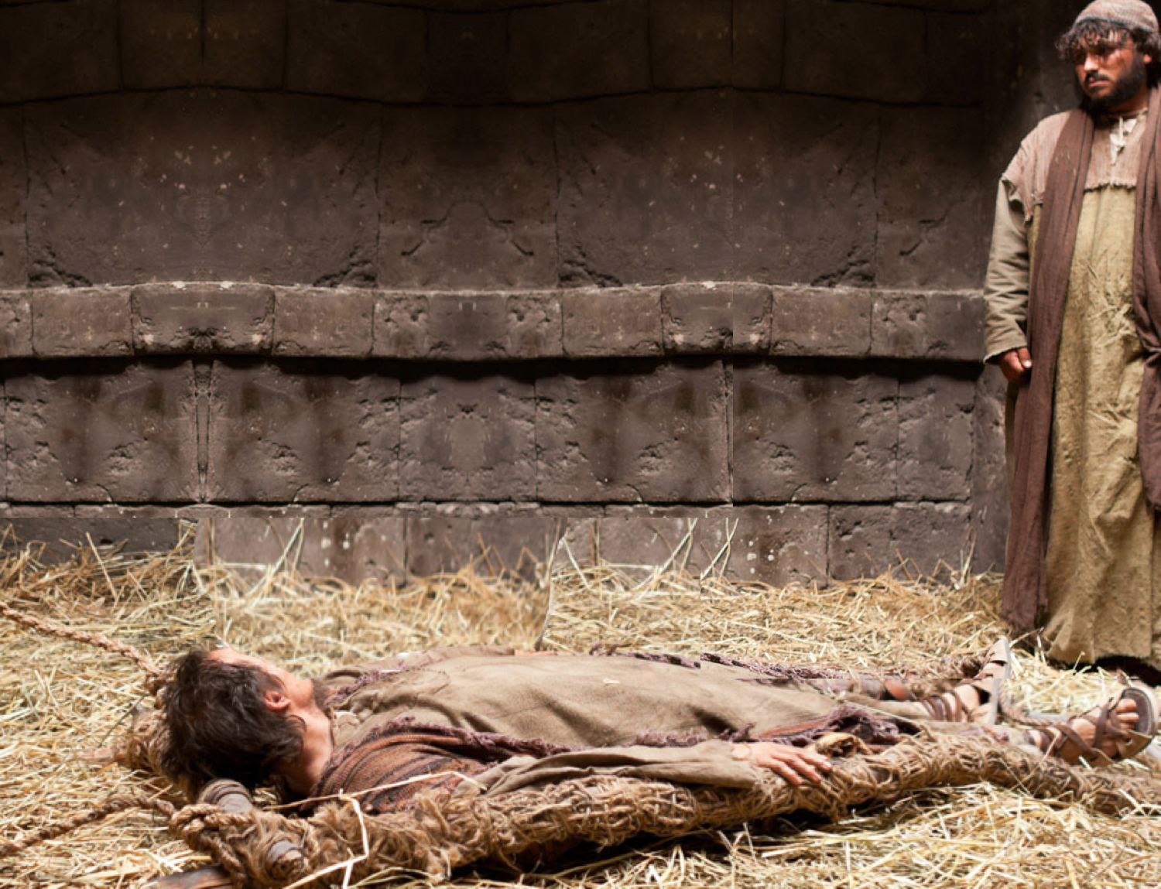
A bleak future
Sympathy the only prescription
Horizontal life
Dependency
Humiliation

Slide 4
ONE POSITIVE WORD!
Friends
With exciting news…

Slide 5
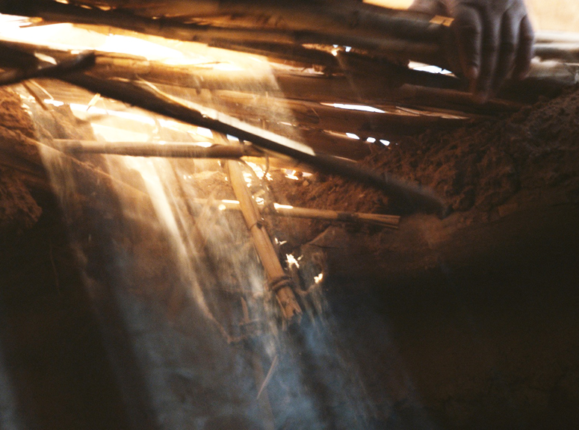
What did the scene look like?

Slide 6
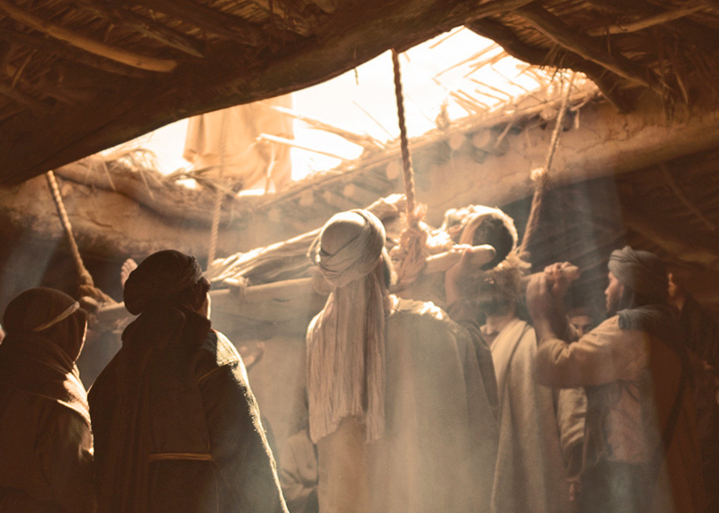
Jesus meets the paralytic.
FAITH IS SEEN !

Slide 7
Jesus meets the paralytic.
FAITH MOVES !

