Slide 1
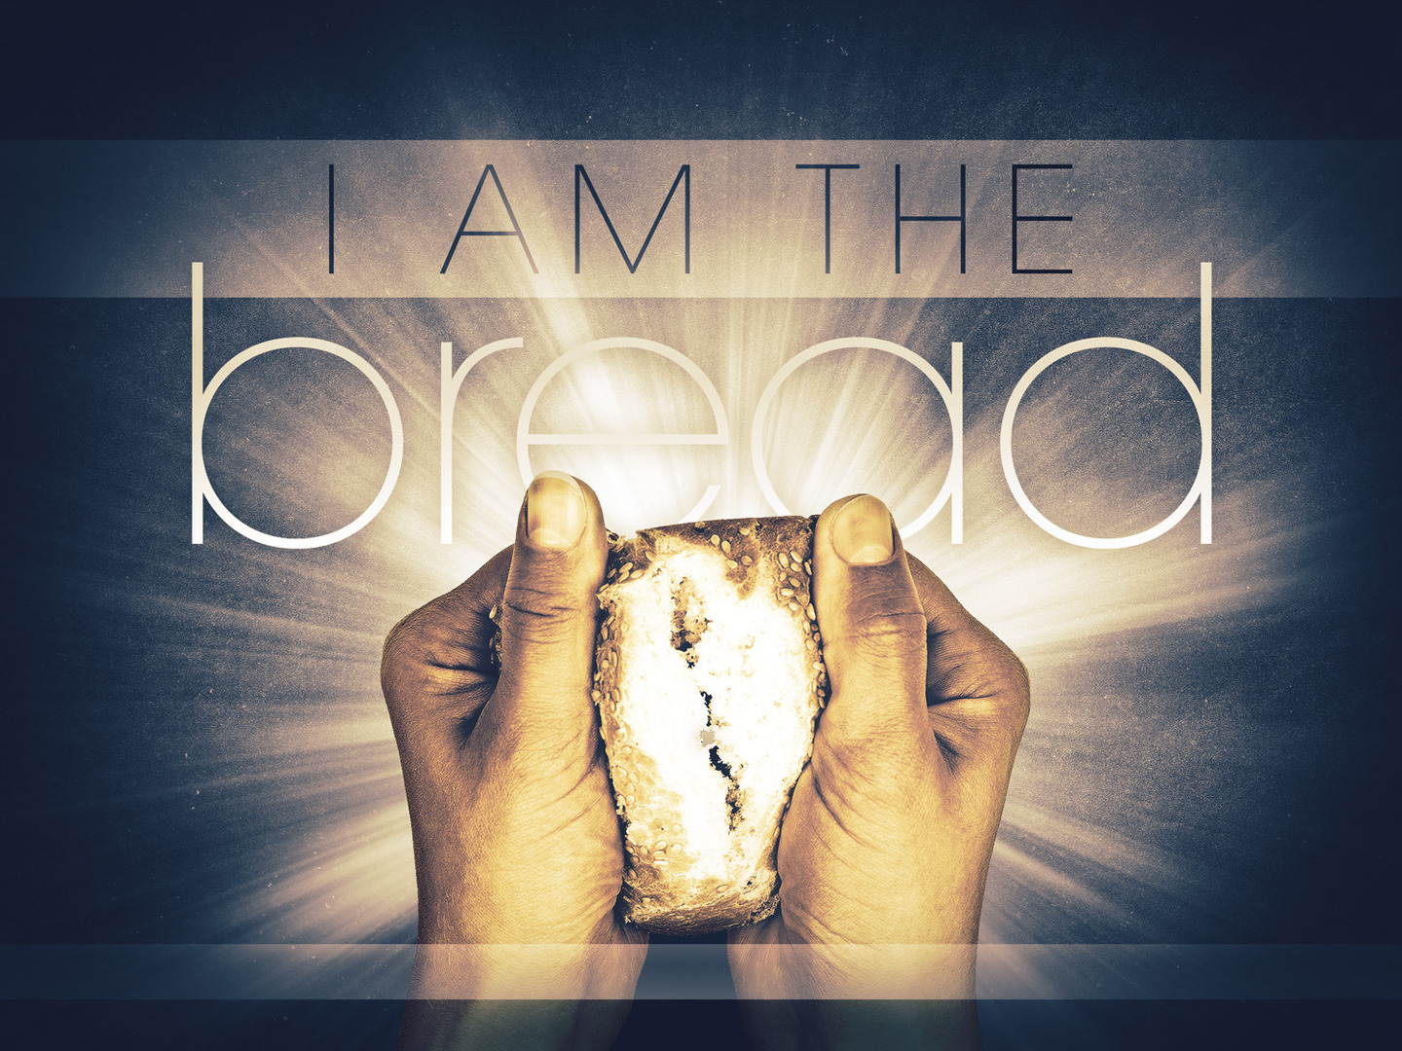
JOHN 6

Slide 2
John 6:14-15
When the people saw the sign that he had done, they said, “This is indeed the Prophet who is to come into the world!”
Perceiving then that they were about to come and take him by force to make him king, Jesus withdrew again to the mountain by himself.

Slide 3
John 6:26-27
“Truly, truly, I say to you, you are seeking me, not because you saw signs, but because you ate your fill of the loaves. Do not work for the food that perishes, but for the food that endures to eternal life, which the Son of Man will give to you. For on him God the Father has set his seal.”

Slide 4
John 6:28-29
Then they said to him, “What must we do, to be doing the works of God?”
Jesus answered them, “This is the work of God, that you believe in him whom he has sent.”

Slide 5
John 6:30-31
So they said to him, “Then what sign do you do, that we may see and believe you? What work do you perform? Our fathers ate the manna in the wilderness; as it is written, He gave them bread from heaven to eat.’”

Slide 6
John 6:49
Your fathers ate the manna in the wilderness, and they died. This is the bread that comes down from heaven, so that one may eat of it and not die.

Slide 7
John 6:34-35
They said to him, “Sir, give us this bread always.”
“I am the bread of life; whoever comes to me shall not hunger, and whoever believes in me shall never thirst.”

Slide 8
John 6:38-40
For I have come down from heaven, not to do my own will but the will of him who sent me. And this is the will of him who sent me, that I should lose nothing of all that he has given me, but raise it up on the last day. For this is the will of my Father, that everyone who looks on the Son and believes in him should have eternal life, and I will raise him up on the last day.”

Slide 9
John 6:41-42
So the Jews grumbled about him, because he said, “I am the bread that came down from heaven.” They said, “Is not this Jesus, the son of Joseph, whose father and mother we know? How does he now say, ‘I have come down from heaven’?”

Slide 10
John 6:51
I am the living bread that came down from heaven. If anyone eats of this bread, he will live forever. And the bread that I will give for the life of the world is my flesh.”

Slide 11
John 6:52-54
The Jews then disputed among themselves, saying, “How can this man give us his flesh to eat?” So Jesus said to them, “Truly, truly, I say to you, unless you eat the flesh of the Son of Man and drink his blood, you have no life in you. Whoever feeds on my flesh and drinks my blood has eternal life, and I will raise him up on the last day.

Slide 12
John 6:55-58
For my flesh is true food, and my blood is true drink. Whoever feeds on my flesh and drinks my blood abides in me, and I in him. As the living Father sent me, and I live because of the Father, so whoever feeds on me, he also will live because of me. This is the bread that came down from heaven, not like the bread the fathers ate, and died. Whoever feeds on this bread will live forever.”

Slide 13
John 6:60-61
When many of his disciples heard it, they said, “This is a hard saying; who can listen to it?” Jesus, knowing in himself that his disciples were grumbling about this, said to them, “Do you take offense at this?”

Slide 14
John 6:66-69
After this many of his disciples turned back and no longer walked with him. So Jesus said to the twelve, “Do you want to go away as well?” Simon Peter answered him, “Lord, to whom shall we go? You have the words of eternal life, and we have believed, and have come to know, that you are the Holy One of God.”

Slide 15
JOHN 6

