Slide 1
Mark 4
Parable of the soils

Slide 2
The Wayside Ground: Mark 4:4, 15
3-4 “Listen! A farmer went out to plant his seed. While the farmer was planting, some seed fell by the road. The birds came and ate all that seed.
15 Sometimes the teaching falls on the path. This is like some people. Those people hear the teaching of God. But Satan (the devil) comes and takes away the teaching that was planted in them.

Slide 3
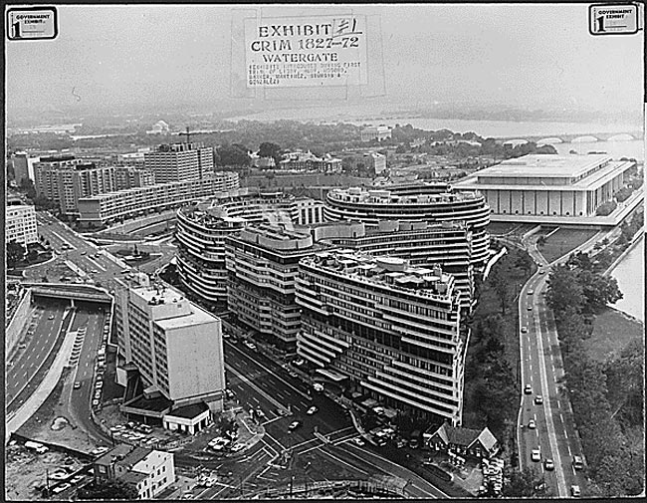
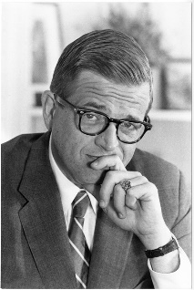
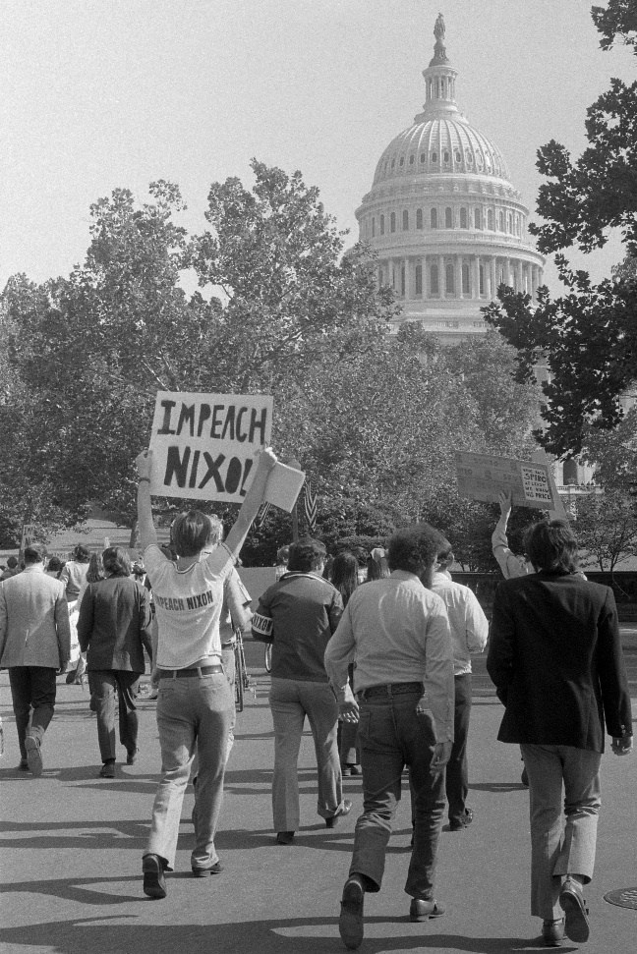
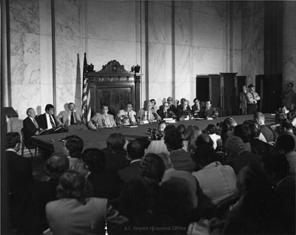
“Jesus was Just a man”
“I know the resurrection is a fact, and Watergate proved it to me. How? Because 12 men testified they had seen Jesus raised from the dead, then they proclaimed that truth for 40 years, never once denying it. Every one was beaten, tortured, stoned and put in prison. They would not have endured that if it weren’t true. Watergate embroiled 12 of the most powerful men in the world-and they couldn’t keep a lie for three weeks. You’re telling me 12 apostles could keep a lie for 40 years? Absolutely impossible.” – Charles Carlton

Slide 4
“Baptism does not save”
Read the first 10 chapters of Acts
-Every convert was Baptized
Read Mark 16:16
“He who has believed and has been baptized shall be saved; but he who has disbelieved shall be condemned.”
Read Galatians 3:27
“For as many of you as have been baptized into Christ have put on Christ.”
Read 1 Peter 3:21
“Corresponding to that, baptism now saves you—not the removal of dirt from the flesh, but an appeal to God for a good conscience—through the resurrection of Jesus Christ,”

Slide 5
The Rocky Soil: Mark 4:5-6, 16-17
5-6 Some seed fell on rocky ground. The ground there did not have enough dirt. The seed grew very fast there because the ground was not deep. But the sun rose and the plants were burned. The plants died because they did not have deep roots.
16-17 Other people are like the seed planted on rocky ground. They hear the teaching and quickly and gladly accept it. But those people don’t allow the teaching to go deep into their lives. They keep that teaching only a short time. When trouble or persecution comes because of the teaching they accepted, they quickly quit.

Slide 6
1 Peter 4:1-5
Since therefore Christ suffered in the flesh, arm yourselves with the same way of thinking, for whoever has suffered in the flesh has ceased from sin, so as to live for the rest of the time in the flesh no longer for human passions but for the will of God. For the time that is past suffices for doing what the Gentiles want to do, living in sensuality, passions, drunkenness, orgies, drinking parties, and lawless idolatry. With respect to this they are surprised when you do not join them in the same flood of debauchery, and they malign you; but they will give account to him who is ready to judge the living and the dead.

Slide 7
Mark 10:29-30
Mark 10:29-30 Jesus said, “I tell you the truth. Every person that has left his home, brothers, sisters, mother, father, children, or farm for me and for the Good News will get a hundred times more than he left. Here in this world that person will get more homes, brothers, sisters, mothers, children, and farms. And with those things, that person will have persecutions. But he will also have a reward in the world that is coming. That reward is life forever.

Slide 8
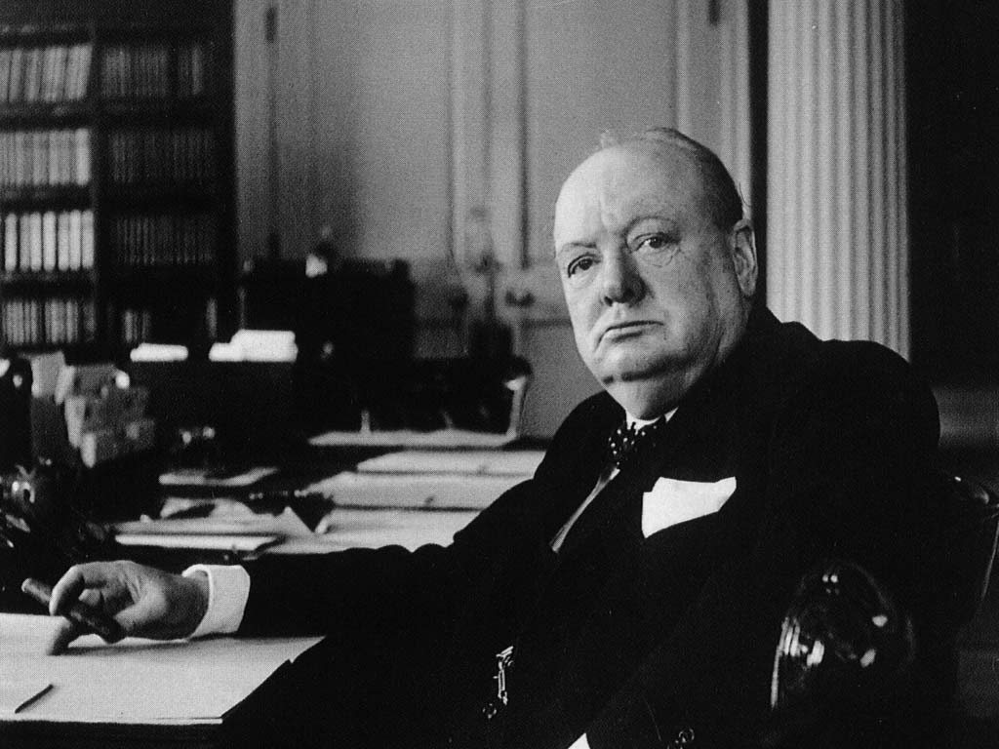
“You have enemies? Good. That means you've stood up for something, sometime in your life.” - Winston Churchill

Slide 9
The Thorny Soil: Mark 4:7, 18-19
7 Some other seed fell among thorny weeds. The weeds grew and stopped the good plants from growing. So they did not make grain.
18-19 “Others are like the seed planted among the thorny weeds. They hear the teaching, but their lives become full of other things: the worries of this life, the love of money, and everything else they want. This keeps the teaching from growing, and it does not produce a crop in their lives

Slide 10
Knowledge to Produce Fruit: Colossians 1:9-11
“For this reason also, since the day we heard of it, we have not ceased to pray for you and to ask that you may be filled with the knowledge of His will in all spiritual wisdom and understanding, so that you will walk in a manner worthy of the Lord, to please Him in all respects, bearing fruit in every good work and increasing in the knowledge of God; strengthened with all power, according to His glorious might, for the attaining of all steadfastness and patience; joyously”

Slide 11
Fruit of Our Lips: Hebrews 13:15
“Through Him then, let us continually offer up a sacrifice of praise to God, that is, the fruit of lips that give thanks to His name.”

Slide 12
Fruit From Giving: Philippians 4:17
“Not because I desire a gift: but I desire fruit that may abound to your account.”

Slide 13
Fruit of the Spirit: Galatians 5:22-23
“But the fruit of the Spirit is love, joy, peace, patience, kindness, goodness, faithfulness, gentleness, self-control; against such things there is no law.”

Slide 14
The Thorny Soil: Mark 4:7, 18-19
7 Some other seed fell among thorny weeds. The weeds grew and stopped the good plants from growing. So they did not make grain.
18-19 “Others are like the seed planted among the thorny weeds. They hear the teaching, but their lives become full of other things: the worries of this life, the love of money, and everything else they want. This keeps the teaching from growing, and it does not produce a crop in their lives

Slide 15
Matthew 7:17-21
(17) In the same way, every good tree makes good fruit. And bad trees make bad fruit.
(18) A good tree cannot make bad fruit. And a bad tree cannot make good fruit.
(19) Every tree that does not make good fruit is cut down and thrown into the fire.
(20) You will know these false people by the fruit they make (things they do).
(21) “Not every person that says that I am his Lord will enter the kingdom of heaven. The only people that will enter the kingdom of heaven are those people that do the things that my Father in heaven wants.

Slide 16
The Good Soil: Mark 4:8, 20
8 Some other seed fell on good ground. In the good ground, the seed began to grow. It grew and made grain. Some plants had 30 grains, other plants had 60 grains, and some had 100 grains.”
20 Other people are like the seed planted on the good ground. They hear the teaching and accept it. Then they grow and make fruit—sometimes 30 times more, sometimes 60 times more, and sometimes 100 times more.”

Slide 17
Mark 4
Parable of the soils

