Slide 1
The Christian Husband
Two Models for Manhood

Slide 2
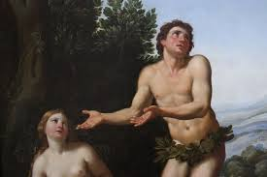
The Christian Husband
The First Adam (Gen. 3:1-16):
Passive Abdication(v.6)
Irresponsibility(3:9-12)
Subjugation(3:16)

Slide 3
The Christian Husband
The Last Adam (Eph. 5:22-33):
Proactively
Responsibly
Sacrificially
Instructionally
Effectively

Slide 4
The Christian Husband
Two Models for Manhood

