Slide 1
Life’s Opportunity
Isaiah 5:1-7

Slide 2
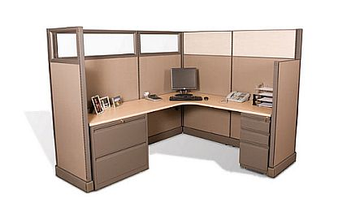

Slide 3
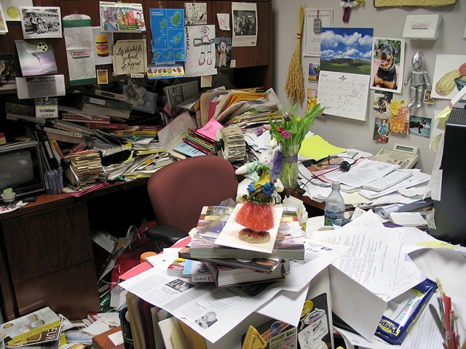

Slide 4
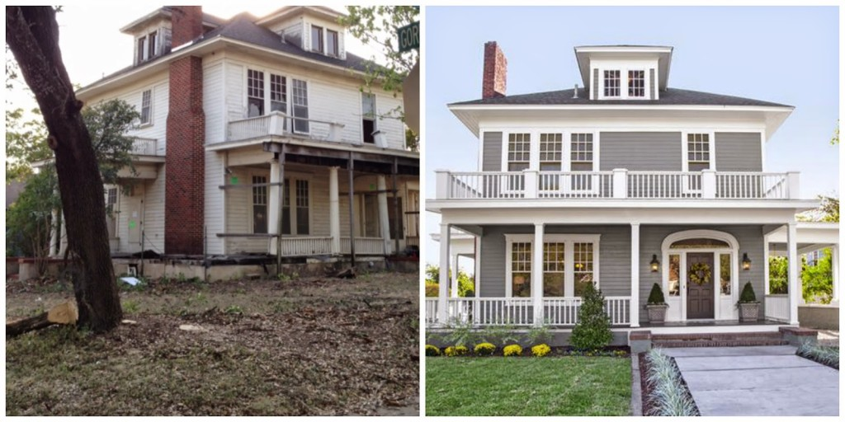

Slide 6
Isaiah 5:1-7
1 I will sing for the one I love a song about his vineyard: My loved one had a vineyard on a fertile hillside. 2 He dug it up and cleared it of stones and planted it with the choicest vines. He built a watchtower in it and cut out a winepress as well. Then he looked for a crop of good grapes, but it yielded only bad fruit. 3 "Now you dwellers in Jerusalem and people of Judah, judge between me and my vineyard. 4 What more could have been done for my vineyard than I have done for it? When I looked for good grapes, why did it yield only bad? 5 Now I will tell you what I am going to do to my vineyard: I will take away its hedge, and it will be destroyed; I will break down its wall, and it will be trampled. 6 I will make it a wasteland, neither pruned nor cultivated, and briers and thorns will grow there. I will command the clouds not to rain on it.” 7 The vineyard of the Lord Almighty is the house of Israel, and the people of Judah are the garden of his delight. And he looked for justice, but saw bloodshed; for righteousness, but heard cries of distress.

Slide 7
God Has Given Us Opportunity To Do Well
1 I will sing for the one I love a song about his vineyard: My loved one had a vineyard on a fertile hillside. 2 He dug it up and cleared it of stones and planted it with the choicest vines. He built a watchtower in it and cut out a winepress as well. Then he looked for a crop of good grapes, but it yielded only bad fruit.
The boundary lines have fallen for me in pleasant places; surely I have a delightful inheritance. (Psalm 16:6)

Slide 8
We Have All Failed A Few Times
2 He looked for a crop of good grapes, but it yielded only bad fruit.
5 Now I will tell you what I am going to do to my vineyard: I will take away its hedge, and it will be destroyed; I will break down its wall, and it will be trampled. 6 I will make it a wasteland, neither pruned nor cultivated, and briers and thorns will grow there. I will command the clouds not to rain on it."

Slide 9
In spite Of It All You Are Still God’s Delight
7 The vineyard of the Lord Almighty is the house of Israel, and the people of Judah are the garden of his delight.
... not willing that any should perish, but that all should come to repentance. (2 Peter 3:9 KJV)
Behold, I stand at the door, and knock: if any man hear my voice, and open the door, I will come in to him, and will sup with him, and he with me. (Revelation 3:20)
The Lord thy God in the midst of thee is mighty; he will save, he will rejoice over thee with joy; he will rest in his love, he will joy over thee with singing. (Zephaniah 3:17)

Slide 10
God Wants Us To Do What Matters Most
7 And he looked for justice, but saw bloodshed; for righteousness, but heard cries of distress.
He has told you, O man, what is good; and what does the Lord require of you but to do justice, and to love kindness, and to walk humbly with your God? (Micah 6:8)

Slide 11
Conclusion
You have complete control over – the final say – in whatever you do.
That’s why today’s message isn’t a call to the nation. It’s a call to you!
Don’t risk squandering the opportunity God has given you!!!

