Slide 2
Psalms 19:1-3
1 The heavens declare the glory of God; And the firmament shows His handiwork.
2 Day unto day utters speech, And night unto night reveals knowledge.
3 There is no speech nor language Where their voice is not heard.

Slide 3
Psalms 135:1-3
1 Praise the Lord! Praise the name of the Lord; Praise Him, O you servants of the Lord!
2 You who stand in the house of the Lord, In the courts of the house of our God,
3 Praise the Lord, for the Lord is good, Sing praises to His name for it is pleasant.

Slide 4
Psalms 138:1
1 I will praise You with my whole heart; Before the gods I will sing praises to You.

Slide 5
Psalms 145: 1-3
1 I will extol You, my God, O King; And I will bless Your name forever and ever.
2 Every day I will bless You, And I will praise Your name forever and ever.
3 Great is the Lord, and greatly to be praised; And His greatness is unsearchable

Slide 6
Psalms 148:1-5
1 Praise the Lord! Praise the Lord from the heavens; Praise Him in the heights!
2 Praise Him, all His angels; Praise Him, all His hosts!
3 Praise Him, sun and moon; Praise Him, all you stars of light!
4 Praise Him, you heavens of heavens, And you waters above the heavens!
5 Let them praise the name of the Lord, For He commanded and they were created.

Slide 7
Psalms 150:6
6 Let everything that has breath praise the Lord. Praise the Lord!

Slide 9
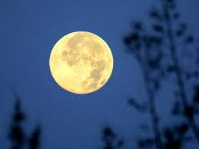
Praise Him

Slide 10
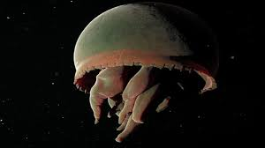
Praise Him

Slide 11
Praise Him

Slide 12
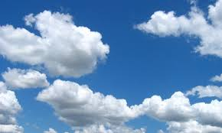
Praise Him

Slide 13
Praise Him

Slide 14
Praise Him

Slide 15
Praise Him

Slide 16
Praise Him

Slide 17
Praise Him

Slide 18
The Praise of God His Word
Law | Perfect | Converting the soul
Testimony | Sure | Making wise the simple
Statutes | Right | Rejoicing the heart
Commandments | Pure | Enlightening the eye
Fear | Clean, Enduring
Judgments | True, Righteous

Slide 19
Praise
Psalms 106:1-2
1 Praise the Lord! Oh give thanks to the Lord for He is good! For His mercy endures forever.
2 Who can utter the mighty acts of the Lord? Who can declare all His Praise?

Slide 20
Praise
I Pet 2:
9 But you are a chosen generation, a royal priesthood, a holy nation, His own special people, that you may proclaim the praises of Him who called you out of darkness into His marvelous light

Slide 21
Praise
Heb 13:
15 Therefore by Him let us continually offer the sacrifice of praise to God, that is, the fruit of our lips, giving thanks to His name.

Slide 22
Praise
Acts 2
46 So continuing daily with one accord in the temple, and breaking bread from house to house, they ate their food with gladness and simplicity of heart,
47 praising God and having favor with all the people

Slide 23
Praise
I Pet 4:
11 If anyone speaks, let him speak as the oracles of God. If anyone ministers, let him do it as with the ability which God supplies, that in all things God may be glorified through Jesus Christ, to whom belong the glory and the dominion forever and ever. Amen

Slide 24
Praise
Psa 103:
1 Bless the Lord, O my soul; AND ALL THAT IS WITHIN ME, bless His holy name!

Slide 25
Praise
To extol; to commend; to glorify by homage;
to magnify
An acknowledgment made of the excellencies
or perfection of any person or action
Expression of approval regarding a superior quality
or excellencies of a person, action or thing

Slide 26
Praise
Reverent acknowledgement of the perfection, the works and benefits of God being the Creator and the blessings that flow from Him to mankind.

Slide 27
Praise
EXAMPLES
God praising man
God in the flesh praising man
Man praising man
Man praising God

Slide 28
Praise
WORSHIP
Prostrate oneself in homage, do reverence, adore (Strong's)
The direct acknowledgement to God of His nature, attributes, ways and claims, whether by outgoing of the heart in praise and thanksgiving or by deeds done (Vines)

Slide 29
Praise
Notes:
Matt 15:7-9

Slide 30
Praise
Prayer

Slide 31
Praise
Prayer
Singing

Slide 32
Praise
Prayer
Singing
Pattern of living

