Slide 2
The battle of Thermopylae 480 B.C.

Slide 3
God’s 300

Slide 4
Judges 6-8
Israel sinned, God raised up Gideon to lead.
Midian’s forces = 135,000
Gideon’s army = 32,000
Ratio of 4:1, too many!

Slide 5
Judges 6-8
Israel sinned, God raised up Gideon to lead.
Midian’s forces = 135,000
Gideon’s army = 10,000
Ratio of 13:1, still too many!

Slide 6
Selecting God’s 300

Slide 7
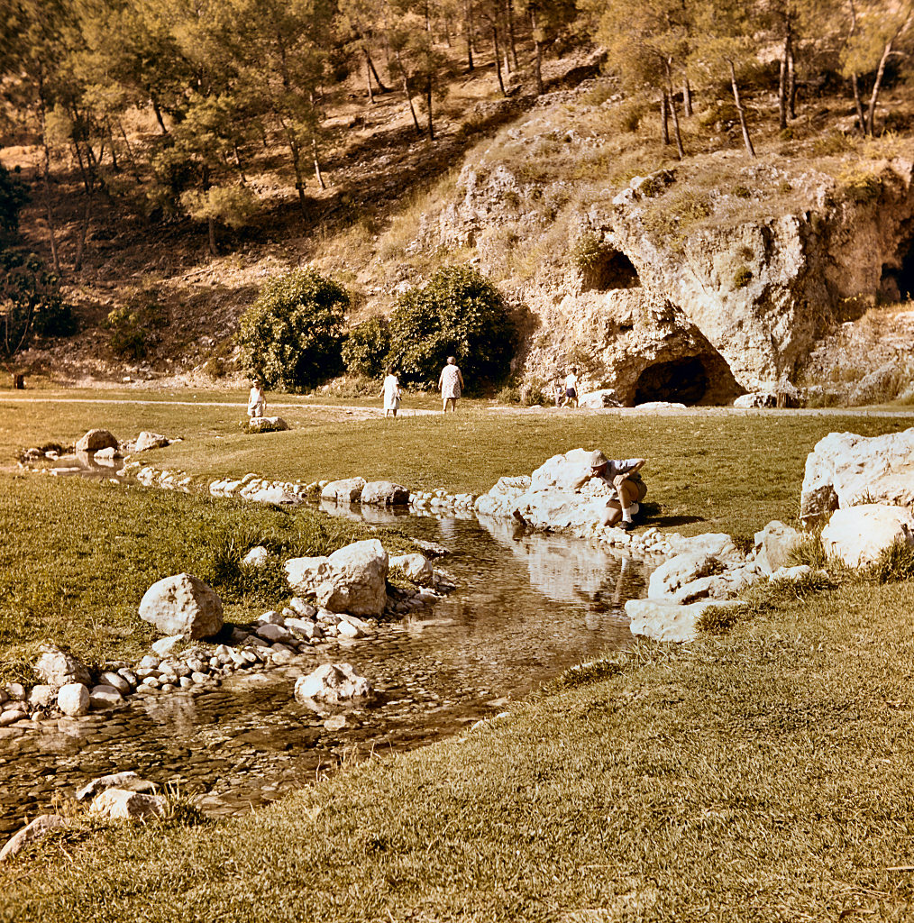
Ein Harod, “Gideon’s stream”

Slide 8
Reenactment of Gideon story

Slide 9
Judges 6-8
Israel sinned, God raised up Gideon to lead.
Midian’s forces = 135,000
God’s army = 300
Ratio of 450:1, just right!

Slide 10
Lessons for us
Trust in the Lord always and be brave and ever watchful.
Be prepared to engage the enemy.
Ephesians 6.10-18
A man must stand ready to defend his home/family.

Slide 11
Our enemy...Satan
Created by God - Isaiah 14; Ezekiel 28
Chose rebellion to God
He was not victorious and ultimately is condemned.
Allowed by God to test and tempt His people
Adam and Eve - Genesis 3
Jesus - Matthew 4
Us

Slide 12
Our enemy...Satan
His motive... to lead men in rebellion to God.
We are tempted and tested in the hope that we will sin.
Satan knows us individually very well.
We expose our vulnerabilities to him and he capitalizes upon them.

Slide 13
Satan’s weaponry
Emotional weapons
In our minds.
Physical weapons
Attacks we can “see.”
Spiritual weapons
In the spiritual realm.

Slide 14
Judges 16.21-30

Slide 15
“He pushed against the columns...” - Judges 16.30

