Slide 1
Put to
DEATH
EARTHLY
In you
What is

Slide 2
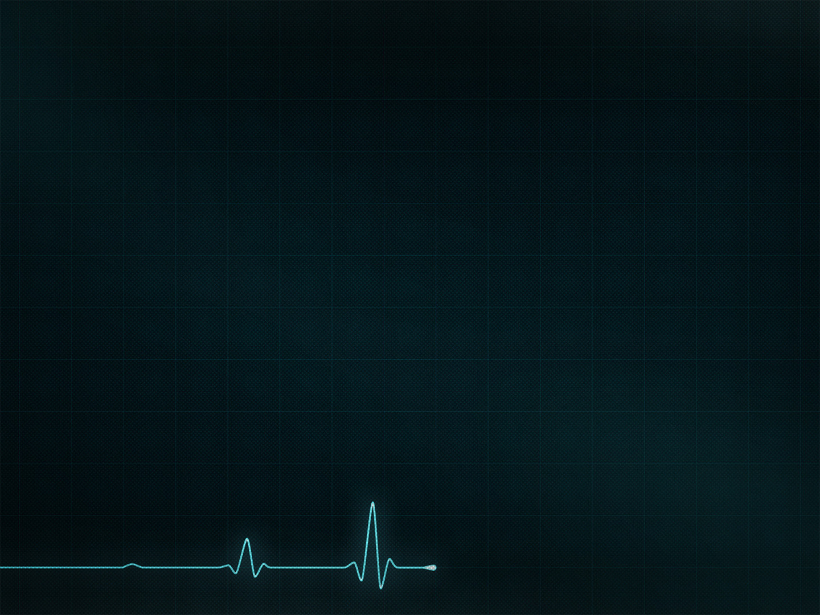
Sin is just that serious

Slide 3
“For you were called to freedom, brothers. Only do not use your freedom as an opportunity for the flesh, but through love serve one another.”
—Galatians 5:13
“For certain people have crept in unnoticed who long ago were designated for this condemnation, ungodly people, who pervert the grace of our God into sensuality and deny our only Master and Lord, Jesus Christ.”
—Galatians 5:13

Slide 4
“Put to death therefore what is earthly in you: sexual immorality, impurity, passion, evil desire, and covetousness, which is idolatry.”
—Colossians 3:5

Slide 5
“Put to death therefore what is earthly in you: sexual immorality, impurity, passion, evil desire, and covetousness, which is idolatry. On account of these the wrath of God is coming.”
—Colossians 3:5-6

Slide 6
“For you are not a God who delights in wickedness; evil may not dwell with you. The boastful shall not stand before your eyes; you hate all evildoers. You destroy those who speak lies; the Lord abhors the bloodthirsty and deceitful man.”
—Psalm 5:4-6

Slide 7
Extreme measures must be taken

Slide 8
“Put to death therefore what is earthly in you…”
—Colossians 3:5 (ESV)
“Therefore put to death your members which are on the earth…”
—Colossians 3:5 (NKJV)
“Put to death therefore your members which are upon the earth…”
—Colossians 3:5 (ASV)

Slide 9
“If your right eye causes you to sin, tear it out and throw it away. For it is better that you lose one of your members than that your whole body be thrown into hell. And if your right hand causes you to sin, cut it off and throw it away. For it is better that you lose one of your members than that your whole body go into hell.”
—Matthew 5:29-30

Slide 10
“Set your minds on things that are above, not on things that are on the earth.”
—Colossians 3:2

Slide 11
“For while we were living in the flesh, our sinful passions, aroused by the law, were at work in our members to bear fruit for death.”
—Romans 7:5

Slide 12
“For while we were living in the flesh, our sinful passions, aroused by the law, were at work in our members to bear fruit for death.”
—Romans 7:5

Slide 13
“Put to death therefore what is earthly in you: sexual immorality, impurity, passion, evil desire, and covetousness, which is idolatry.”
—Colossians 3:5
“But now you must put them all away: anger, wrath, malice, slander, and obscene talk from your mouth.”
—Colossians 3:8

Slide 14
“For the wages of sin is death...”
—Romans 6:23

Slide 15
God will give the victory!

Slide 16
“Truly the Lord has given all the land into our hands.”
—Joshua 2:24

Slide 17
“He is the image of the invisible God, the firstborn of all creation. For by him all things were created, in heaven and on earth, visible and invisible, whether thrones or dominions or rulers or authorities—all things were created through him and for him. And he is before all things, and in him all things hold together. And he is the head of the body, the church. He is the beginning, the firstborn from the dead, that in everything he might be preeminent…
—Colossians 1:15-23

Slide 18
“…For in him all the fullness of God was pleased to dwell, and through him to reconcile to himself all things, whether on earth or in heaven, making peace by the blood of his cross.
And you, who once were alienated and hostile in mind, doing evil deeds, he has now reconciled in his body of flesh by his death, in order to present you holy and blameless and above reproach before him, if indeed you continue in the faith, stable and steadfast, not shifting from the hope of the gospel…”
—Colossians 1:15-23

Slide 19
“He who did not spare his own Son but gave him up for us all, how will he not also with him graciously give us all things?”
—Romans 8:32

Slide 20
Put to
DEATH
EARTHLY
In you
What is

Slide 21
“…For in him all the fullness of God was pleased to dwell, and through him to reconcile to himself all things, whether on earth or in heaven, making peace by the blood of his cross.
And you, who once were alienated and hostile in mind, doing evil deeds, he has now reconciled in his body of flesh by his death, in order to present you holy and blameless and above reproach before him, if indeed you continue in the faith, stable and steadfast, not shifting from the hope of the gospel…”
—Colossians 1:15-23

Slide 22
Put to
DEATH
EARTHLY
In you
What is

