Slide 1
Lesson From Naaman
2 Kings 5:1-15
2 Kings 5:1-15

Slide 2
Let Our Light Shine to Bring Glory To God
Israelite Slave Girl:
Willing to share the good news (v3)
Led to God being glorified (v8, v15) (Matt 5:13-16)
Had faith based on her knowledge of God’s power (2 Kings 4)
Had faith despite trials (another example is Joseph)
2 Kings 5:1-15

Slide 3
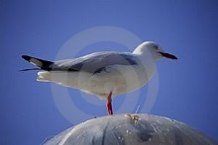
Trust That God Cares and Provides for Us
A chain of events led to Naaman being healed and God being glorified
God provides for us and cares for us (Matt 6:26-33)
God’s will is done (James 4:13-15)
God’s providence is powerful
Esther 4:14
Philemon v15-16
Romans 8:26-28
2 Kings 5:1-15

Slide 4
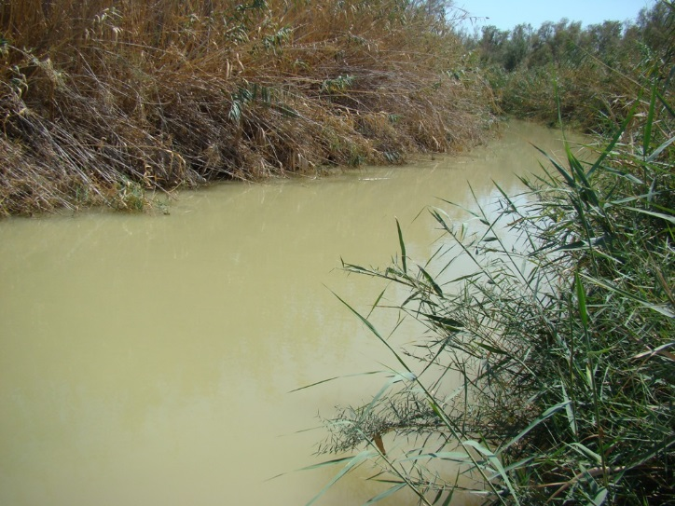
Trust and Obey God, Not Our Own Thoughts
Naaman said “behold I thought” (v11)
It is not in man to direct his steps (Jeremiah 10:23)
God’s ways are higher than our ways (Isaiah 55:8-9)
Naaman showed a lack of faith after Elisha didn’t come out to meet him (v10-11)
Contrast his attitude with the Centurion who had a sick servant (Luke 7:1-7)
Jesus said blessed are those who have not seen and yet have believed (John 20:29)
2 Kings 5:1-15

Slide 5
Seek Council From the Wise, Shun Foolish Council
Naaman listened to the wise counsel of his servants and was cleansed (v13-14)
Who do we seek advise from? The wise or the foolish? (Mt 7:24-27)
Rehoboam asked for advice but didn’t heed wise counsel (1 Kings 12)
Queen of Sheba went to the right person with her questions (1 Kings 10:1-3,9)
God grants wisdom liberally if we ask with the right attitude (James 1:5-6)
2 Kings 5:1-15

