Slide 1
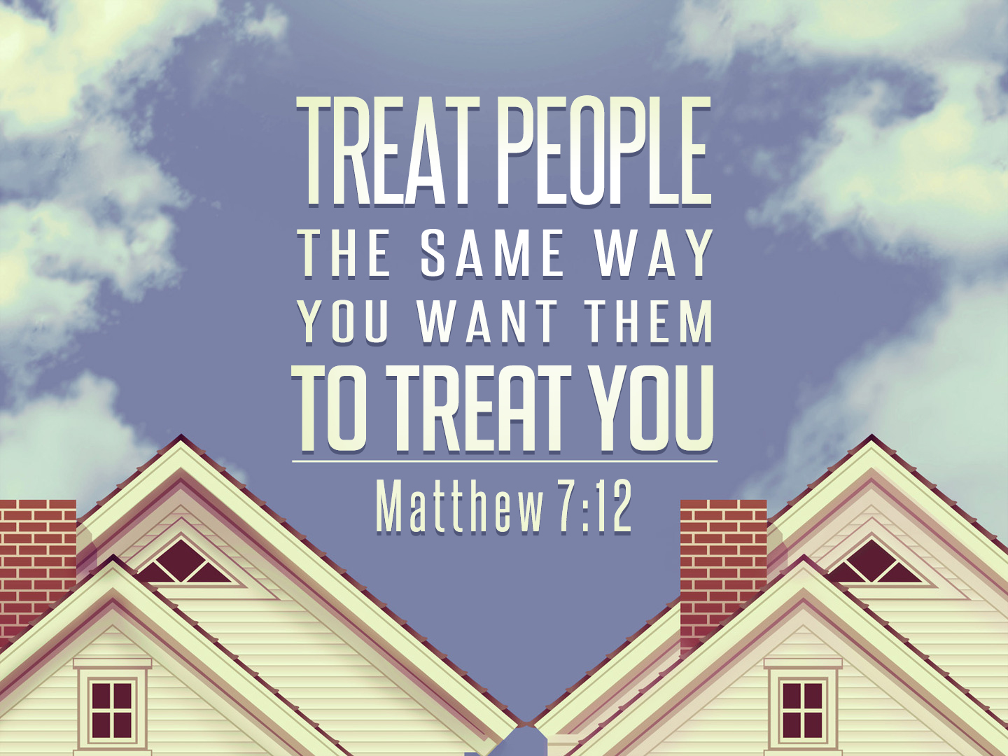
The Golden Rule
Notes:
Jesus gives us the Golden Rule… A powerful principle to carry with us, and live out, daily…
The Golden rule guides us in our families, when we give someone else the bigger bowl of ice cream, or wait to start the movie until all are settled in on the couch.
The Golden rule guides us at work, when a colleague needs a hand, or when we receive praise with humility.
The Golden rule guides us when roles are reversed and we are in a position to exact our revenge…but we show mercy instead.
Today we want to examine the beauty of the Golden Rule and appreciate how it Changes us from the inside out…

Slide 2
The Beauty of the Golden Rule
The Golden Rule Reflects God’s Goodness.
Matthew 7:7-11
The Golden Rule Concerns Both God & Man.
Matthew 7:12
The Golden Rule Demands Action.
“Treat people…”
The Golden Rule Encapsulates The Old Law.
“…for this is the Law and the Prophets.”
Notes:
Based on the Good Gifts of God.
CONCERN FOR MAN TOO: Especailly Applicable In How We “Judge” Others.
Demonstrates That Religion Is Concerned Not Only A Connection With God, But With Fellow Man.
ACTION: While it calls for self-reflection, it certainly doesn’t stop there. This command presumes that we WILL take action, and will do so with Justice & Mercy.
A “Doing Commandment”
THE LAW: Prophets All Established This Essential Principle. … Law & Prophets
The Law of Moses contained many commandments about the just and king treatment of one’s neighbor. This principle, rightly applied, covers all of them. Thus, they also inform us of how to rightly apply this principle. Should we seek examples of How God expects this principle to be applied the Law and prophets are full of specific cases that help us understand.
It is Beautiful… It Goes Beyond Doing What Others Can “Bear” or “Tolerate” or “Deal With” – Extends To Doing What We Would Desire Be Done To Us. Calls for Judgement
Calls us to Judge what is fit and reasonable…. What we ourselves would gladly accept.

Slide 3
The Golden Rule Changes Me
Changes My Thinking.
2 Kings 7:9
Changes My Offers To Help.
2 Kings 4:8-10
Changes My Spending.
Acts 4:32-35, 2 Corinthians 8:13-14
Changes My Desire For Vengeance or Mercy.
Matthew 18:23-35
Notes:
Jesus uses the Golden Rule to do at minimum two things: One is that with this command, God ensures that those who find themselves in need of help – will be helped. The weak will be strengthened, the poor will be given a hand up, the sick will be shown compassion. God uses this command to take care of those who need it.
But secondly, God uses this command to transform the hearts of those who are providing the aid. God uses this command to call for deeper thinking, reflection, and sympathy.
Changes My Thinking To Go Beyond Personal Goals. Stop and Consider The Impact on Others.
Calls for Thoughtfulness & Equality…
- Considering Their Circumstances.
- Others deserve the same love and kindness we desire for ourselves. Not half, not double – but equality.
Changes My Reactions. If I Were In Their Shoes, What Would I Need.
Time & Place for asking. But also Something to be said for doing, what you know others need, without asking.
2 Kings 4:8-10
Changes My Drive For Vengeance.
Changes My Appreciation For Mercy. (I am thankful for the mercy that’s been shown to me.)
Changes My Spending. “Charity” in its most beautiful sense: the combination of love and generosity.
2 Cor. 8:13-14……I just can’t be happy in the lap of luxury, when others in my spiritual family are in distress. Internally, there is a sense that this just isn’t right.

Slide 4
The Golden Rule
Notes:
Come to God’s Mercy Today…

